Slide 1

  POLICY FEEDBACK
  THEORY

Slide 2
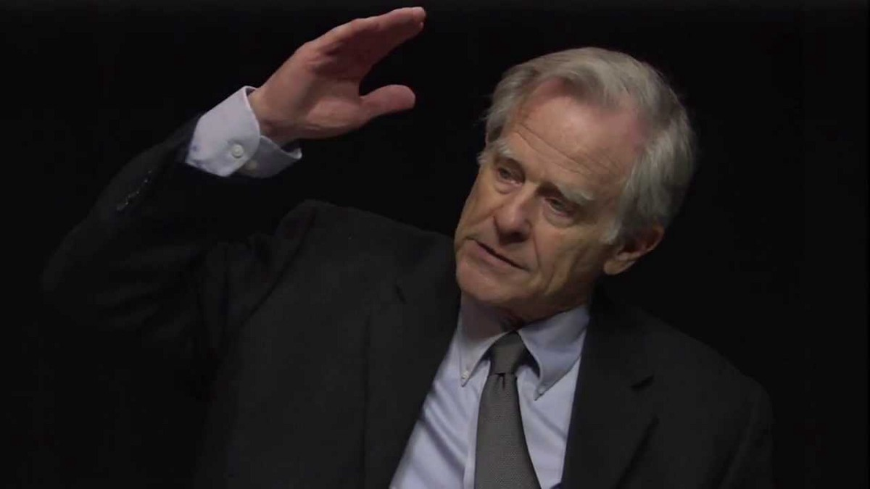
Ted Lowi

Slide 3

Policies create politics
“policy feedback”
“feed-forward” effects

Slide 4
Policies distribute
Benefits
Burdens

Slide 5
Policies distribute
Benefits
Burdens

Slide 6
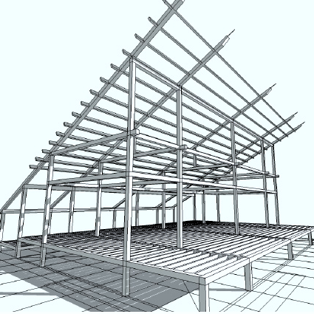

Benefits
Burdens
Social construction
Policy design
Feedback effects

Slide 7
Benefits
Burdens
Social construction
Policy design
Feedback effects

Slide 8

Feedback effects
POLICY
TIME 1
POLICY
TIME 2

Slide 9
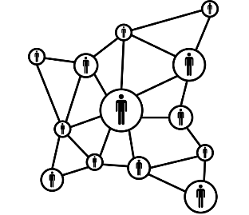
Feedback effects
POLICY
TIME 1
POLICY
TIME 2
Civic & political engagement
Participation in public affairs such as political and policy advocacy

Slide 10
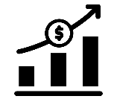

Feedback effects
POLICY
TIME 1
POLICY
TIME 2
Payments, goods, & services
Resource
effects
Benefits, payments, and incentives to participate
Civic
capacity
Civic engagement skills, time, resources, etc.
Civic & political engagement
Participation in public affairs such as political and policy advocacy

Slide 11

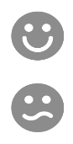
Feedback effects
POLICY
TIME 1
POLICY
TIME 2
Payments, goods, & services
Resource
effects
Benefits, payments, and incentives to participate
Civic
capacity
Civic engagement skills, time, resources, etc.
Civic & political engagement
Rules & procedures
Interpretive effects
Statuses, identities, roles
Civic
predisposition
Perceptions of efficacy, duty, standing, etc.

Slide 12


Slide 13


Slide 14
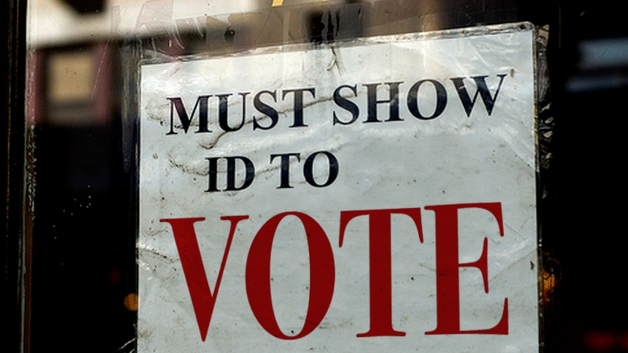

Slide 15
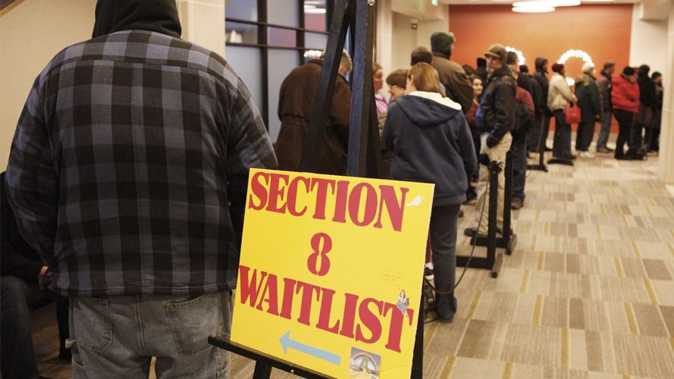

Slide 16
Feedback effects
POLICY
TIME 1
POLICY
TIME 2
Meaning of citizenship
Membership in political “class”
Status
Identity

Slide 17
Feedback effects
POLICY
TIME 1
POLICY
TIME 2
Meaning of citizenship
Membership in political “class”
Status
Identity
Forms of governance
Legitimate domain of government
Policy options

Slide 18
Feedback effects
POLICY
TIME 1
POLICY
TIME 2
Meaning of citizenship
Forms of governance
Legitimate domain of government
Policy options
Power of social groups
Interest groups
Social movements

Slide 19
Feedback effects
POLICY
TIME 1
POLICY
TIME 2
Meaning of citizenship
Membership in political “class”
Status
Forms of governance
Legitimate domain of government
Policy options
Power of social groups
Interest groups
Social movements
Political agendas & policy problems
Perceptions of target populations
Problem definitions
Constituents

Slide 20
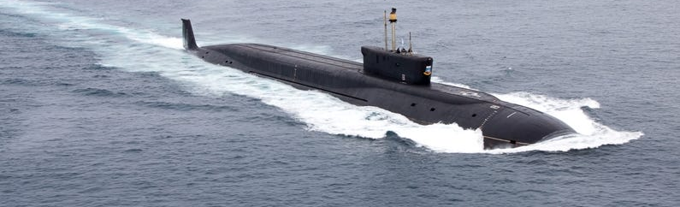
Submerged State
Policies are more or less visible
And therefore more or less stable

Slide 21
Institutional Feedbacks
Agency termination is rare
Program termination less rare but not common either
Why? Create constituencies and transform state capacity

Slide 22
When does path dependence occur? QWERTY example
High set-up/fixed costs
Learning effects
Coordination effects
Adaptive expectations

Slide 23
Size of benefits
Larger is better - resources but also identity

Slide 24
Traceability
Outcomes linked to policy
  And
Policy linked to credit/blame claim?

Slide 25
Proximity and concentration/diffusion of benefits
Back to Lowi
Nearness/proximity -> more likely feedback
How clear is the target population

Slide 26

Duration
Less research but theoretically longer is better

Slide 27
Program Administration
Direct vs. mediated (contracted)
Level of administrative burden

Slide 28
State Building
Identity and capacity

Slide 29
Interest Group Mobilization
AARP example

Slide 30
Lock-in Effects and Policy Change
Path dependence
Early adapter

Slide 31
Private Programs?
i.e. private health insurance in the US

Slide 32
Mass Politics
As discussed variously above

Slide 33
Which stage of the policy process is feedback most likely?
Problem Recognition
Identification of Policy Options
Policy Selection/ Adoption
Implementation
Evaluation
Problem Definition

