Slide 1

The Future

Slide 2
The environment
Human reference (anthropocentric), but implicitly natural

Slide 3
Environmental assessment
Or Environmental Impact Assessment (EIA)
Institutionalized by 1969 National Environmental Policy Act (NEPA)
Routine, but weakened by court interference
  Also maybe too strong still? Create significant delays for projects that might have large, long term environmentally positive effects

Slide 4
Environmental Risk
Mesoscale concept – not macro or micro
Reliance on science to depoliticize
  Not entirely successful

Slide 5
Environmental Justice
Roots in environmental racism
  That is, non-white communities in the US often live in more environmentally polluted neighborhoods, bear the brunt of environmental policy failures disproportionately
Primarily a community-based approach

Slide 6
Environmental security
Environment as cause AND effect of conflict

Slide 7
Sustainable Development
To promote inter and intragenerational equity
Implicitly relies on ecological limits
Imperialist origins but applied at local level in ‘developed’ nations

Slide 8
Biodiversity
Relies on island theory of ecology
Provides nature a voice and measurable target for some environmental policy

Slide 9
Critical Loads
AKA Critical thresholds
Related to ecological limits
Has both scientific component (measurement) but also social (tolerance)

Slide 10
Adaptive Management
Mesolevel concept
Learning, knowledge accumulation to make continuous, incremental adjustments
  Associated with stakeholder involvement

Slide 11
Green economy
Can increase human well-being and protect the environment
Relies on natural capital – idea that landscapes and environment have inherent value
  Use of economic theory to determine (some oppose this commodification of the environment)
    Techniques include hedonistic analysis, contingent valuation, etc.
  Especially when there are no substitutes
Incorporates things like ESG and B Corps

Slide 12
Sustainable consumption
Micro level concept with a focus on behavior in developed nations, particularly
Focus on reduced consumption, ethical/environmentally conscious consumption, even recycling

Slide 13
Innovation
Ideas must be policy relevant – address a need
Up-framing: integrating multiple existing ideas into a broader, new concept
Decomposing: distinct concepts from one larger, broader one
  Coupling environment with other concepts

Slide 14
Institutional Embedding
UN level is common in environmental policy
Others are at more national levels – via EPA, etc.
Lower levels: via development and relevant concerns

Slide 15
Feedback Cycle of Innovation
Science and Academia
Policymakers

Slide 16
“In a sense, all the critical organizing concepts in the environmental realm trade, at least indirectly, on findings from the natural sciences.”

Slide 17
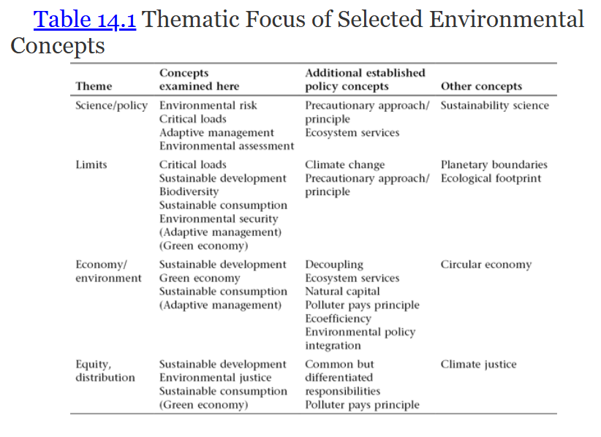

Slide 18
Ideas matter, but what’s next?
New science?
Greater integration of social science?
  Agency of stakeholders emphasized!
Regulatory regime instability
Relation between environmental policy and other domains?

