Slide 1

Ch. 11 Environmental Security

Slide 2
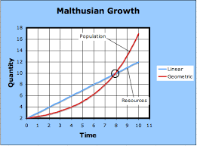
Malthus
Debunked, imperialist fear mongering

Slide 3
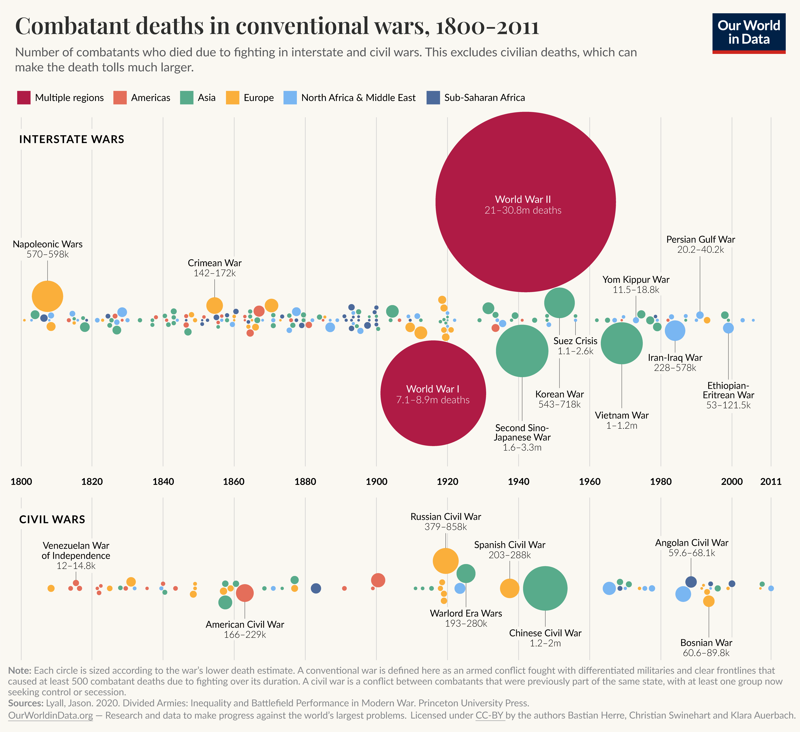
Increases in violence?

Slide 4
“Environmental change never “causes” conflict in a direct sense; it instead works as an “exacerbating factor” or “threat multiplier,” to use a word frequently invoked in policy discussions on a climate-changed world.”

Slide 5
“historical response to temperature suggests a roughly 54% increase in armed conflict incidence by 2030, or an additional 393,000 battle deaths if future wars are as deadly as recent wars”
OR
“for each one standard deviation (1s) change in climate toward warmer temperatures or more extreme rainfall, median estimates indicate that the frequency of interpersonal violence rises 4% and the frequency of intergroup conflict rises 14 %.”

Slide 6
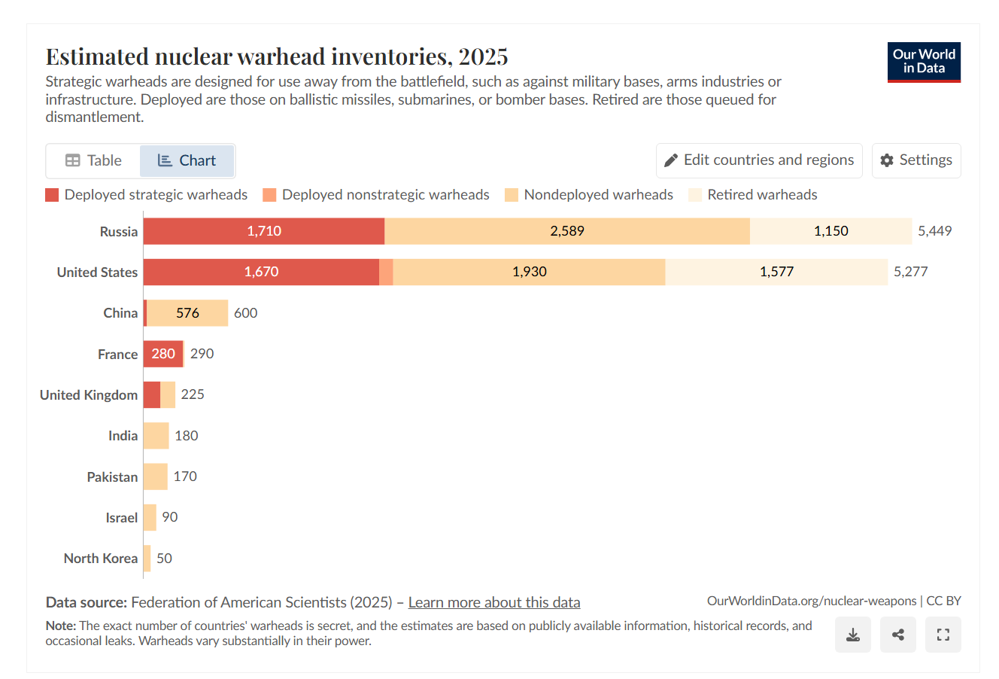
Nuclear

Slide 7
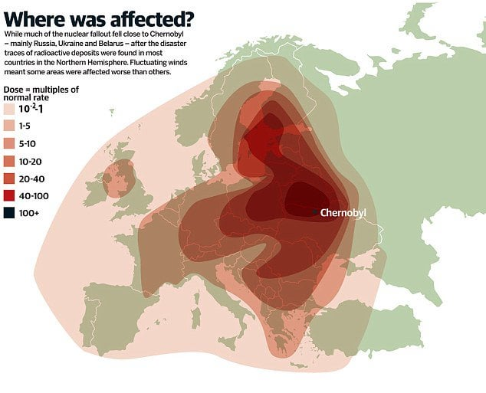
Chernobyl

Slide 8
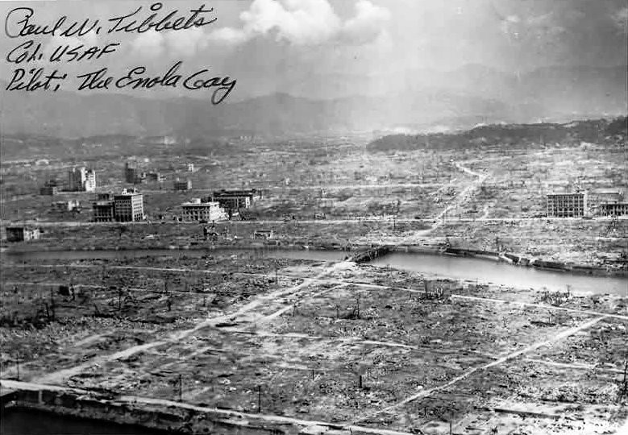
Hiroshima and Nagasaki

Slide 9
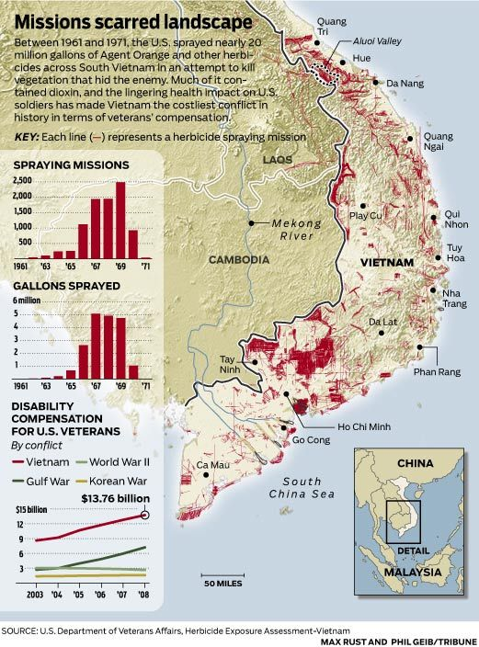
Vietnam and Agent Orange
$$$ for veteran compensation
  In addition to health and environmental effects

Slide 10
Mines as Pollution
Princess Diana’s 1997 landmine walk: ‘I come with my heart’

Slide 11
Current Event Example
CNN reports blackened rain in Tehran | CNN

