Slide 1

  ADVOCACY COALITION
  FRAMEWORK

Slide 2
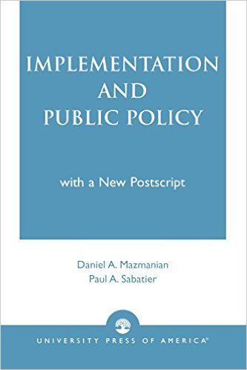
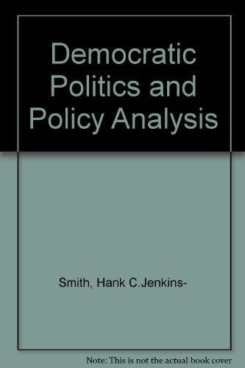
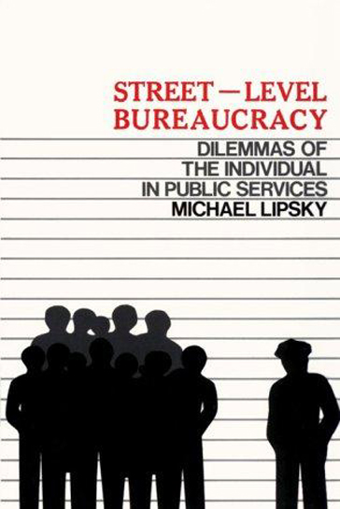
  theoretical
  BACKGROUND

Slide 3

human cognition is
imperfect
selective attention
confirmation bias
motivated reasoning
prospect theory

Slide 4
Advocacy coalition
Policy subsystems
The set of actors (organizations and individuals) invested and involved in a specific policy problem or policy debate – usually bounded by geographical and temporal parameters
Deep core beliefs
Political opportunity structures

Slide 5


Slide 6


Slide 7


Slide 8


Slide 9
Advocacy coalitions
Actors that coalesce around similar beliefs and engage in coordinated action towards a policy goal

Slide 10
Secondary beliefs
Preferences regarding specific aspects of a policy issue
Policy core beliefs
Values, commitments, and preferences regarding a policy issue; the “glue” of advocacy coalitions
Deep core beliefs
Basic convictions and values that apply across policy subsystems – such as value of equity vs. individual freedom, religious beliefs, etc.

Slide 11

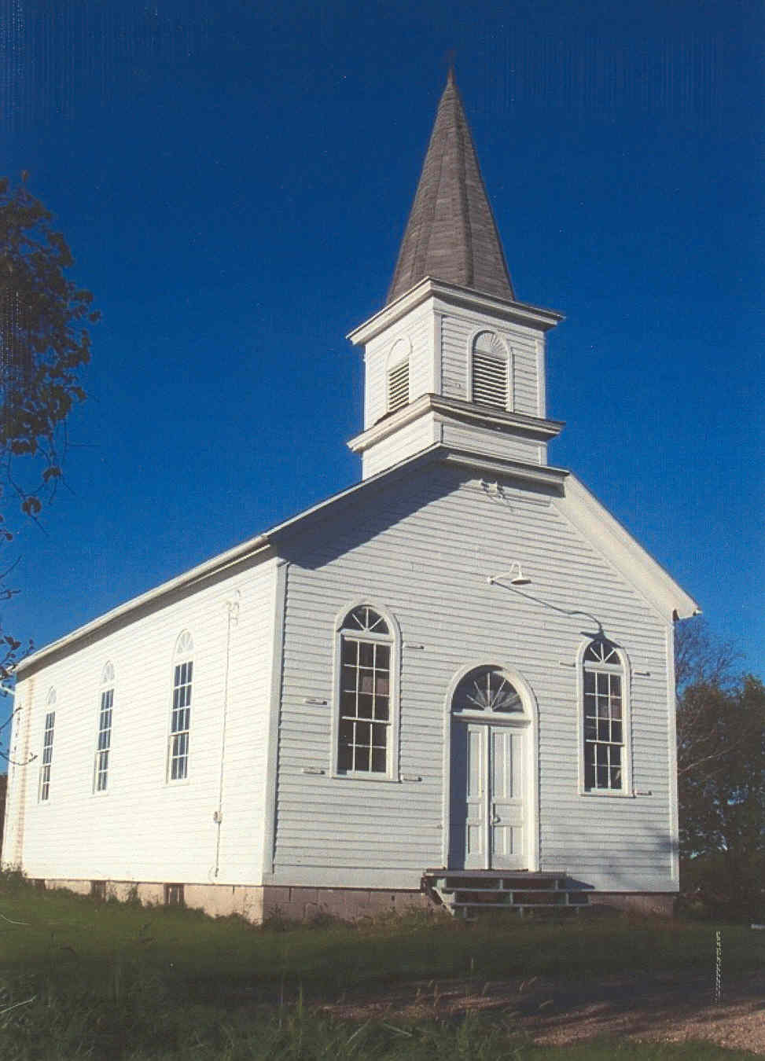

Slide 12
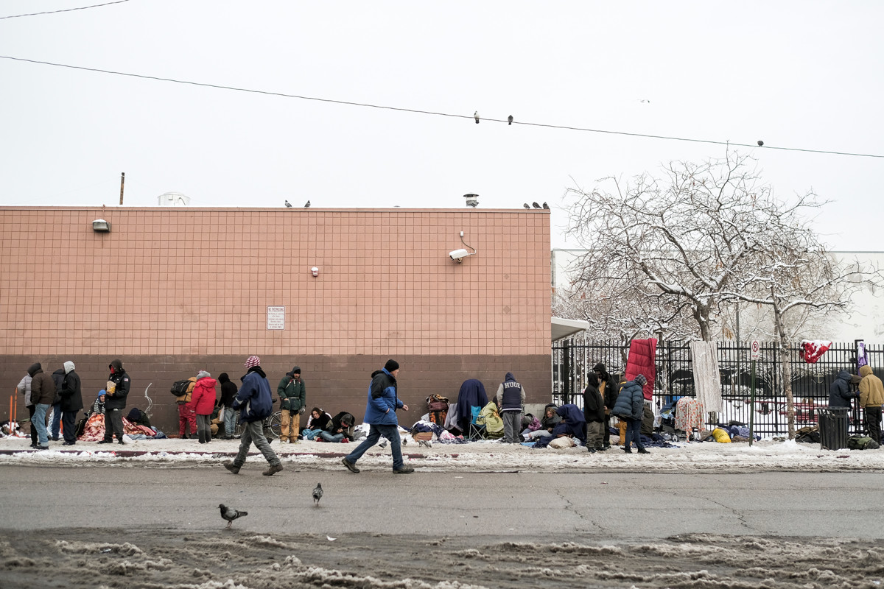

Slide 13


Slide 14

policy subsystem
Beliefs
Secondary beliefs
Policy core beliefs
Deep core beliefs

Slide 15
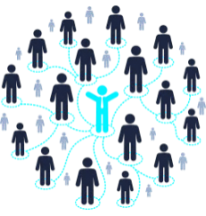
policy subsystem
Coordination
Beliefs
Secondary beliefs
Policy core beliefs
Deep core beliefs

Slide 16

policy subsystem
Advocacy
Coalition
Advocacy
Coalition
Coordination
Analysis
Evidence
Framing
Narratives

Slide 17
“Devil shift”
Policy actors tend to perceive their opponents as more malicious and powerful than they really are, while overestimating their coalition’s benevolence and underestimating its power

Slide 18
opportunity structures
Degree of consensus needed for change
Openness of political system
policy subsystem

Slide 19
External
parameters
Problem characteristics
Distribution of resources
Social values & structure
opportunity structures
Degree of consensus needed for change
Openness of political system
policy subsystem
short-term constraints & resources

Slide 20
External
parameters
Problem characteristics
Distribution of resources
Social values & structure
opportunity structures
policy subsystem
short-term constraints & resources
external
events

Slide 21


Slide 22

policy conflict & policy learning
When does coalition conflict lead to entrenchment and when does it lead to learning, compromise, and problem solving?
Which types of policy problems and policy making venues are more conducive to policy learning?
What constitutes sufficient evidence to overcome deeply-held policy beliefs and who’s belief change or learning matters most for policy change to occur?

Slide 23

  American Public Policy
  PSCI 4730

