Slide 1
Narratives and Education Policy

Slide 2
Use of Evidence
Lessons?
Methods?

Slide 3
“In summary, the methodological potential of policy narrative lies in its capacity to stimulate empirical studies that: place an emphasis on the language and practices of policymakers; engage with the communication / audience-specific nature of policy development; examine the dynamics and mobility of policy developments over time and space; embrace the political / contested nature of policymaking; and has methodological flexibility.” pg. 249

Slide 4
Charter School Editorials
Charters vs. vouchers

Slide 5
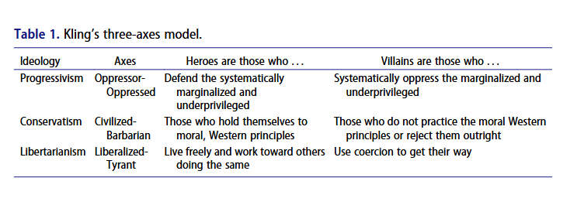
Three Languages
Progressives
Conservatives
Libertarians

Slide 6
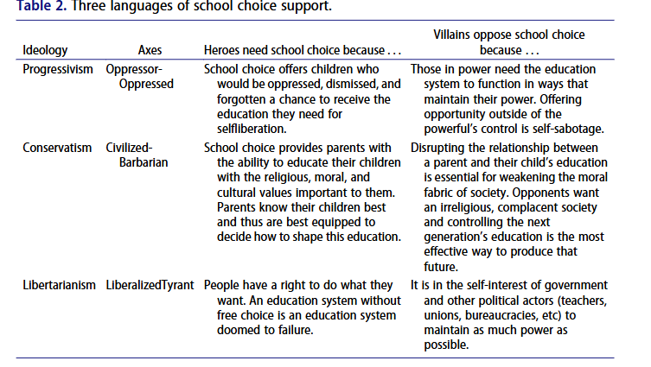

Slide 7

Brainstorm

