Slide 1

Ch. 8 Sustainable Development

Slide 2
Intellectual Origins
Our Common Future (1987) from World Commission on Environment and Development

Slide 3
Definition
“development that meets the needs of the present without compromising the ability of future generations to meet their own needs.” (WCED 1987, pg. 43)

Slide 4
Underlying concepts
Environmental limits (critical loads)
Sustainability?
Development?

Slide 5
Implementation
UN Sustainable Development Goals: THE 17 GOALS | Sustainable Development
Adopted in 2015 unanimously – same meeting as the Sendai Framework for Disaster Risk Reduction What is the Sendai Framework for Disaster Risk Reduction? | UNDRR

Slide 6
Tensions
Global North and developed countries immediately benefit from environmental protection
Not so in Global South and developing countries
But also, affluent lifestyles in Global North

Slide 7
SDG Progress 2025
Health setbacks due to COVID (reduced healthy life expectancy by almost 2 years)
Global unemployment hit a historic low of 5% in 2024 (previously 6% in 2015)
Conflict escalating, more refugees –> more refugee deaths
92% of world population has access to electricity in 2023
  Lagging outcomes for drinking water
Hottest year on record in 2024

Slide 8
Summary SDG Progress
“The latest data reveal that only 35 per cent of SDG targets with available trend data are on track or show moderate progress. Nearly half are moving too slowly or making only marginal progress, while 18 per cent have regressed” from SDGs_Report_Key_Findings_2025.pdf

Slide 9
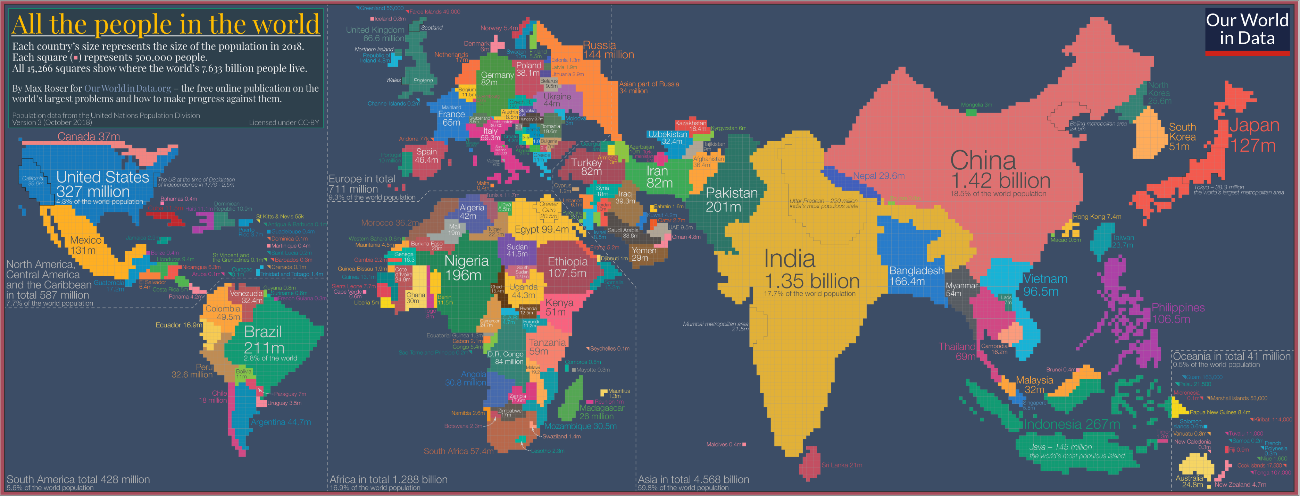
Population Distribution

Slide 10
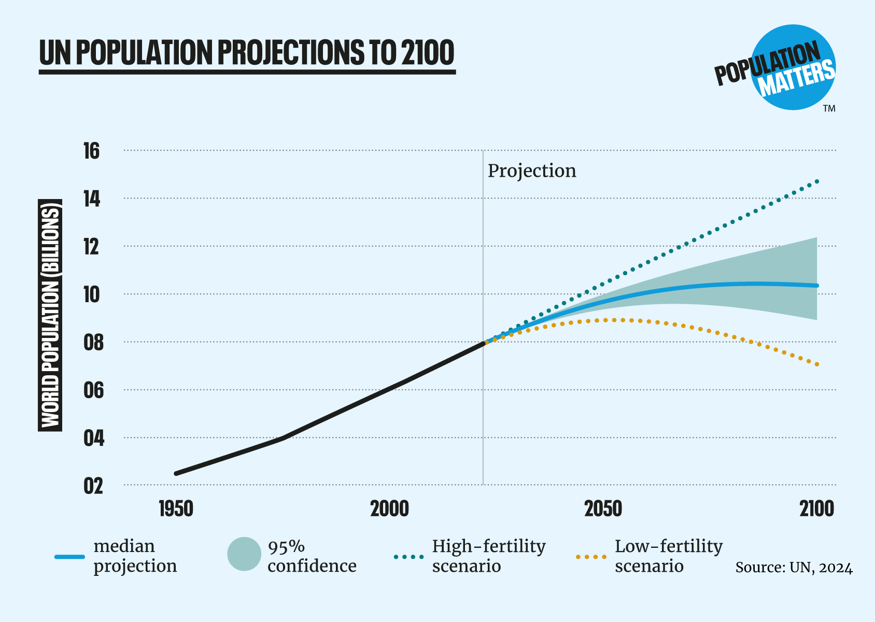
Population Growth

Slide 11
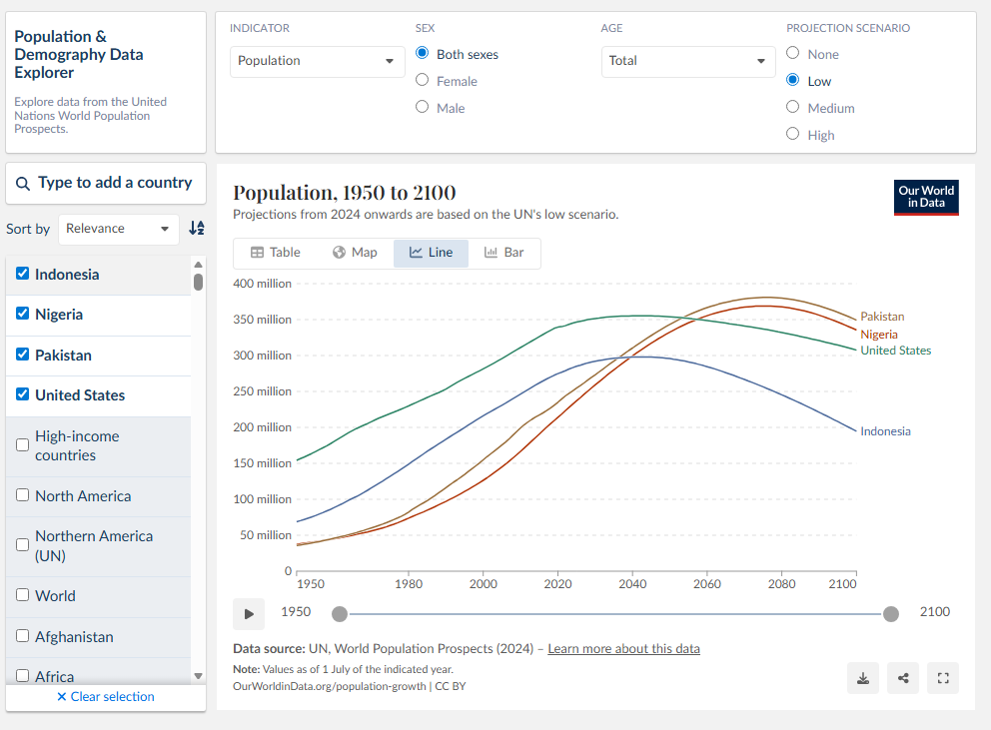
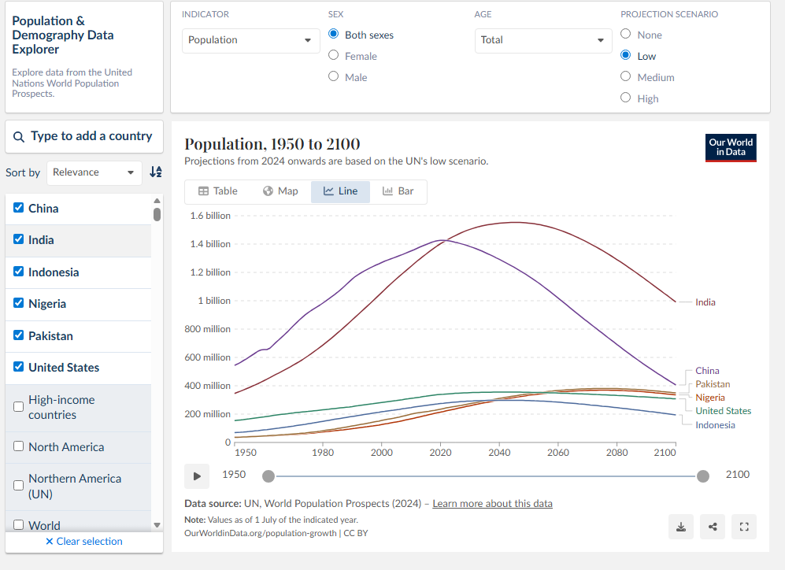
Population Growth

Slide 12
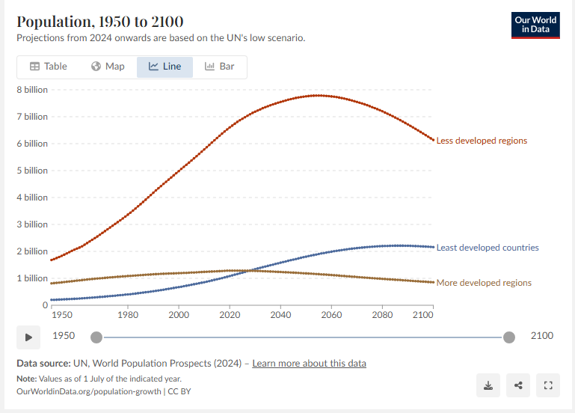
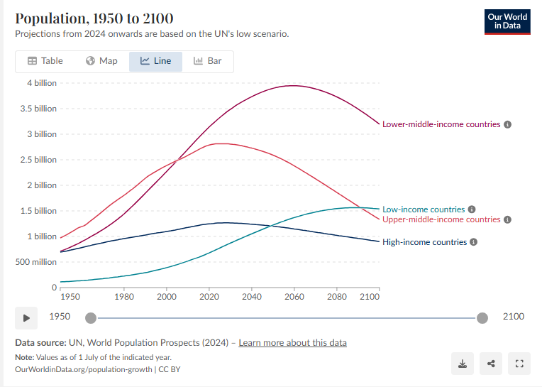
Development and Income and Growth

Slide 13
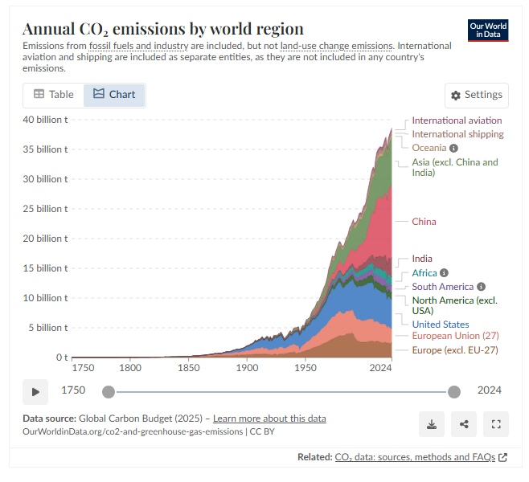
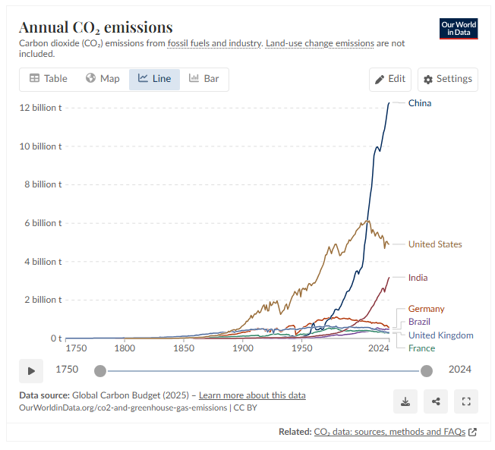
Emissions and Development

Slide 14
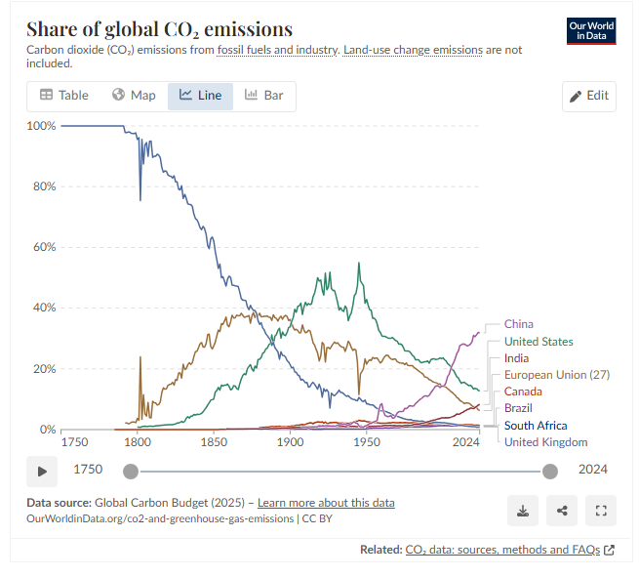
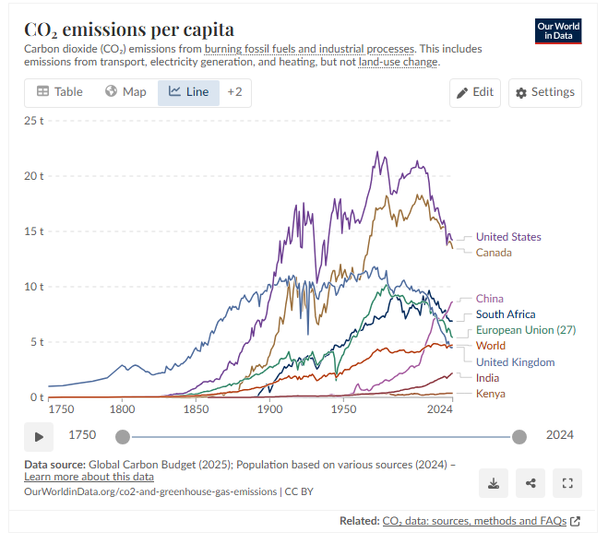
Emissions and Development

Slide 15
Relevant Current Events
U.S. Aid Cuts Are Hitting Global Conservation Projects Hard - Yale E360

Slide 16
Questions for Discussion
Does the concept of sustainable development apply to the US?
Does it apply to other higher income countries?

