Slide 1

Critical Loads

Slide 2

Scientific Backing – Intuitive Approach
Evokes ecological limits
Successful in air pollution

Slide 3
Examples
Total Maximum Daily Loads – of pollutants under US Clean Water Act
2-degree temperature target, potentially
  Paris Agreement in 2015
    Aspirational to 1.5 degree

Slide 4
Foundations
Science
Measurement
Ecosystem tolerance levels
Short and long time frames

Slide 5
“The development of critical loads illustrates the powers at work when a commonsense idea is legitimated by scientific ‘facts.’” (pg. 128-129)

Slide 6
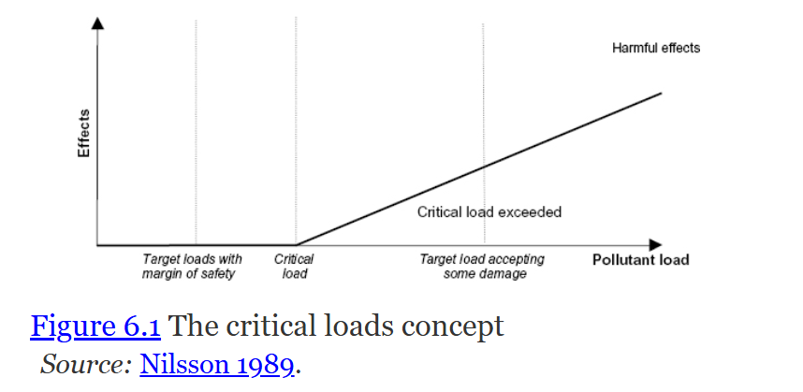
Visualization

Slide 7
Convention on Long Range Transboundary Air Pollution (CLRTAP)
From 1979 – focus on the regional level
  Acidification from sulfur dioxide
  Primary focus on Europe (northern)

Slide 8
“The workshop produced the following working definition of critical loads: “The highest load that will not cause chemical changes leading to long-term harmful effects on the most sensitive ecosystems” (Nilsson 1986).”

Slide 9
Use of Simulation
Scientific models that allow us to model changes in inputs to observe potential effects on outputs/outcomes
Dynamic vs. steady state modeling
Example: En-ROADS

Slide 10
Gothenburg Protocol
The Protocol establishes national emission ceilings for four pollutants—sulphur (SO₂), nitrogen oxides (NOₓ), volatile organic compounds (VOCs), and ammonia (NH₃)

Slide 11
Improvements
Based in science, less political negotiation
Geographic nuance – less uniform

Slide 12
Complications
Regional needs are nested within global systems
Limited deliberative/public involvement

