Slide 1

  FRAMING
  & NARRATIVES

Slide 2


Slide 3
Framing
How policy problems are defined and the associated images, symbols, and concepts

Slide 4
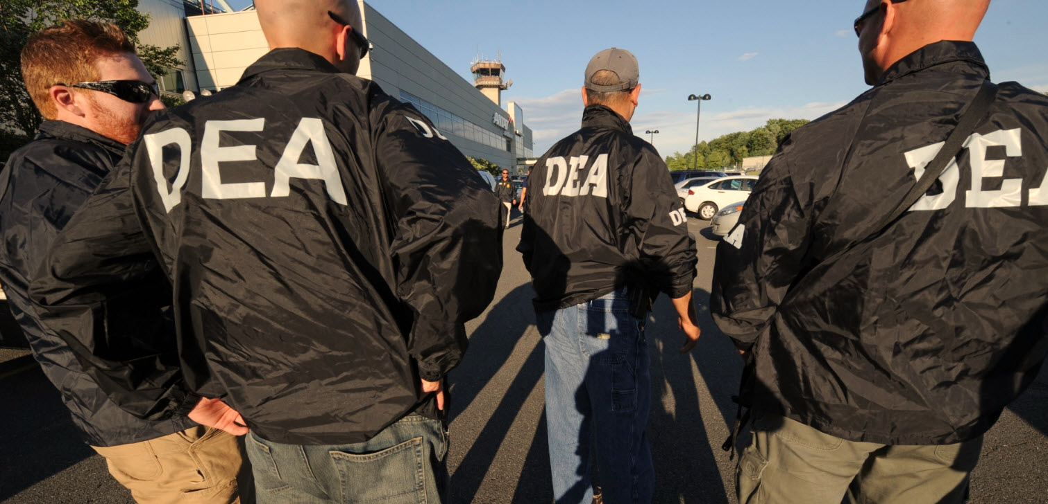

Slide 5
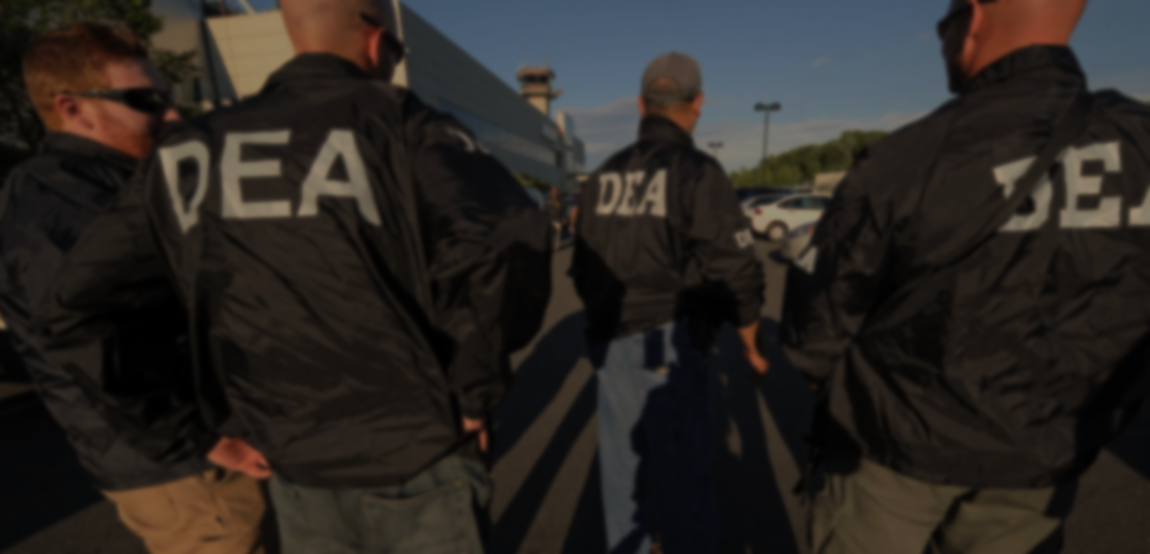


Slide 6
immigration
Future citizens seeking for a better life | Taking jobs and government resources

Slide 7
immigration
Future citizens seeking for a better life | Taking jobs and government resources
poverty
People that have been harmed by unfair system | Lazy people preferring to live off of aid

Slide 8
immigration
Future citizens seeking for a better life | Taking jobs and government resources
poverty
People that have been harmed by unfair system | Lazy people preferring to live off of aid
environmental protections
Necessary to mitigate the harms of progress | Threats to economic and human wellbeing

Slide 9

human cognition is
imperfect
“hot” cognition
identity-protective cognition
heuristics

Slide 10
Narrative
A manner of describing or framing a policy issue that comprises specific elements and form, including a setting, characters, a plot, and a solution (i.e. “moral of the story”)

Slide 11
Narratives create Social Constructions
The central questions of NPF scholarship are:
  What is the empirical role of policy narratives in the public policy process and do policy narratives influence policy outcomes?

Slide 12


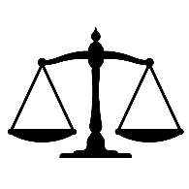

Policy Narrative
Characters
Heroes, villains, victims, beneficiaries, allies, etc.
setting
Context: geographical, social, economic, etc.
moral
Often the equivalent of a policy solution
plot
The arc of actions and events

Slide 13
What counts as a narrative?
Policy stance or judgment
Can be cost/benefit, “moral of story” solution
One character in a hero, villain or victim role
Do you agree with this definition?
What about narrativity or narrative complexity?

Slide 14
Narrative Elements, Narrative Strategies, and Policy Beliefs
Narrative elements – the actual structural bits and pieces
Narrative strategies – how those bits and pieces are used to tell stories
Policy beliefs – moral beliefs driving the narrative

Slide 15
Elements
Plots
  Decline or control
Causal mechanism
  Intentional – purposeful cause of outcome
  Inadvertent – Unforeseen consequences of action
  Mechanical – not purposeful action, but purposeful outcome
  Accidental – as it sounds
Characters
  Hero
  Villain
  Victim
  Other
Evidence
Solution/Moral
Strategy – Devil-Angel shift

Slide 16
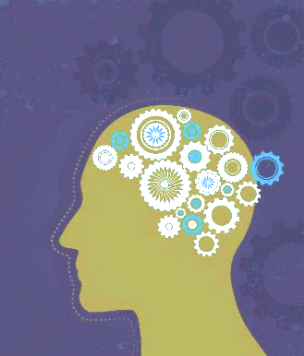
Policy Narrative
Characters
Heroes, villains, victims, beneficiaries, allies, etc.
setting
Context: geographical, social, economic, etc.
moral
Often the equivalent of a policy solution
Policy preferences
Beliefs
Cognition
Emotions
Relationships
plot
The arc of actions and events

Slide 17
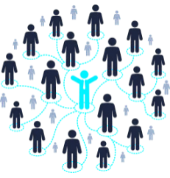

Policy Narrative
Characters
setting
moral
Policy preferences
Beliefs
Cognition
Emotions
Relationships
plot
Narrative strategy

Slide 18
Policy Narrative
Characters
setting
moral
plot
Narrative strategy

Slide 19
Strategies
Expand or contain a coalition broadly
Distribution of costs and benefits
  For opposition, diffuse costs and concentrate benefits
  Vice Verse for own position
Devil and Angel shift

Slide 20
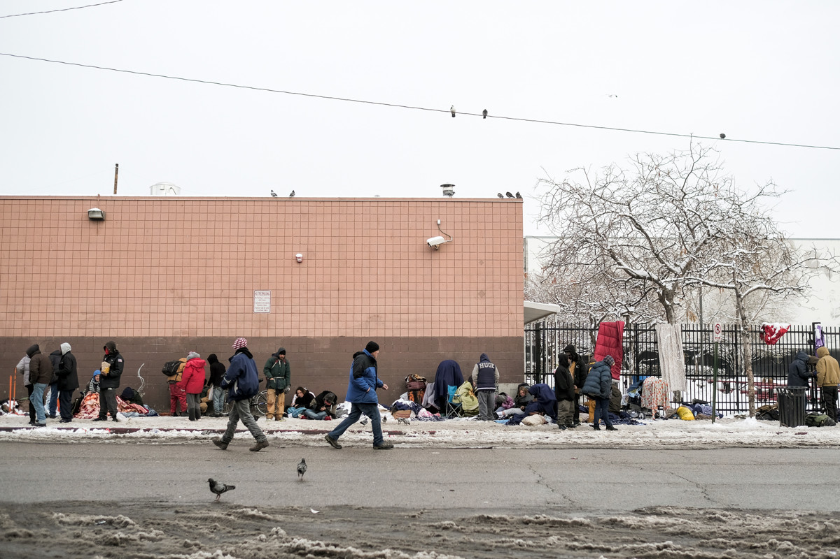

Slide 21
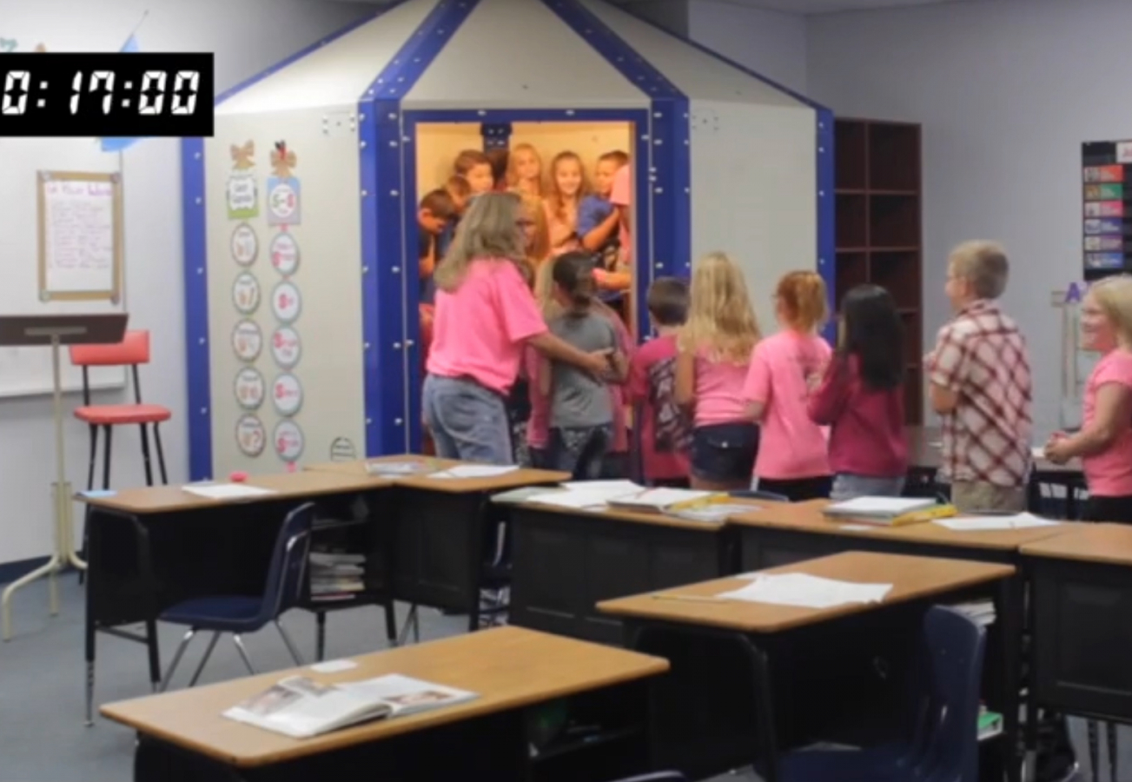

Slide 22

Macrolevel
Societies
Cultures
History
Policy Narrative
Characters
Mesolevel
setting
Coalition cohesion
Framing
Issue expansion
Issue containment
Devil-shift
moral
microlevel
plot
Narrative transportation
Policy preference entrenchment or change
Learning

Slide 23
Micro Level
Primarily interested in the relationships between narratives and public opinion
  Survey research and experiments
  What are the strengths and weaknesses?

Slide 24
Meso Level
Strategic construction of policy narratives and relationship to losing and winning
  Method: Quantitative content analysis
  Strengths and weaknesses?
Macro Level?
  No major study yet… APD or narrative event analysis eventually maybe

Slide 25


Slide 26

What types of narratives are more effective at shaping individual policy preferences and possibly influencing policy change?
Which narrative strategies serve to mobilize coalition members and external actors?
Which types of narratives and narrative strategies, when combined, are most likely to lead to policy change?
How do policy narratives and narrative strategies shape societal politics and political discourse over time?

