Slide 1

Introduction to Environmental Policy

Slide 2

Some
Big Ideas in environmental policy
Public attitudes and values
  New ecological paradigm
  Climate change beliefs
International norms
Environmental discourses
Human-nature interaction
Political theory, even
  Plato and beyond

Slide 3
Why this book
Substantive domain – environmental
Focus on policy and politics
Tracking change over time (historical perspective)
  1960-2014 roughly
Innovative (duh)
  Concepts sound impractical or simply academic, but they help us imagine real societal change
    Bread and butter of public administration

Slide 4
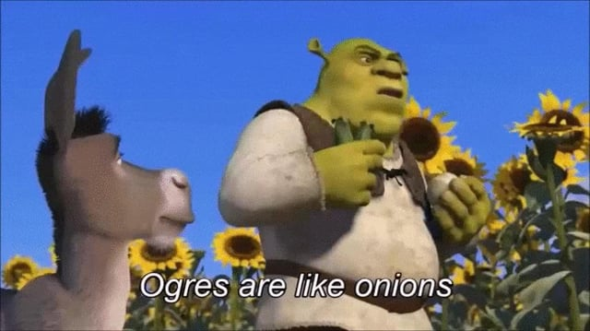
Layers of concepts
Macro-concepts: capture whole domain (i.e. all of environmental policy)
Environment dominated concepts: where environment modifies an existed idea
Particularized concepts: narrow in application, context, community

Slide 5
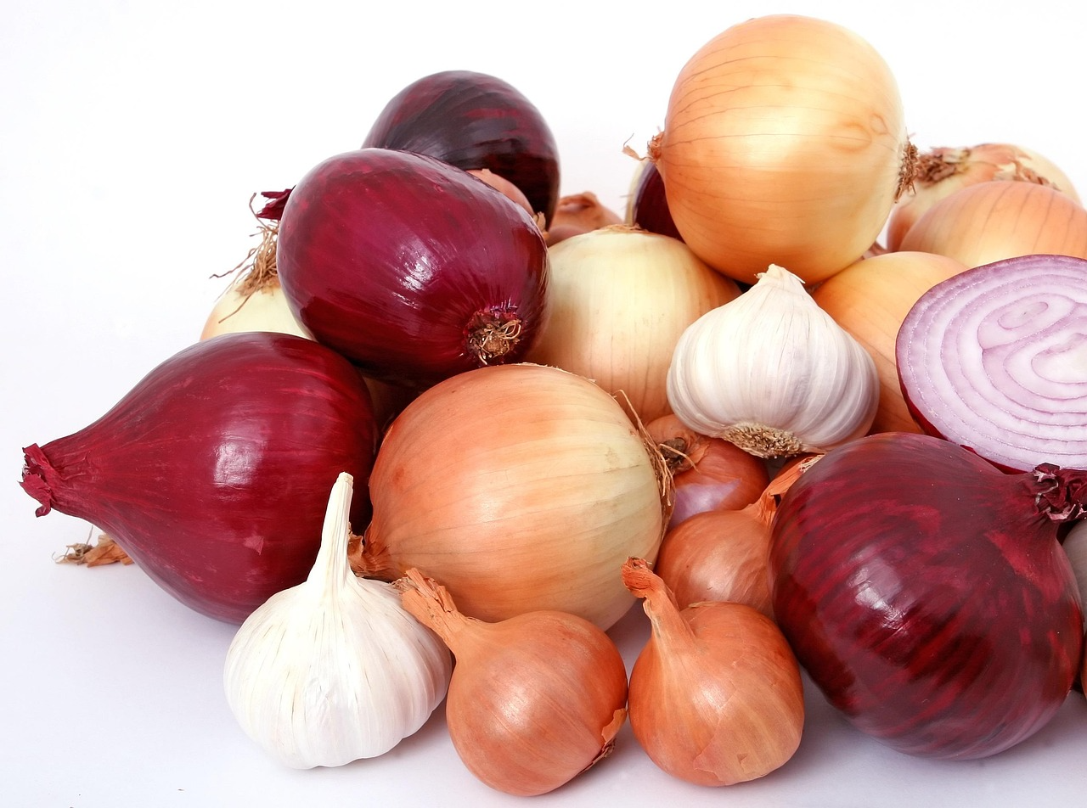
Layers have layers
Concepts can be:
  Problem oriented
  Management oriented

Slide 6

Concepts vs. Themes
Concepts are categorical devices as are themes
Connection between academic sphere and pop cultural sphere
Can map concepts into dimensional space via connections
  Analytical process and critical thinking

Slide 7
Language matters
Specific
  Geographic context
  Time-bound
But also abstract

Slide 8

Institutional Embeddings
Or legitimization in policymaking bodies
  Example of sustainable development progression

Slide 9
But why do some concepts embed while others fail?
Needs to be needed
Diverse audiences
Realistic

Slide 10
How do we evaluate concepts?
To what extent has the concept been important in argument and practice in environmental policy?
To what degree has the concept proven productive or fruitful?

Slide 11
A preliminary and premature example
What is “The Environment”? (we will return to this question in Chapter 3)

