Slide 1

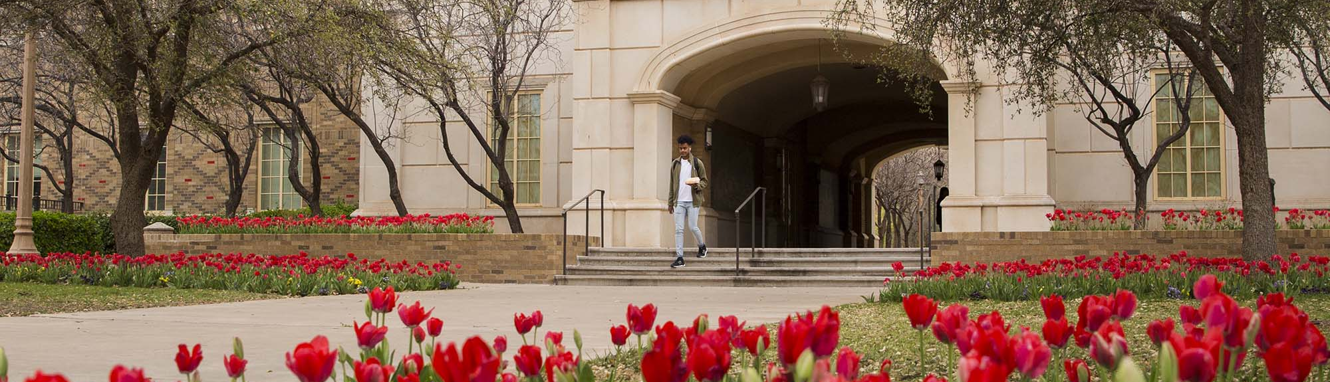


Policy Conflict
Guest Lecture: Ariell Bertrand, PH.D.

Slide 2
Class Outline
Introductions
Brief overview of the traditional theory of the policy process and alternatives
Group Discussion on Schattschneider
Overview of Schattschneider
Overview of the Policy Conflict Framework (discuss some connections to Koeble and Crow (2020)
Group Discussion / Application of PCF and comparison to Schattschneider
Overview of Ford & Ihrke (2021)

Slide 3
About Me
First Generation College Student
Worked in the Missouri House of Representatives before I started graduate school
Graduated with my PhD in Education Policy from Michigan State University this year
Politics of Education
  Interest Groups and Political Parties
  Local School Boards
  Theories of the Policy Process (Narrative Policy Framework)
Postdoctoral Research Associate in the Educational Psychology, Leadership, and Counseling (ELPC) Department
  I work with Dr. Jessica Gottlieb
Name, interesting/fun/funny fact about you. Why did you decide to join the MPP? Please share any information you want the class or myself to have about you!​

Slide 4
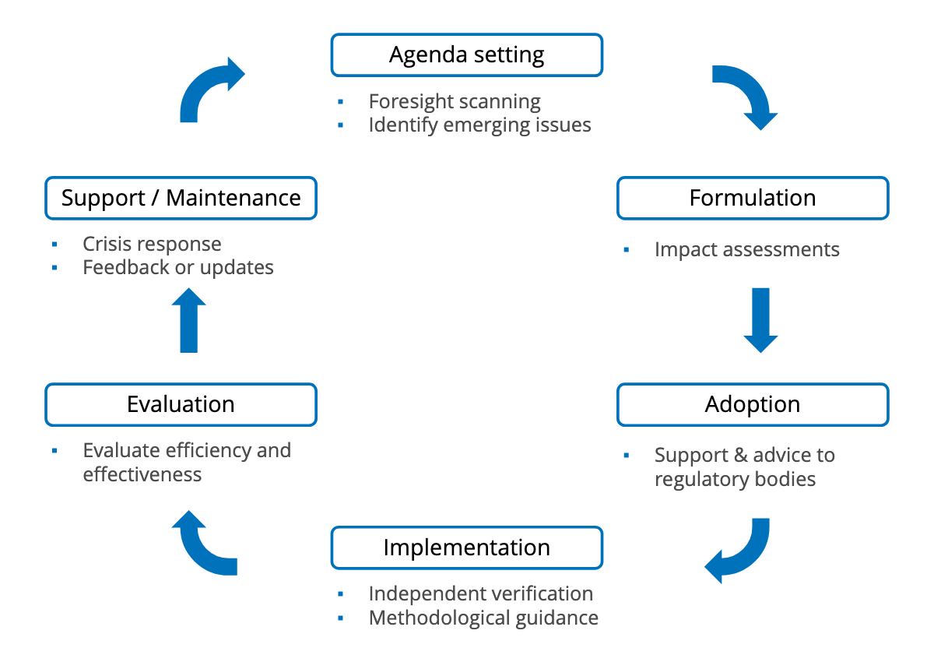
Traditional View of the Policy Process
Idea that policy happens in a linear fashion – you have a policy problem, set the agenda, evaluate a range of alternatives, and select the best policy
Why might the policy process not actually work that way?

Slide 5
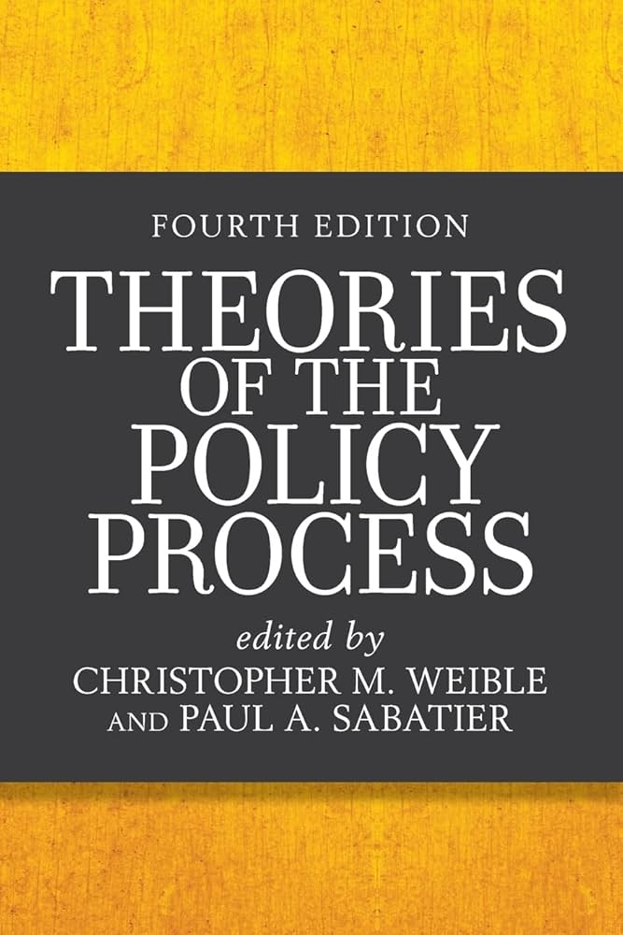
Alternative Theories of the policy process
Policy Conflict
Kingdon's Three Streams
Social Construction
Narrative Policy Framework
Policy Feedback
Advocacy Coalition Framework

Slide 6

Policy Conflict as a Model of Policy Change
Schattschneider (1957) Intensity, Visibility, Direction, and Scope
How does Schattschneider view politics?
  A strategic contest / conflict between actors
  Partially putting an argument up against pluralism
In groups, discuss:
  What are the four main concepts of conflict that Schattschneider states govern conflict?
  Which one is the most determinant / important to Schattschneider, and why?
  Apply these concepts to a chosen policy conflict
    You’ll use this same policy conflict / policy issue later!

Slide 7
Intensity, Visibility, Direction, and Scope
Intensity
  Changes in public opinion
    “A very slight change in the temperature of the mass may have important consequences…”
  Not all participants care equally
    Small, organized groups care more than the public
    Gives them disproportioned influence in low-visibility areas
Visibility
  Most conflicts aren’t in the public view
  Public attention changes the balance of power
  Example: Changing policy through local referendums to increase public visibility
Direction
  Many conflicts exist at the same time – but they aren’t equal
  Main Policy / Conflict = Direction
    Nationalism example
If you had to pick one issue that most strongly structures U.S. political conflict right now, what would it be? What other issues does it push aside? What evidence could you use to support that claim?

Slide 8
The importance of the scope of Conflict
Imagine there is a public fight between Sarah and Emma
  What can the weaker fighter do to change the outcome of the fight?
Sarah’s friends jump in – the fight is no longer about strength, it’s about numbers, and the scope of conflict has expanded.
  No longer a private fight – it’s a public one
The weaker / losing side in a policy conflict almost always wants more people involved, more visibility, more institutions, higher levels of authority – to try and gain an advantage.
The stronger / winning side wants the conflict to stay small / the way it is – fewer people, fewer rules, fewer visibility let’s them keep their advantage

Slide 9
Scope of Conflict Examples
School Policy Example:
  Parent has a disagreement with a teacher about a discipline policy.
  Private matter, and the teacher has more administrative power, says they are just following the rules of the district.
What can the parent do to try and win the conflict?
  Mobilize other parents with similar beliefs – form an interest group
  Go to the school board – they have more power than the teacher
  Go to their state legislator and advocate for higher level changes to discipline policy
Another example?

Slide 10
The Scope of conflict shows up in many other public policy theories
Narrative Policy Framework example:
  Narratives can expand or constrict the scope of conflict
    Winning Coalitions: Distribute benefits of a policy to a large group of people (victims), while the costs are constrained to a small group (sometimes characterized as the villains)
    Losing Coalitions: Distribute costs to a broad spectrum of victims, and benefits to an elite few – typically villains
Advocacy Coalition Framework example:
  Policy change depends on competition between advocacy coalitions within a policy subsystem
    Scope of conflict expands when:
      New actors enter a subsystem
      External shocks (elections, crisis, focusing events) broaden participation
      Issues cross subsystem boundaries

Slide 11
Policy Conflict Framework
PCF is designed to “advance both localized and generalized knowledge about policy conflict”
  Localized: specific insights about specific policy conflicts in specific settings
  Generalized: About the nature of conflict itself
  Adds to the research because other theories treat conflict as a background characteristic, measured indirectly
Borrows heavily from the Advocacy Coalition Framework (ACF) so I’ll go over some of those basic concepts!
Conflict is not good or bad – but “under what settings do conflicts emerge, endure, and subside, and which forms have what consequences?’

Slide 12
Policy Conflict Framework
Episodes of Policy Conflict:
Policy Setting:
Outputs are the outcomes of policy conflicts on public policies.
Can be direct (Change in Policy)
Can be indirect (change in institutional rules) governing the policy
Feedback:
1.) Outputs
2.) Outcomes

Slide 13
Policy Conflict Framework
Episodes of Policy Conflict:
Policy Setting:
Outcomes
Short term impacts of the conflict
Long term impacts of the conflict
Feedback:
1.) Outputs
2.) Outcomes

Slide 14
Policy Conflict Framework
Episodes of Policy Conflict:
Policy Setting:
Levels of Action
Socioeconomic Conditions, Physical Setting, and Institutional Arrangements of the Three Different Levels
Feedback:
1.) Outputs
2.) Outcomes

Slide 15
The Advocacy Coalition Framework: Policy Subsystem
US Education Policy
Texas State Education Policy
ISD Discipline Policy

Slide 16
Policy Conflict Framework: Three Levels of Action
US Education Policy
Texas State Education Policy
ISD Discipline Policy
Political System (Broadest Scope for Governing a Territory)
Policy Subsystem
Policy Action Situations

Slide 17
Policy Conflict Framework
Episodes of Policy Conflict:
Policy Setting:
Levels of Action
Policy Actors
Intrapersonal:
Attributes of individual policy actors (Deep core beliefs, knowledge, personal resources, risk/benefit perceptions, etc.)
Feedback:
1.) Outputs
2.) Outcomes

Slide 18
The Advocacy Coalition Framework: Belief Systems
Deep Core Beliefs
Policy Core Beliefs
Secondary Beliefs

Slide 19
Policy Conflict Framework
Episodes of Policy Conflict:
Policy Setting:
Levels of Action
Policy Actors
Interpersonal
- Groups of policy actors (network relations, organizational relations, and collective resources)
Feedback:
1.) Outputs
2.) Outcomes

Slide 20
The Advocacy Coalition Framework: Coalitions
Policy Subsystem
Advocacy Coalition
Advocacy Coalition
Beliefs
Beliefs
Conflict
Coordination
Coordination

Slide 21
Policy Conflict Framework
Episodes of Policy Conflict:
Policy Setting:
Levels of Action
Policy Actors
Events
Events
Complexity
  How many people does this impact? How often does it happen?
Proximity
  Where did this event happen? Who did it impact?
Feedback:
1.) Outputs
2.) Outcomes

Slide 22
Policy Conflict Framework
Episodes of Policy Conflict:
Policy Setting:
Levels of Action
Policy Actors
Events
Policy Issue
Morality:
Fundamental issues about what is right or wrong and the way society ought to be.
  Issues: Abortion, immigration, religion
Feedback:
1.) Outputs
2.) Outcomes

Slide 23
Policy Conflict Framework
Episodes of Policy Conflict:
Policy Setting:
Levels of Action
Policy Actors
Events
Policy Issue
Complexity:
What causes this issue?
Who is affected by this issue, both positive and negative, and how badly?
What are effects of this issue in both the short and long term?
Feedback:
1.) Outputs
2.) Outcomes

Slide 24
Policy Conflict Framework
Episodes of Policy Conflict:
Cognitive Characteristics
Policy Setting:
Levels of Action
Policy Actors
Events
Policy Issue
Divergence in Policy Positions
The degree to which actors express differences on the formation, adoption, or implementation of public policies
Feedback:
1.) Outputs
2.) Outcomes

Slide 25
Policy Conflict Framework
Episodes of Policy Conflict:
Cognitive Characteristics
Policy Setting:
Levels of Action
Policy Actors
Events
Policy Issue
Threats in Policy Priorities
The degree to which actors believe that the policy positions of others will impose costs, harm, or other negative consequences to themselves or society
Feedback:
1.) Outputs
2.) Outcomes

Slide 26
Policy Conflict Framework
Episodes of Policy Conflict:
Cognitive Characteristics
Policy Setting:
Levels of Action
Policy Actors
Events
Policy Issue
Unwillingness to compromise on policy positions
The degree to which policy actors are willing to change their views on a policy position
Feedback:
1.) Outputs
2.) Outcomes

Slide 27
Policy Conflict Framework: Compromise and Belief Change
The ACF argues that belief change is essential for overcoming policy conflicts
The Policy Conflict Framework, on the other hand, argues that belief change isn’t necessary, but instead a willingness to compromise / cooperate / reach negotiated solutions is needed.
Regarding Koeble and Crow (2020), what did they hypothesize regarding belief change and collaboration? What did they find?
  Where they more in line with the ACF or PCF? Why?

Slide 28
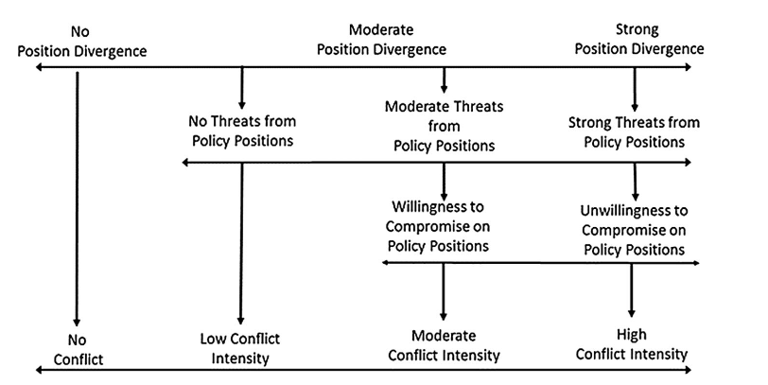

Slide 29
Policy Conflict Framework
Episodes of Policy Conflict:
Cognitive Characteristics
Behavioral Strategies of Policy Conflict
Policy Setting:
Levels of Action
Policy Actors
Events
Policy Issue
Political strategies or tactics
Efforts by individuals to directly (e.g., lobbying, voting) or indirectly (e.g., narrative debates, forming coalitions, organizing protests) influence outputs and outcomes and how those efforts are conducted
Feedback:
1.) Outputs
2.) Outcomes

Slide 30
Group Work: Policy Application – Comparing Schattschneider and the PCF
Apply whatever previous policy conflict example you used to the PCF.
  What is the policy setting (e.g. what is the level of action, who are the actors, what are their deep beliefs / policy core beliefs, did any events contribute to this conflict? Is morality tied to the policy issue, if so, how? What issues of complexity are important to the issue?)
  Who are the actors on each side of the policy debate? How divergent are they in their policy positions? How much are they threatened by each other? Are they willing to compromise?
    How does the policy setting impact these issues?
  What political strategies or tactics does each side take to win the policy issue?
Then, Discuss:
What do we gain from Schattschneider that we don’t see in the PCF? What do we gain from the PCF that we don’t see from Schattschneider? Can we “see” any of Schattschneider’s conflicts in the PCF? Does one side do a better job at explaining who wins and who loses?

Slide 31
Determinants of Priority Conflicts on City School Boards by Ford and Ihrke (2021)
School boards are one of the closest democratic arenas that the public can participate in
  For years, though, there have been attacks on the usefulness of school boards, and even calls for eliminating all school boards (Miller, 2008)
    Due to persistent struggles to raise academic outcomes in the U.S.
    Arguments over vested interests (e.g. teachers unions) blocking policy change
    Overall inefficient / dysfunctional

Slide 32
Determinants of Priority Conflicts on City School Boards by Ford and Ihrke (2021)
Policies such as:
  charter schools
  voucher programs
  and removing power from school boards and putting power in the hands of mayors or states
Are all programs that reduce democratic decision making over local schools
Justified as a responses to conflict, gridlock, dysfunction, and poor outcomes
Measuring conflict as a way of evaluating school boards:
  especially given research (Grissom, 2014; Ford & Ihrke, 2016; Kogan, 2025) that link conflict in school boards to academic outcomes
Assumption: Less conflict – better outcomes

Slide 33
Determinants of Priority Conflicts on City School Boards by Ford and Ihrke (2021)
Methodology:
  Measured conflict on school boards through a survey sent to nearly all school board members in the United States but limited to only cities.
  Limited to only school boards with 2+ responses
    163 responses across 72 districts
  Asked board members to rank their top 10 priorities (things like strategic planning, setting academic standards, board development, coordinating with interest groups, making student behavior policies)
    Used variance for each of the 10 priorities to determine the degree to which board members serving together have priorities in conflict with one another
What do you think of their methodological approach?

Slide 34
Determinants of Priority Conflicts on City School Boards by Ford and Ihrke (2021)
Hypotheses:
  More conflict:
    harder to educate students
  Less conflict
    Higher levels of spending, engage in regular strategic planning, regular board development, positive perceptions of board members, positive relationship with superintendent
Findings:
  More conflict with greater ELL and male student population and less conflict when board members indicate they engage in continuous strategic planning
Do you see any connection between these hypotheses and conflict theories we’ve talked about? Why or why not?
If school boards are democratic institutions, should we expect, or even welcome, some degree of conflict?
  Do Ford & Ihrke and Schattschneider / Weible & Heikkila value conflict differently?
Who gains from low conflict, according to Schattschneider?

Slide 35
Any questions? Thank you!
Ariell Bertrand, PH.D.
arbertra@Ttu.edu

