Slide 1

Environmental Policy: What, Who, How & Where?
PUAD 3329: Environmental Politics and Policy
Invited speaker: Dr. Zyanya I. Ramirez Diaz
Spring 2026

Slide 2



Last class…
Conceptual Innovation
Key ideas that structure arguments and action in the environmental policy realm.
Conceptual innovation + examining the significance of adjustment to the categories with which we think and argue about environmental governance.

Slide 3
Overview of today’s class:
What? Mitigation, Adaptation, Intervention & Knowledge-Based Expansion
Who? Science Policy and the role of scientist
How? Types of practice
Where? Government, non-profits, etc.; federal, state, local & international
Case study for air quality policy at the local level

Slide 4
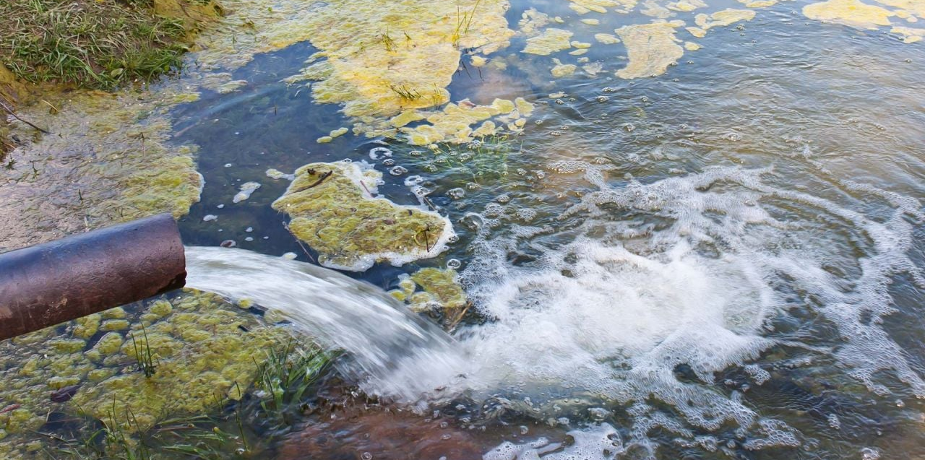
Polluted River

Slide 5
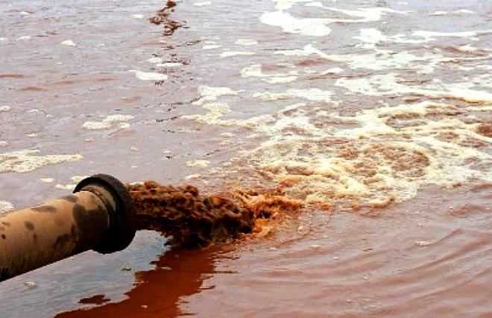
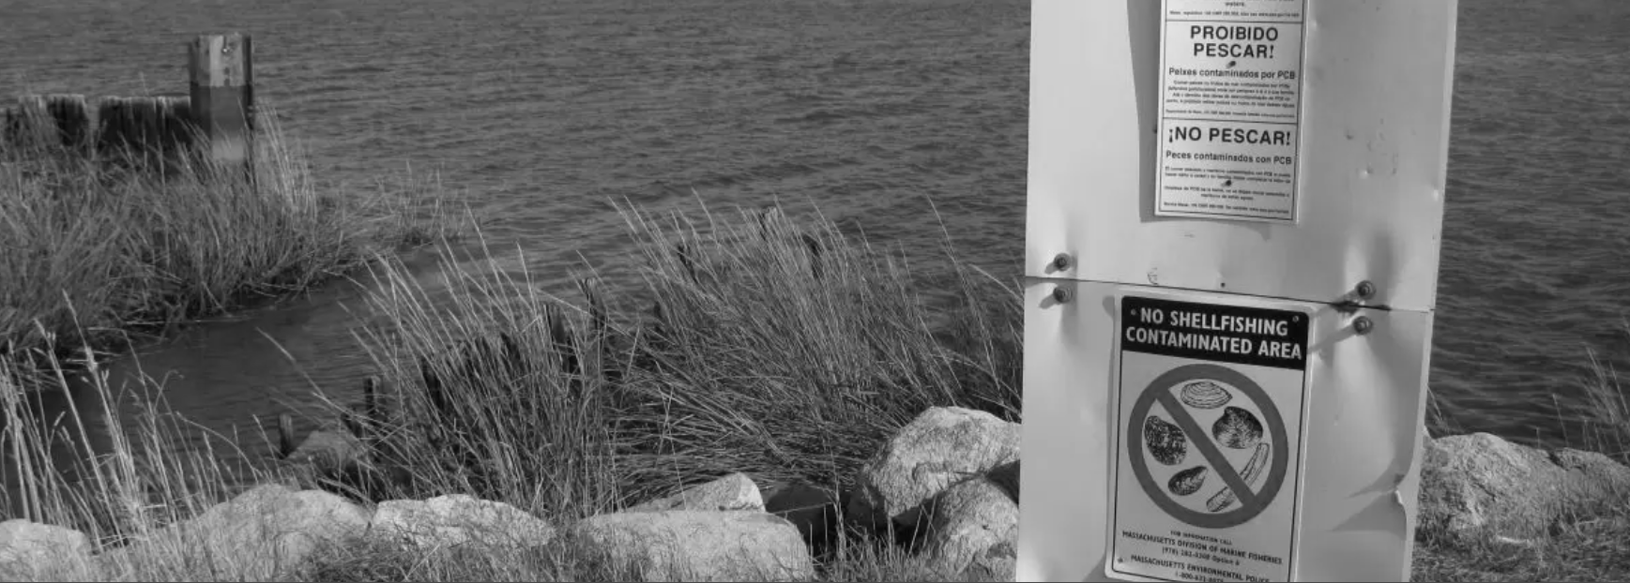
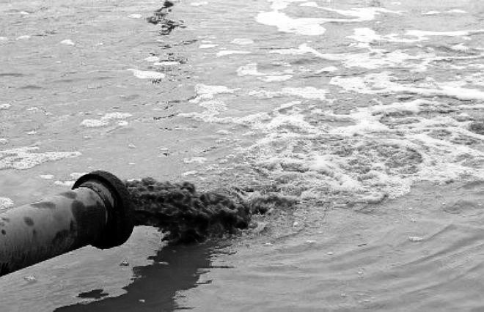
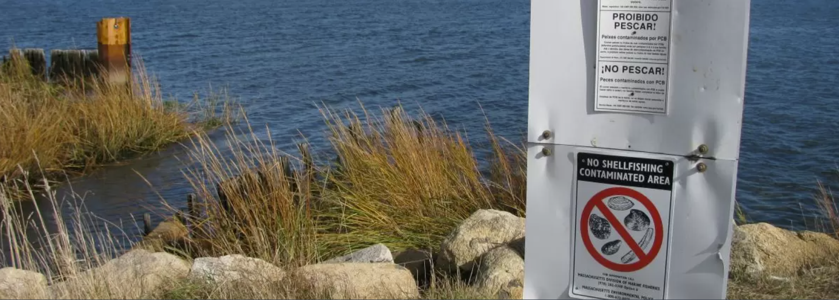
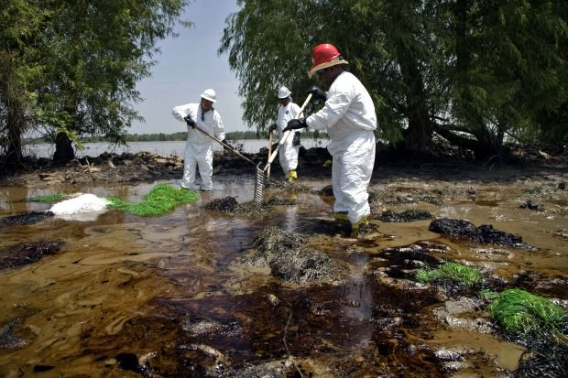
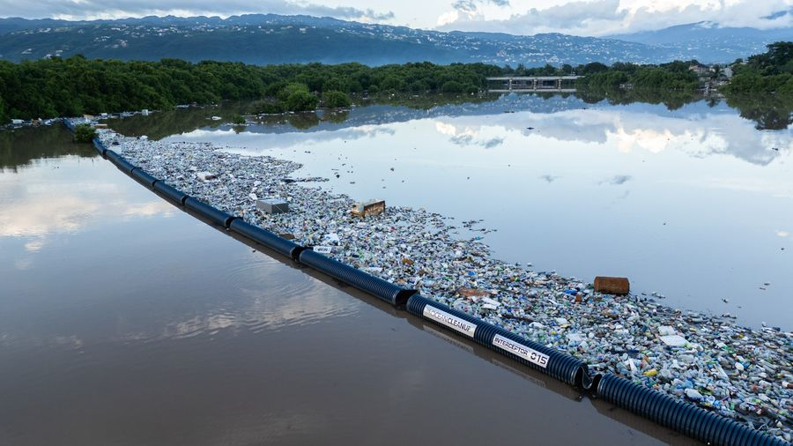
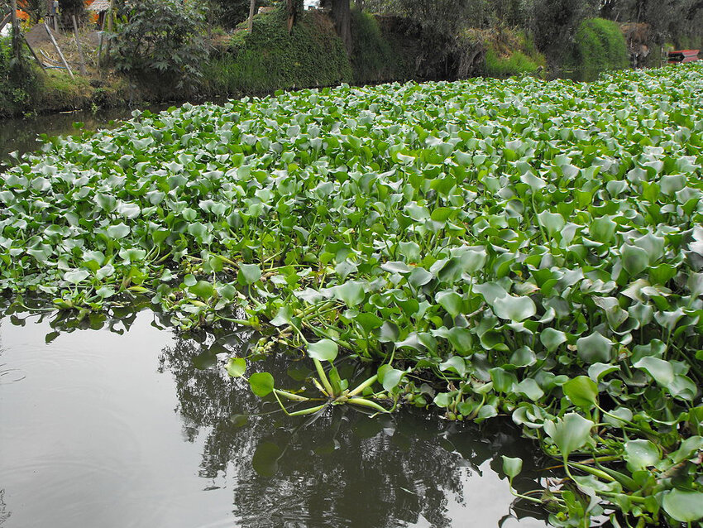

What?
Mitigation
- Reduce emissions
Adaptation
Plan for impacts
Build resilience
Improve response capacity
Intervention
Introduce additional changed to counteract emissions
Knowledge-based expansion
Scientific assessment
Technology development
Observations
Research

Slide 6

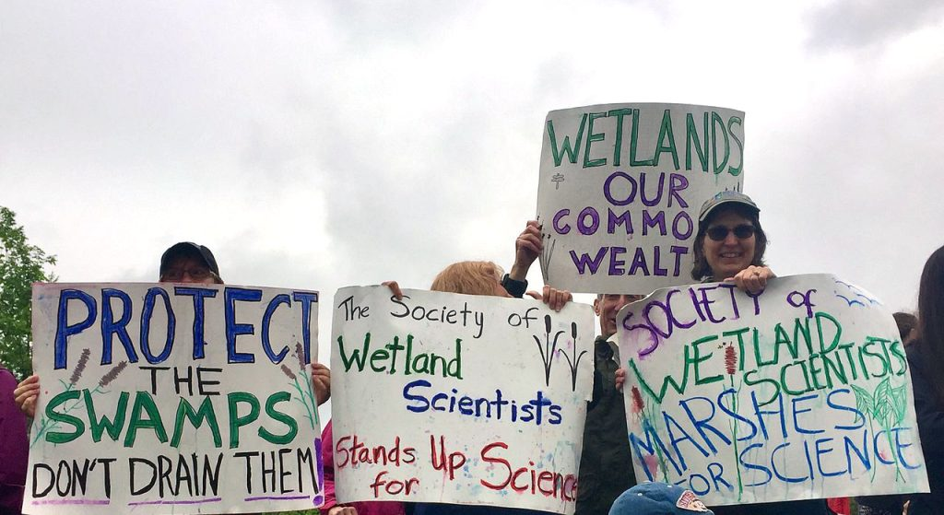

Who?
Science Policy
The intersection between scientific research and public policy: A two-way street.

Slide 7

How?
Types of Practice
Advising, Communications, Advocacy, Program Management, Technical Writing, Diplomacy, Education, Research

Slide 8
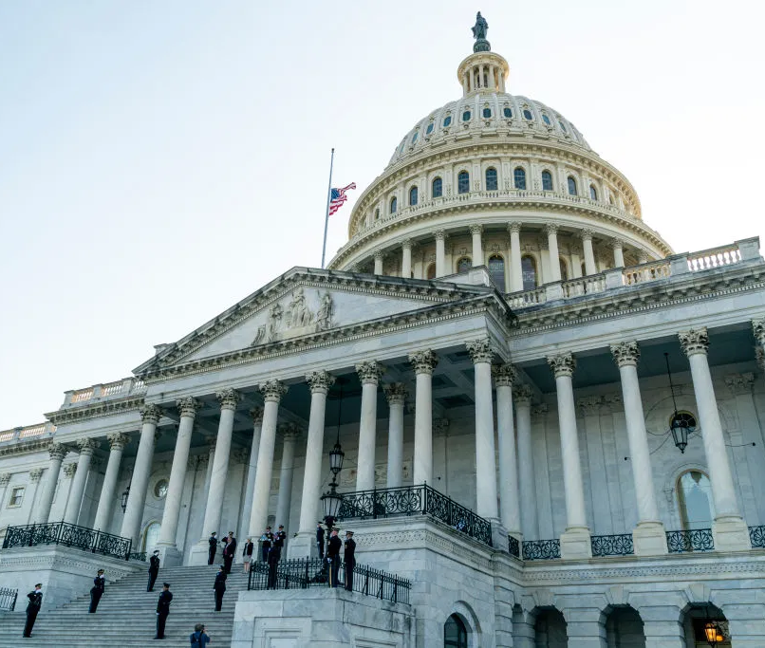

Where?
Government, Non-profit Organizations, Professional Associations, Think Tanks, Academia, Lobbying Firms, Industry, Law Firms…

Slide 10
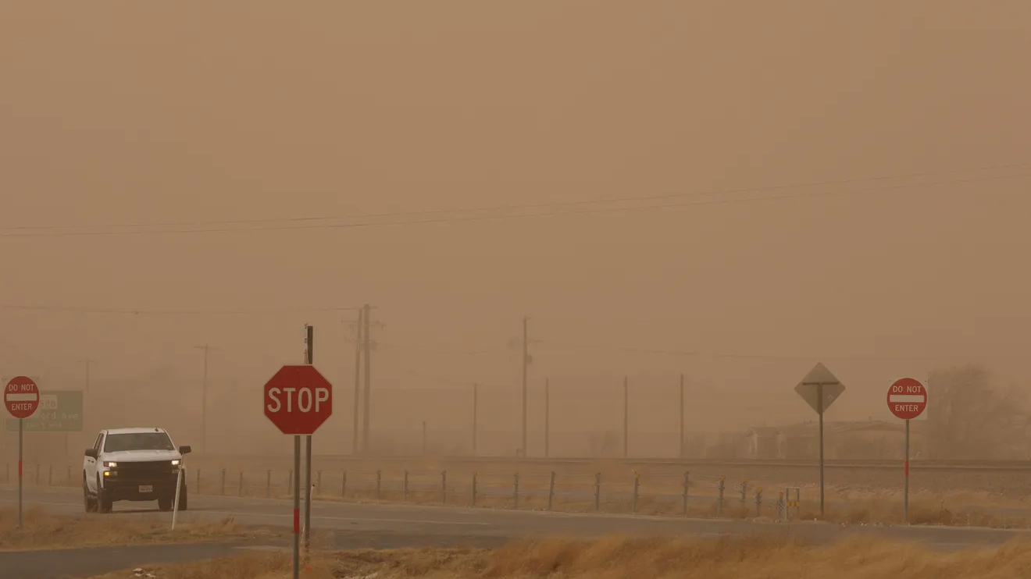
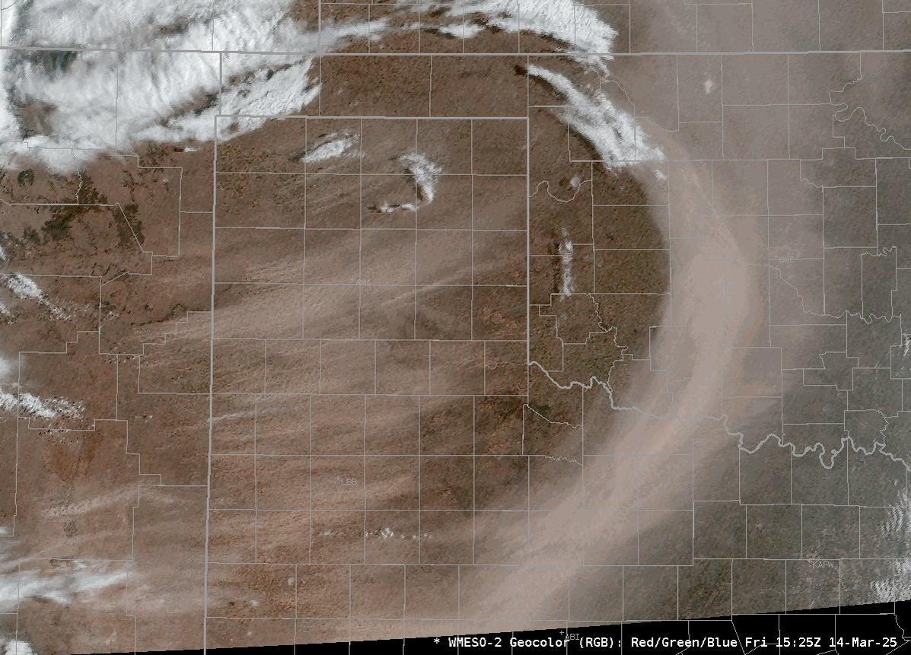
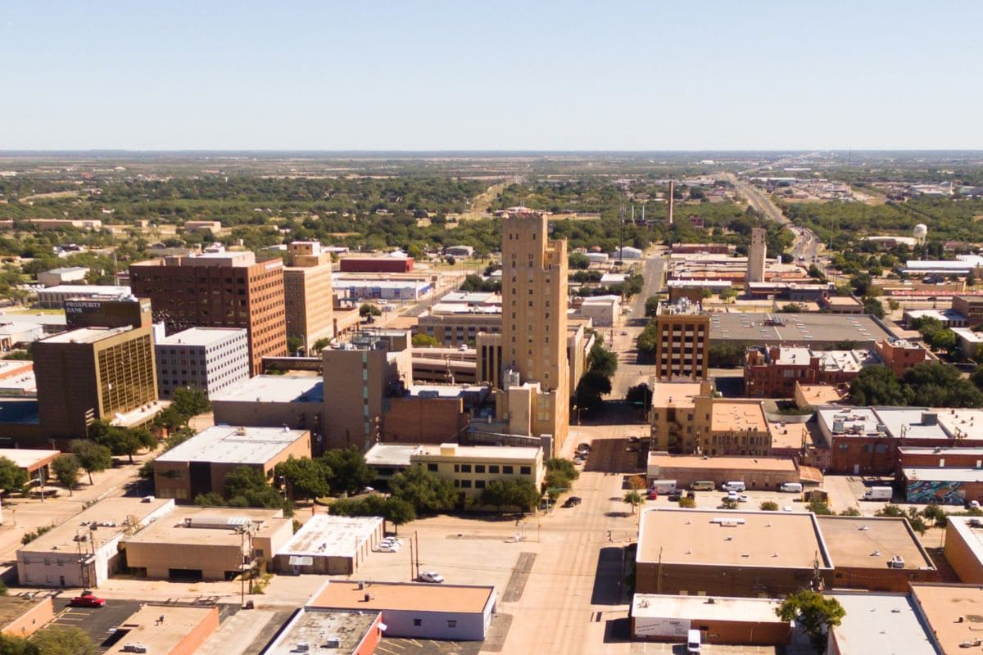

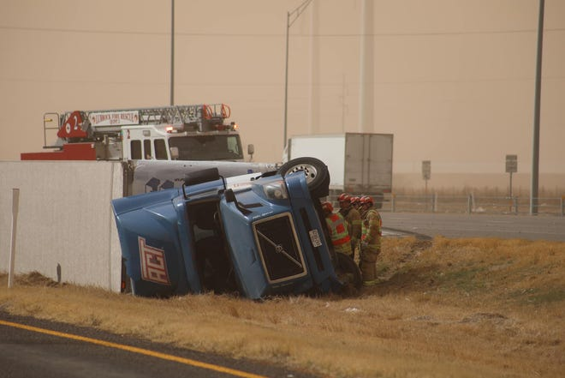
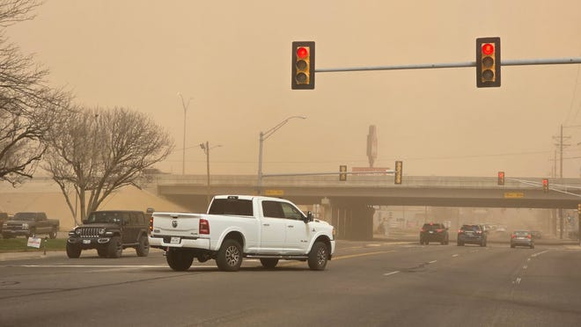
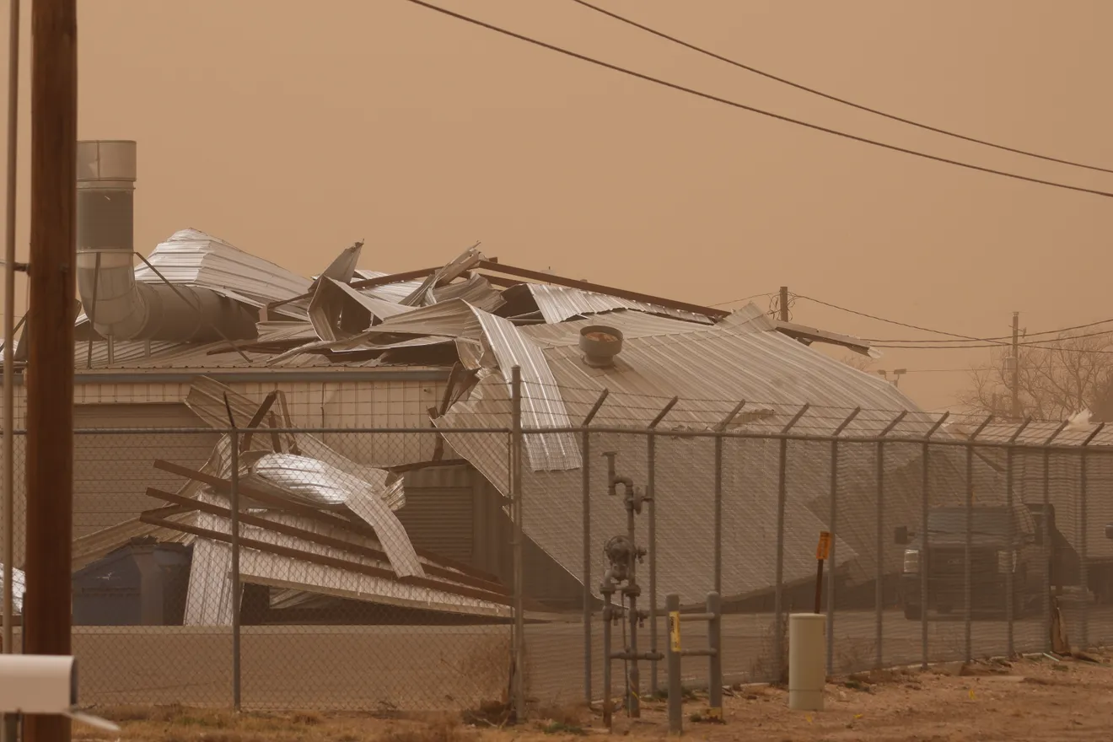
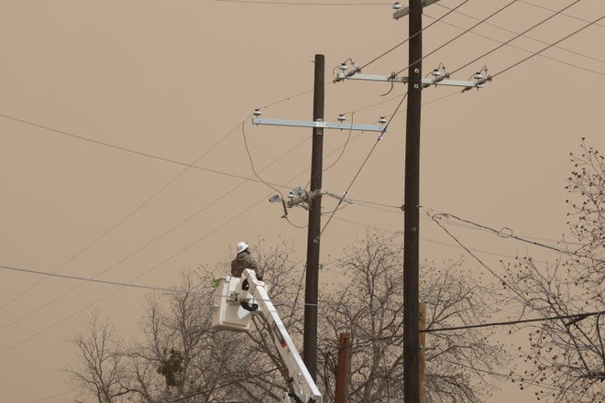
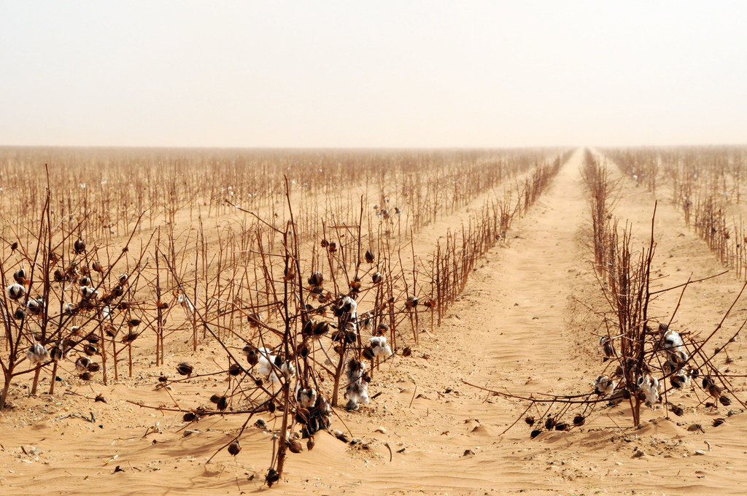
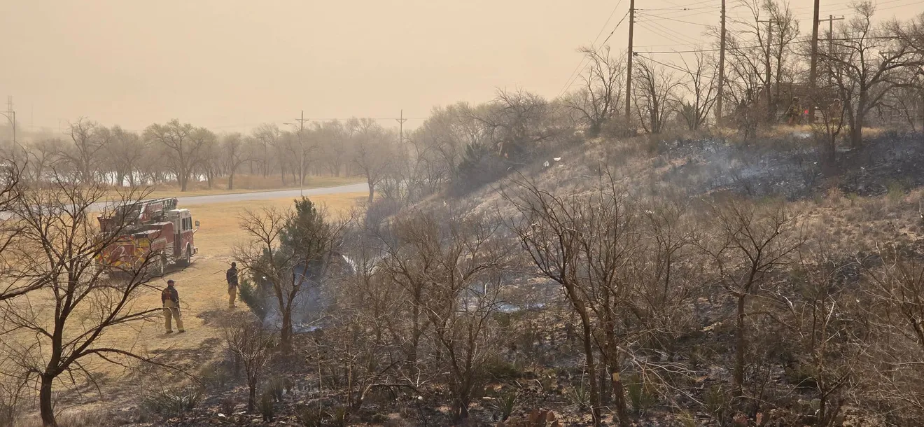
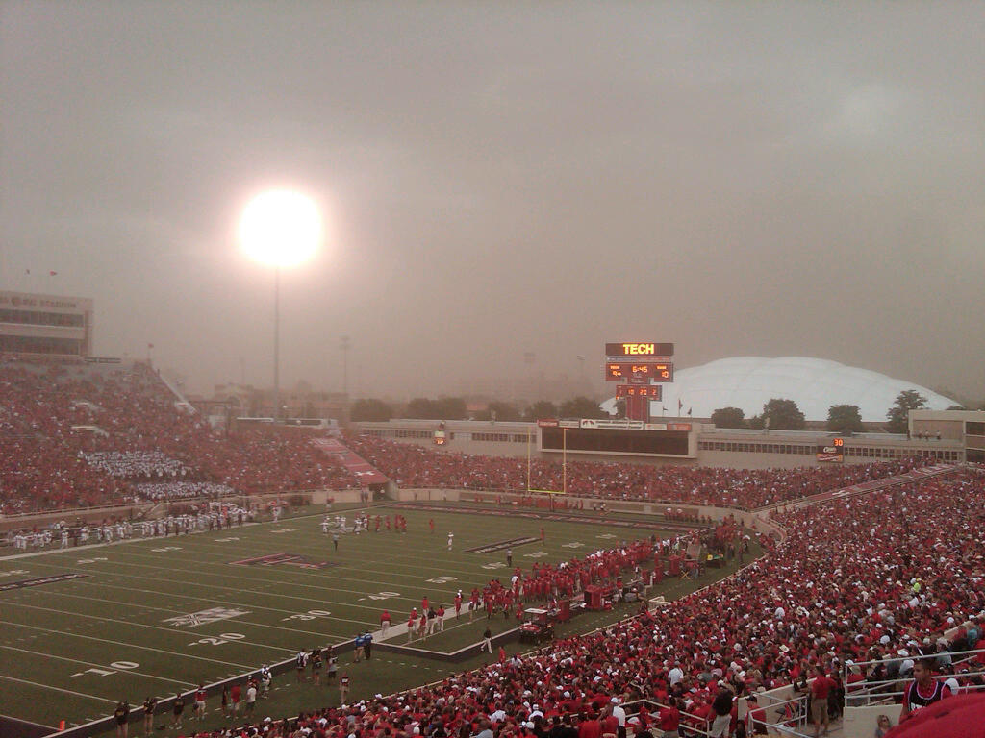

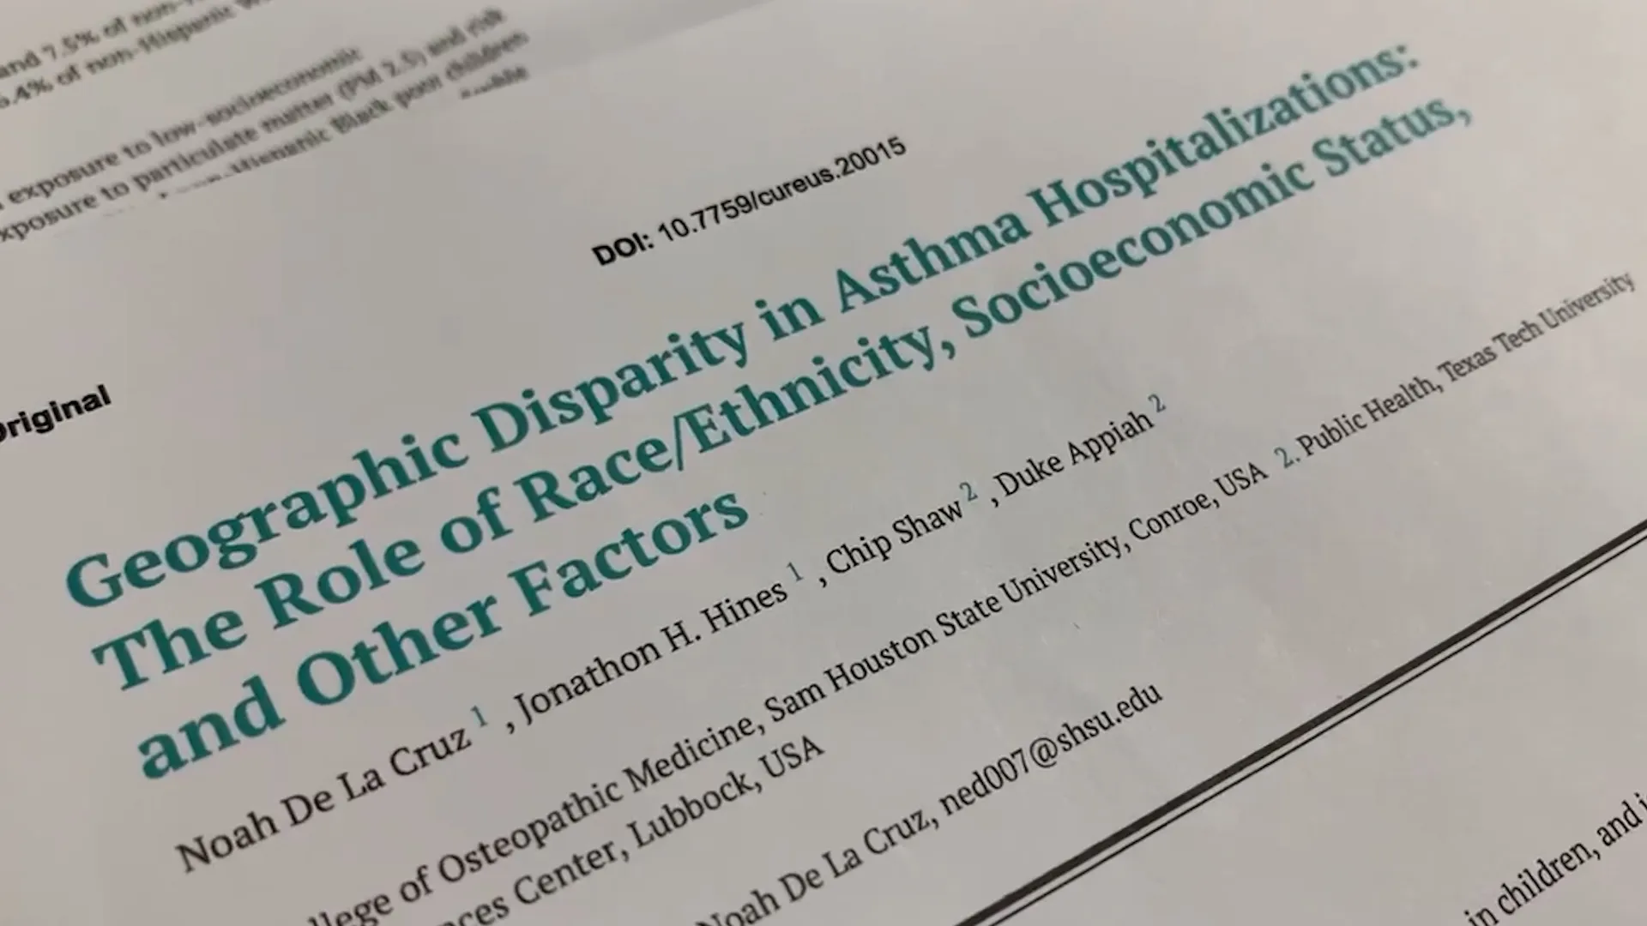
Lubbock
Population: 300,000
Urban, surrounded by rural
Photos by: Mateo Rosiles, Lubbock Fire Rescue, Michael Cuviello & Texas Department Of Public Safety

Slide 11
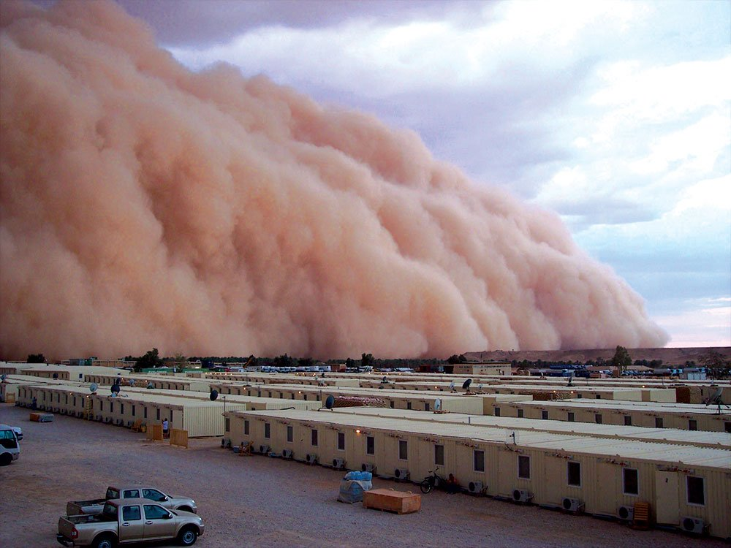
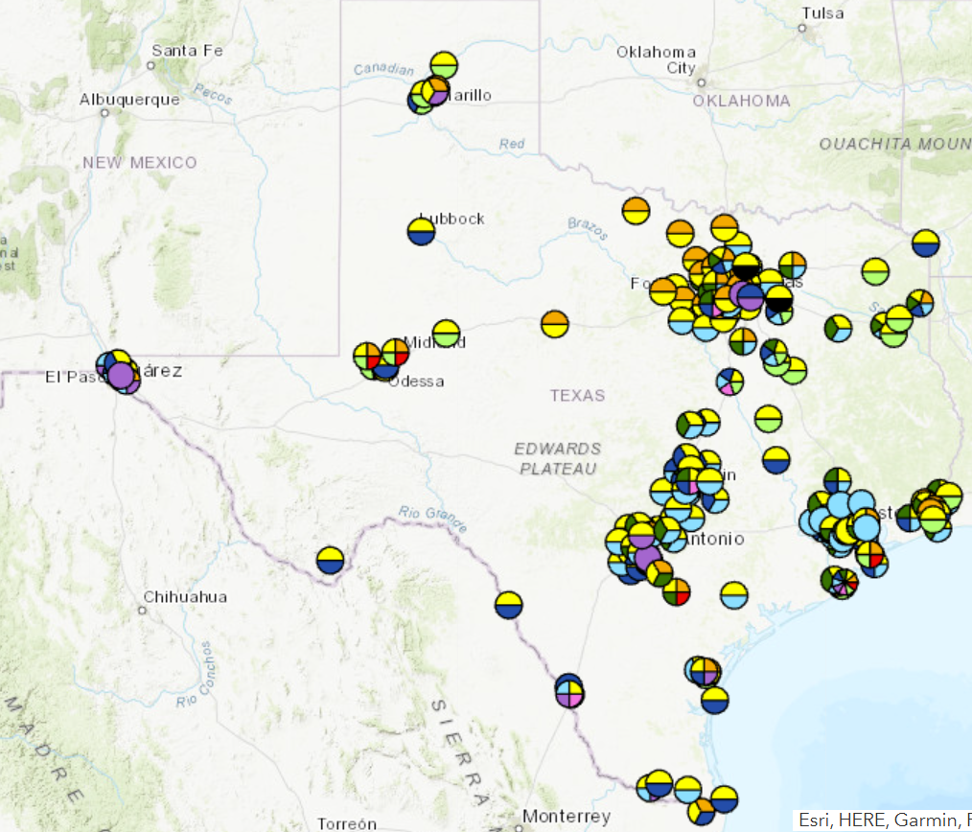
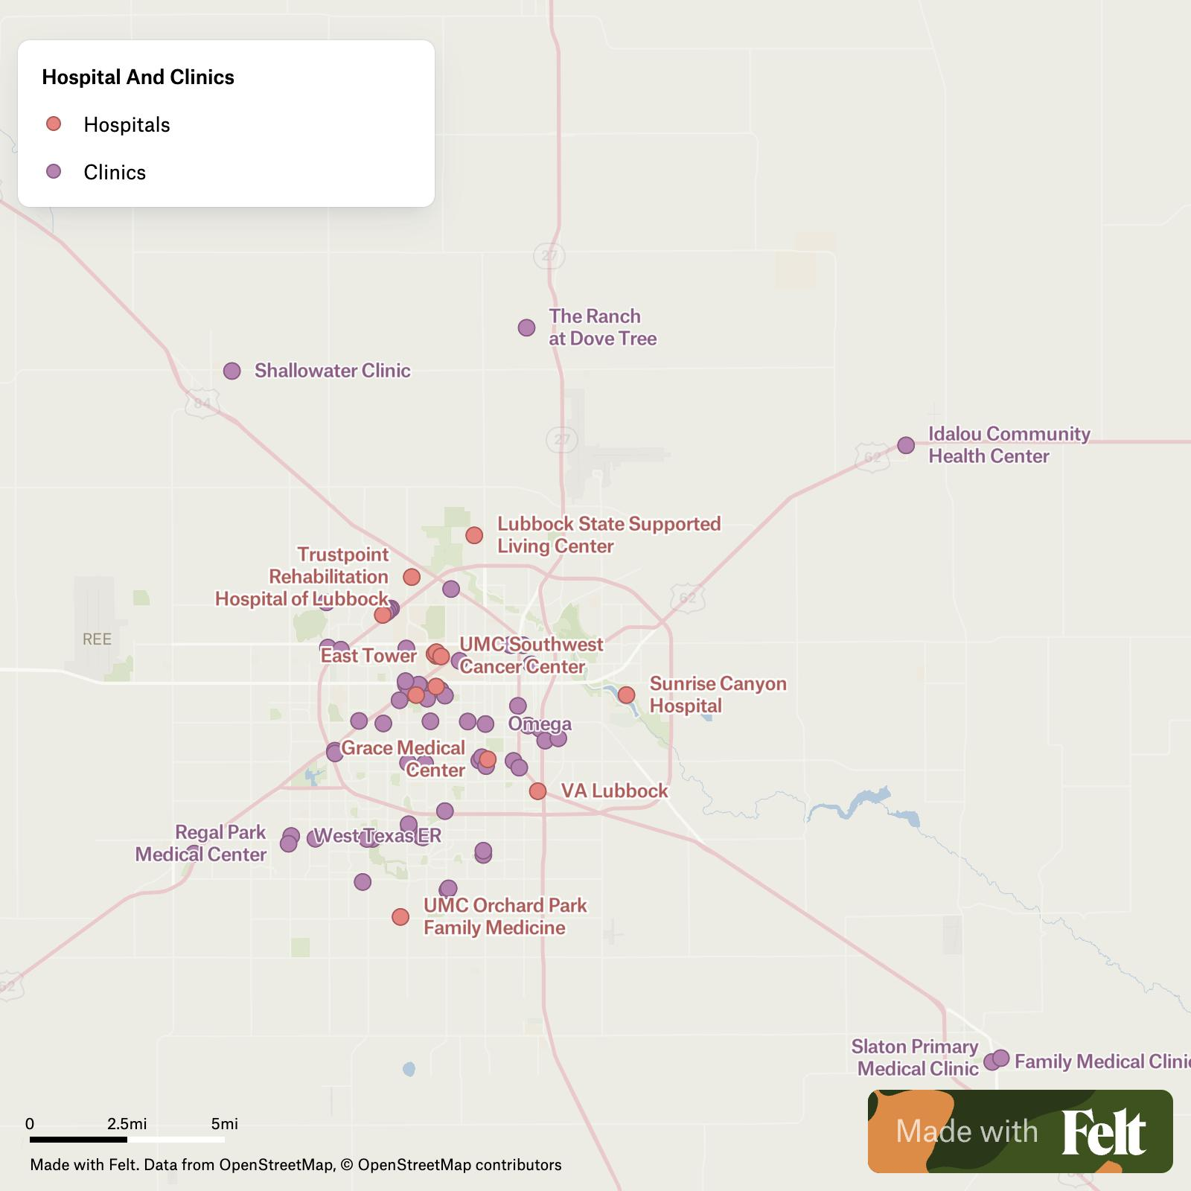
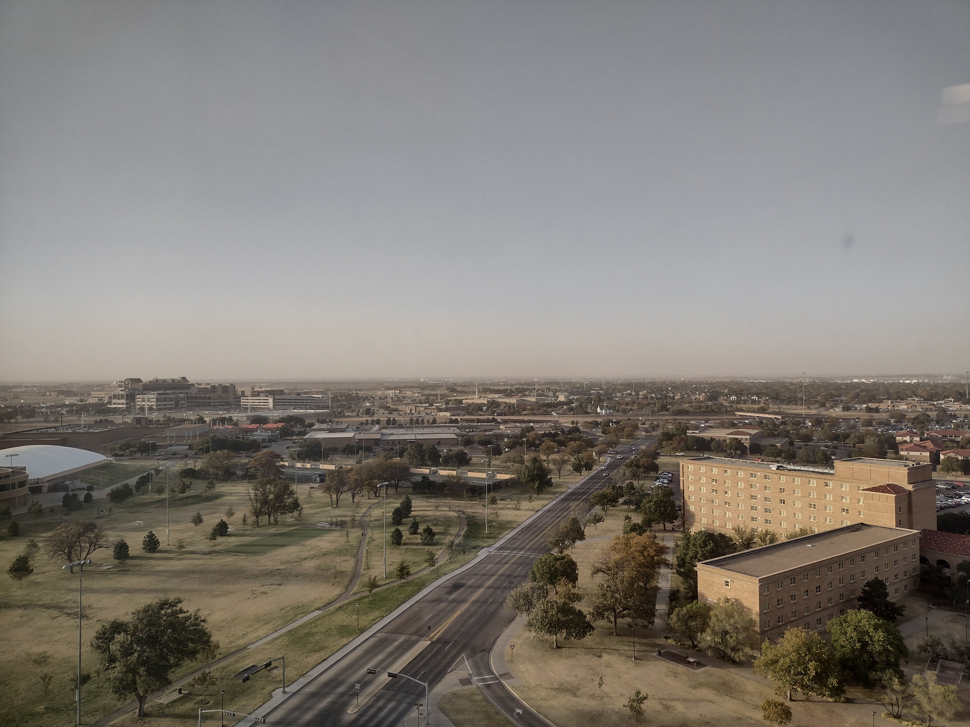
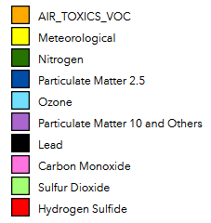

3 Key Susceptibilities of Lubbock
Lack of monitoring
Healthcare Hub
Synoptic dust events
TCEQ
TTU
Lubbock Compact

Slide 12

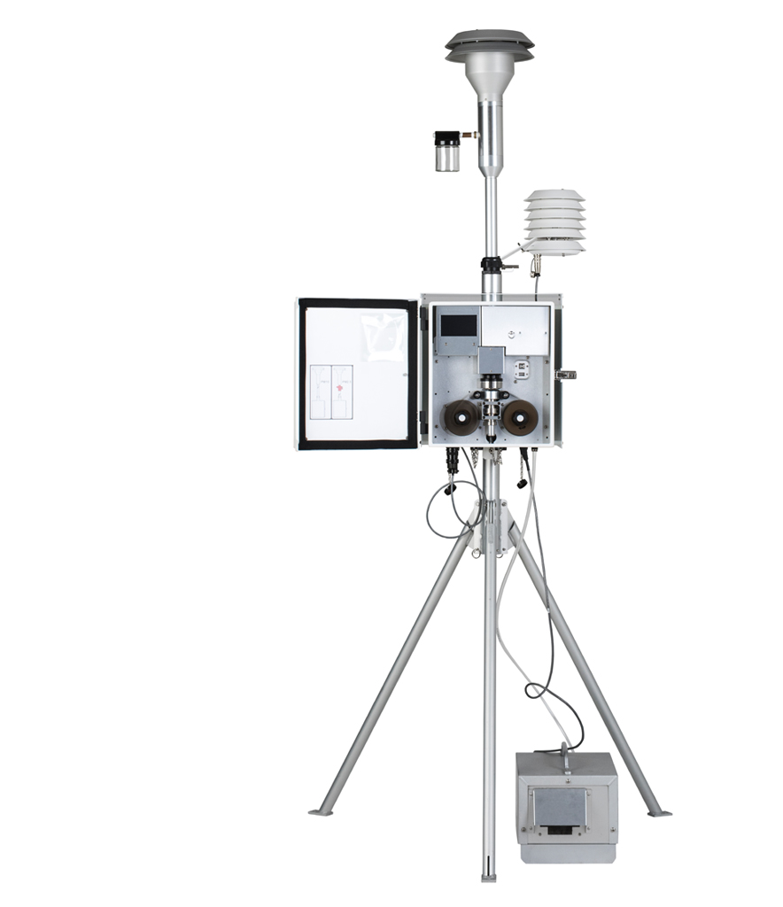
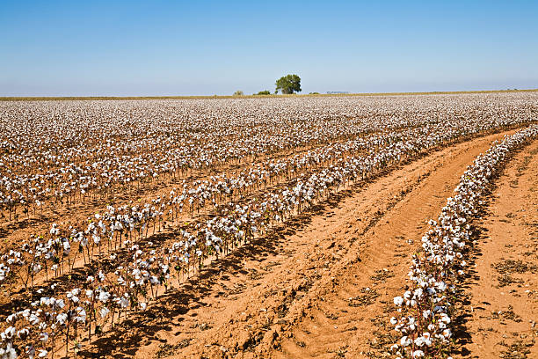

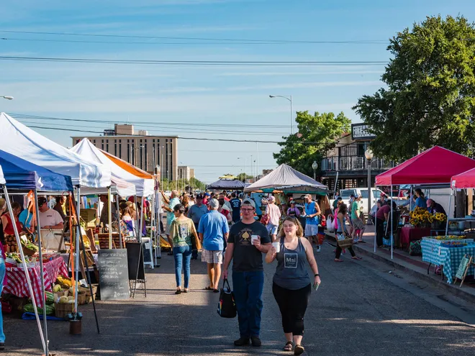
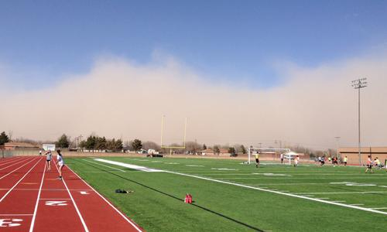
Our proposal
To encourage the local government to purchase and install a PM₁₀ instrument that:
Detect dust events
Reflects the air quality of the region
Requires low maintenance
> 10 years life span
< $60,000

Slide 13
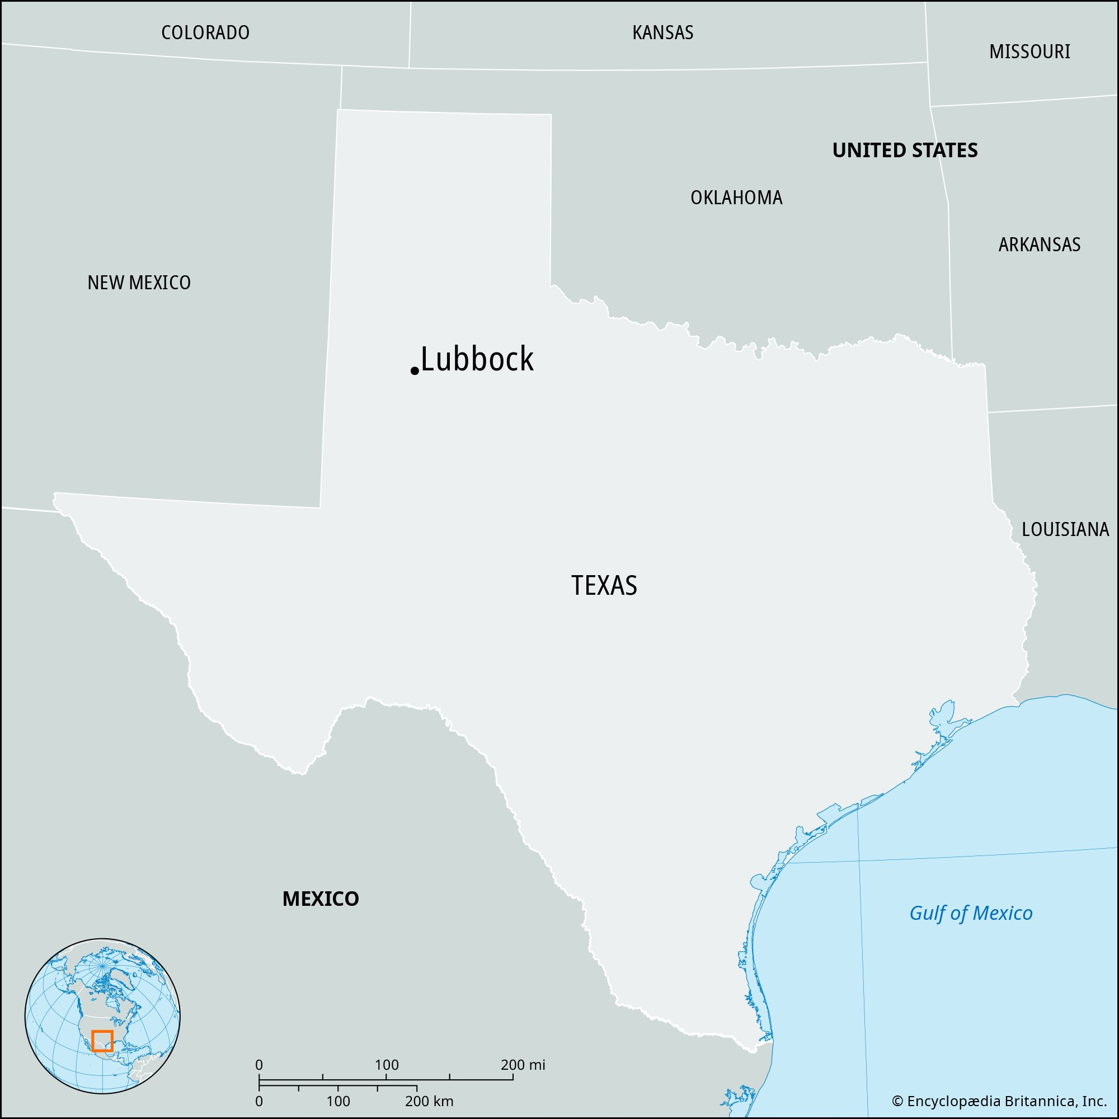
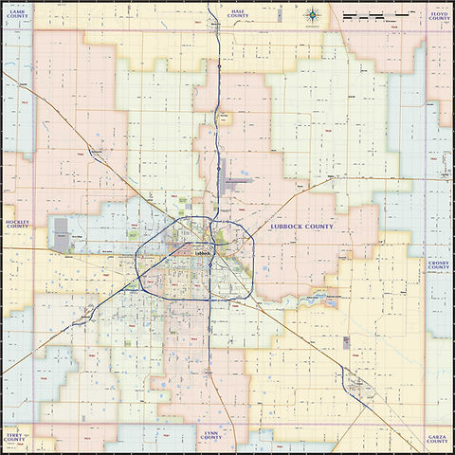
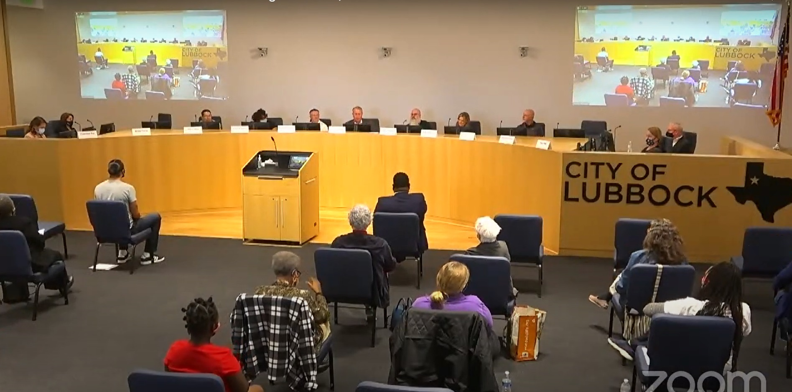
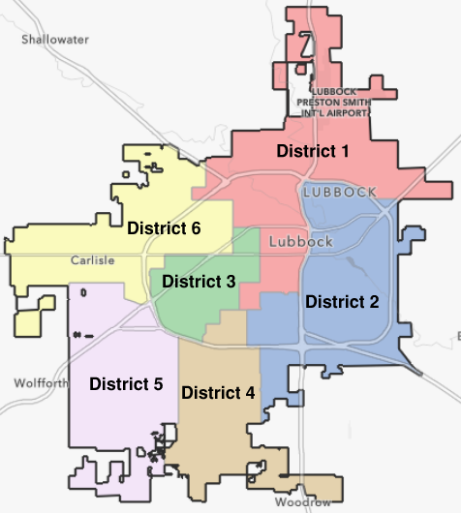

Engaging in the Policy Process
Considerations:
Practical
Financial
Political
Economic
Initial investment | $ 23,847.00
10-year maintenance | $ 7,618.00
Total | $ 31,465.00
Notes:
Reaching

Slide 14

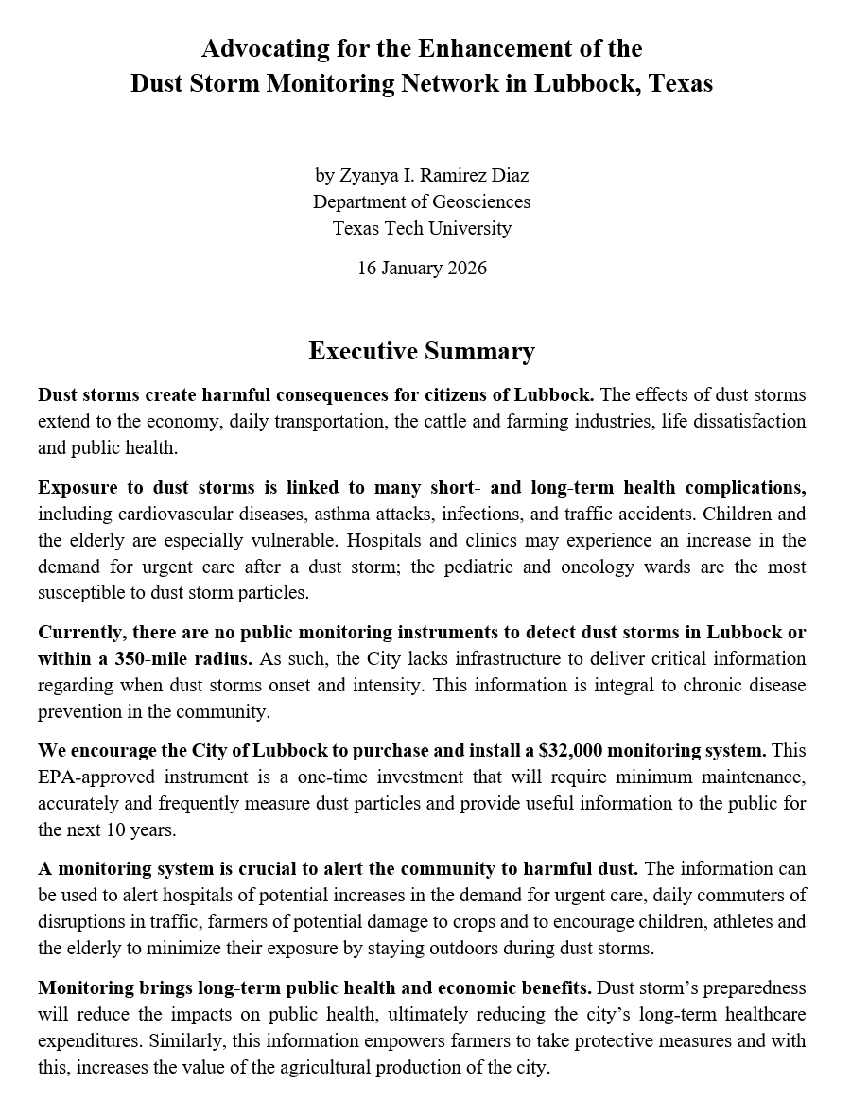
Policy Documents
Leave-behind
Report
Issue Brief
Notes:
Documents

Slide 15
Challenges and Lessons Learned
The policy proposal was relevant to the local context.
The process requires patience and diligence.
We framed the proposal to show its benefits to the local economy.
We understood the local political system and local values.

Slide 16
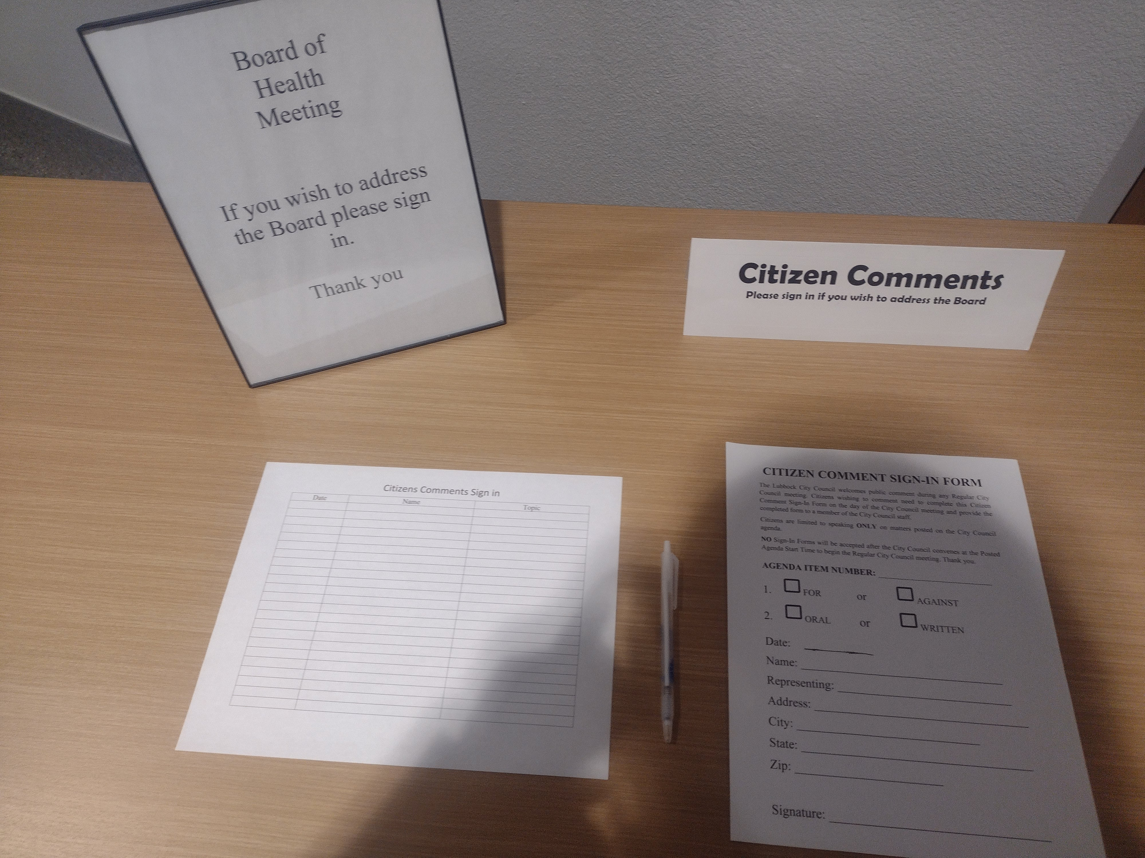
Presentation to the Board of Health
jtaggart@mylubbock.us
2015 50th
Lubbock, TX
Friday February 20th
12:30 PM

Slide 17
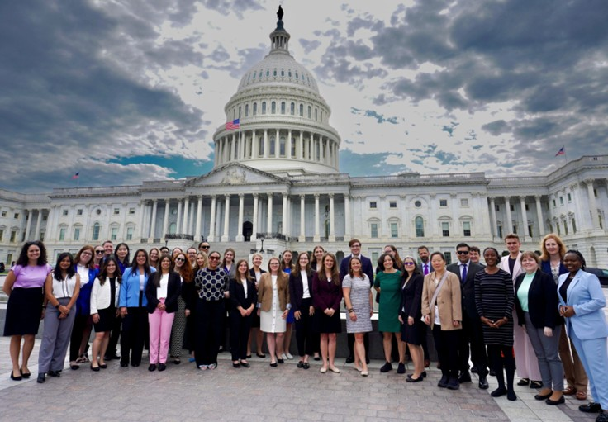

Science Policy Colloquium
(Application deadline March 8th, 2026)
Climate Policy Colloquium
Pathways to Policy Fellowship

Slide 18
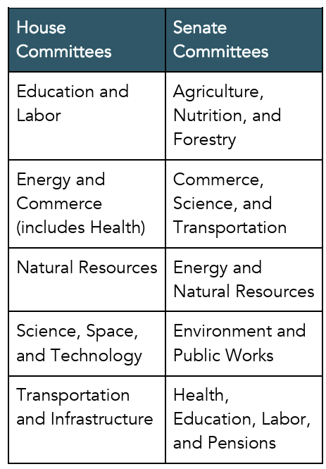
Supplemental Material
Environmental Policy in Congress:

Slide 19
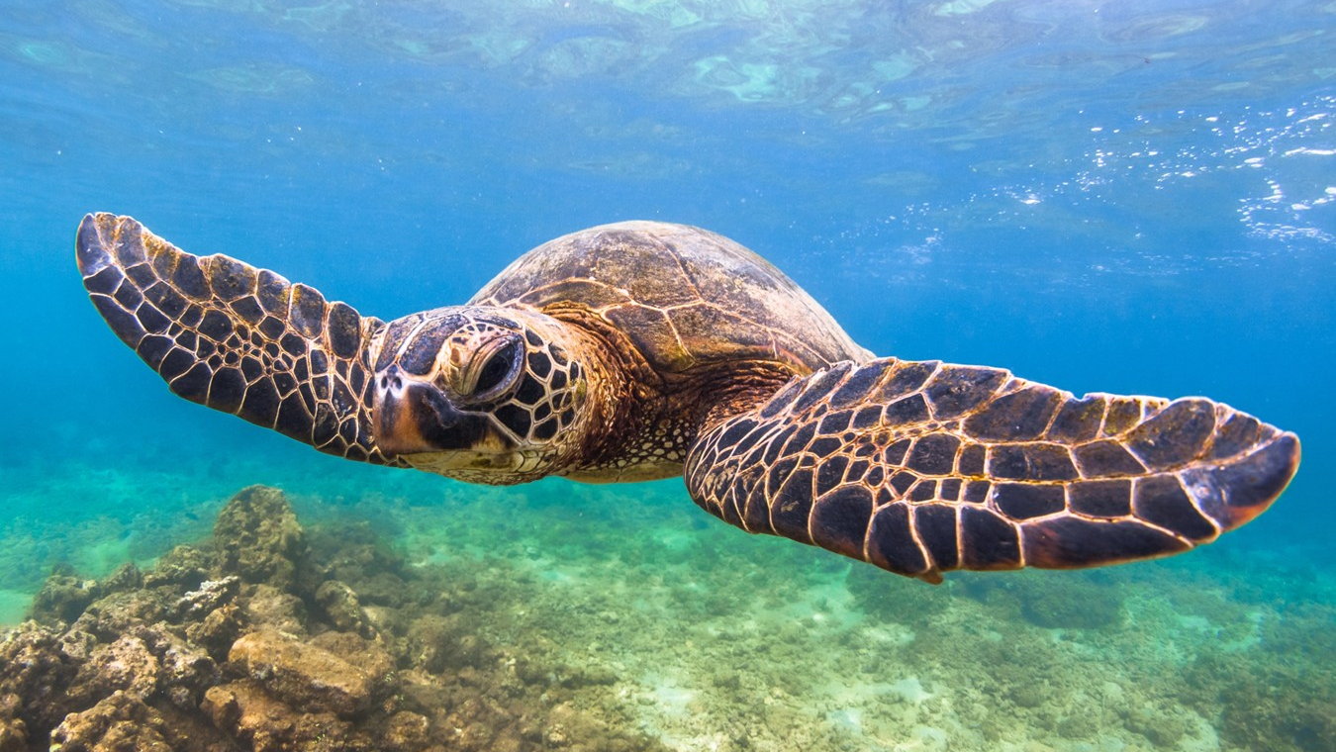
The Conceptual Repertoire of Environmental Policy
PUAD 3329: Environmental Politics and Policy
Invited speaker: Dr. Zyanya I. Ramirez Diaz
Spring 2026

Slide 20
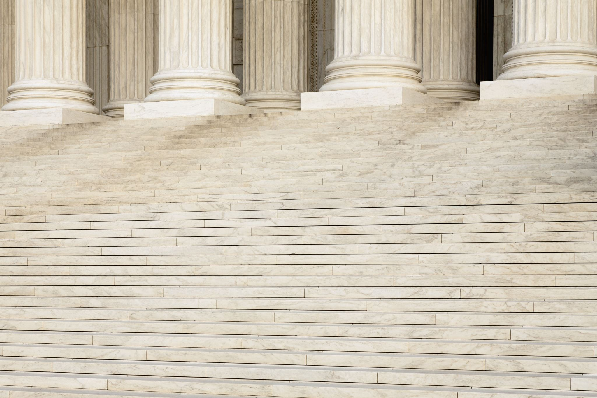
Last class…
Practical Mechanisms for Environmental Policy in the U.S. → What can be done? Who, how and where? in the policy process
Disconnections between policy and environmental processes
Case study at the local level

Slide 21

Concepts
Notes:
Concepts are not just words. After all, one word may denote several concepts (consider state as a condition or international unit); and several words may denote a single concept (for example, liberty freedom and are usually understood as such equivalents)

Slide 22

Concepts
Notes:
as “thought categories” through which we apprehend and, to some degree, constitute the world around us. They enable, but also constrain, reasoning and debate, and serve as building blocks for more elaborate arguments, theories, discourses, and ideologies.

Slide 23
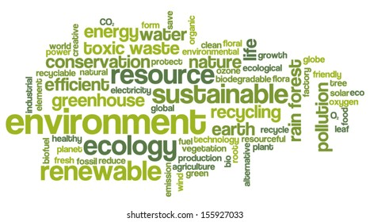

Why Concepts Matter in Environmental Policy?
Concepts evolve over time
Concepts shape problems, solutions, and debates
Environmental policy as a conceptual field
The term “carbon footprint” was first introduced by BP
https://youtu.be/ywrZPypqSB4?si=IWuJxHCJJ-N-ulqv
Notes:
This chapter starts from a simple but powerful idea: environmental policy is not just made of regulations and institutions—it is built on concepts. Concepts define what counts as an environmental problem, who is responsible, and what kinds of solutions are even imaginable. The authors use the idea of a conceptual field to describe a dense network of interrelated ideas that evolve over time and structure how environmental policy is argued and practiced. Understanding this field helps us see why certain policies emerge when they do, and why others remain marginal.

Slide 24

Adaptive management Biodegradable Biodiversity Ecotourism Emissions trading Environmental audit Carbon capture and storage Environmental integration Carbon offset Circular economy Decoupling Net zero housing Nuclear waste Organic farming Planetary boundaries Extended producer responsibility Polluter pays principle Flue gas desulphurization Geoengineering Ecological footprint Green growth Rewilding Sustainable tourism
Environmental concepts do different types of things:

Slide 25
Adaptive management Biodegradable Biodiversity Ecotourism Emissions trading Environmental audit Carbon capture and storage Environmental integration Carbon offset Circular economy Decoupling Net zero housing Nuclear waste Organic farming Planetary boundaries Extended producer responsibility Polluter pays principle Flue gas desulphurization Geoengineering Ecological footprint Green growth Rewilding Sustainable tourism
Environmental concepts do different types of things:
they denote particular physical phenomena, technological options, or societal practices
they identify problems and solutions and frame debate
they articulate social critiques, management principles, or policy instruments.
Notes:
“Resilience

Slide 26

Adaptive management Biodegradable Biodiversity Ecotourism Emissions trading Environmental audit Carbon capture and storage Environmental integration Carbon offset Circular economy Decoupling Net zero housing Nuclear waste Organic farming Planetary boundaries Extended producer responsibility Polluter pays principle Flue gas desulphurization Geoengineering Ecological footprint Green growth Rewilding Sustainable tourism Renewable Energy
Environmental concepts vary with respect to their inherent complexity and the density of their external linkages
Environmental concepts differ in the way they relate to normative commitments
Notes:
Terms like environmental, ecological, sustainable, and green are repeatedly paired with other words to create clusters of meaning—such as environmental justice, ecological footprint, sustainable development, or green economy. While these terms are sometimes used interchangeably, they carry different histories, assumptions, and political implications. Choosing one term over another is often a strategic act in policy debates.
Shared roots, different meanings
Adaptative management [(has substantial internal complexity (integrating notions of resource management, experimental learning, adaptation, and stakeholder participation) and dense external linkages (to ideas such as conservation, sustainability, and ecosystems)] vs Nuclear waste (Easier to visualize)
Biodegradable, Renewable Energy→ Overwhelmingly positive connotation?

Slide 27

Environmental concepts vary in their range of application and the forms of social communication
Environmental concepts differ in the extent to which they are integrated into official policy argument and practice.
Sustainable
Green
Ecology
Environment
Notes:
Environmental justice (human) vs ecojustice (non-human); Environmental footprint (of a service or product) vs ecological footprint (the mechanisms to measure it); Extended producer responsibility is an approach that assigns management duties for product impacts and disposal to those manufacturing and marketing goods; Offset (any sphere) vs carbon offset (explicitly related to climate change); pollution (used in many context) vs decoupling (used only in policy context)
.
Cost–benefit analysis (CBA) is firmly integrated into official policy argument and decision-making, especially in environmental regulation and infrastructure planning. It is routinely required in impact assessments, codified in guidelines, and embedded in bureaucratic procedures, making it a taken-for-granted tool in governance.
Degrowth, by contrast, remains only weakly institutionalized. While it is increasingly discussed in academic debates and activist circles as a response to ecological limits and social inequality, it has limited influence on formal policy frameworks and is rarely translated into concrete regulatory practices.

Slide 28

“Climate Change”
Notes:
Sea level rise (more neutral) vs carbon tax (more loaded)
2 degree Climate target (specific policy) vs resilient
Concepts can group, link or integrate

Slide 29
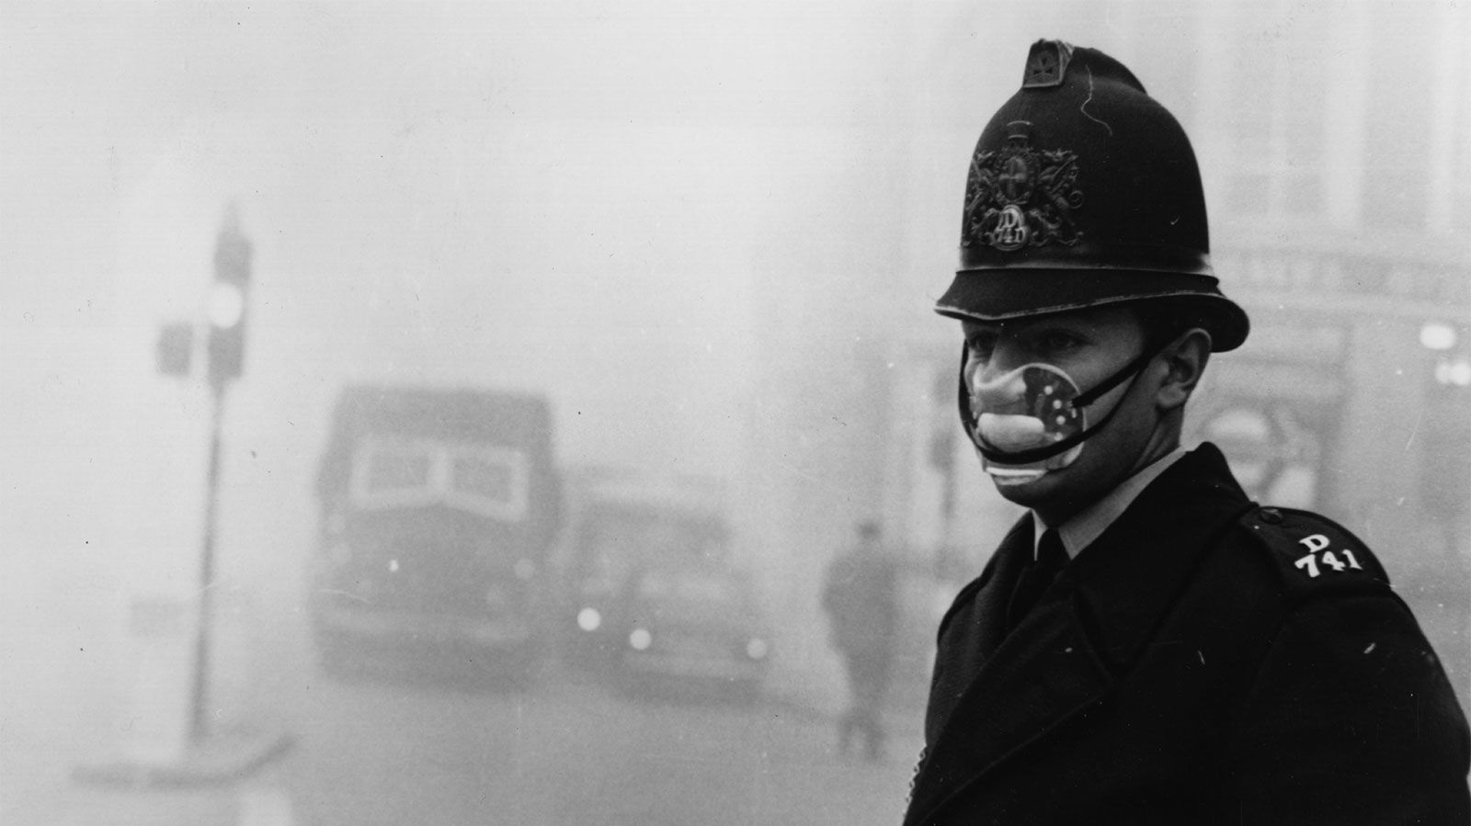
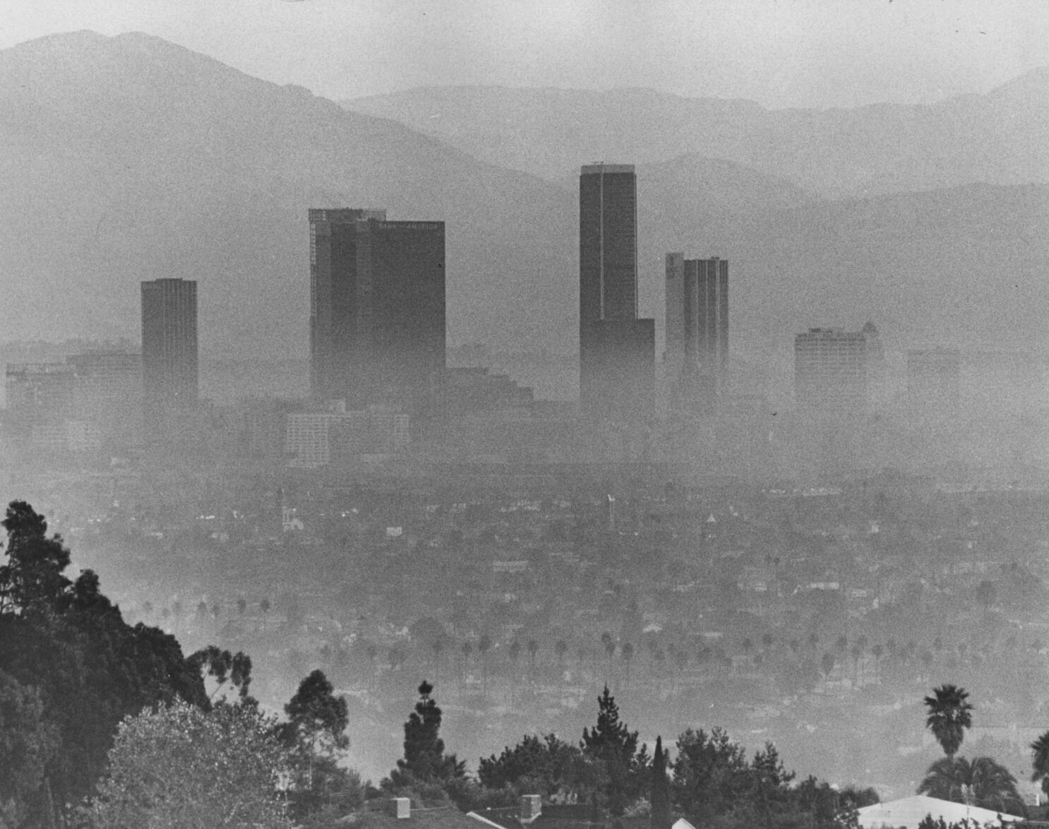
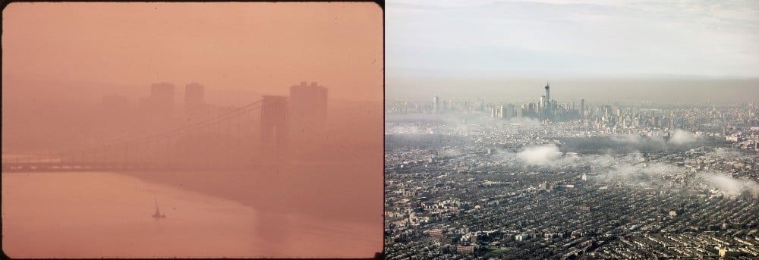
Conceptual Anchors: e.g.“Climate pollution”
London, 1952
L.A., 1960
L.A., 1973
L.A., 2013
Notes:
Pollution was the dominant organizing concept in early environmental policy. It framed environmental harm as a technical problem requiring regulation and control. Carbon-based concepts emerged later, especially with climate change. Importantly, calling greenhouse gases “carbon pollution” reframes climate change as a familiar air-pollution issue, enabling the use of existing legal frameworks. This shows how conceptual shifts can open—or close—policy pathways.

Slide 30

Meta-concepts
Problem or issue concepts
Mesolevel analytic or management concepts
Policy approaches & instruments
Notes:
certain environmental policy concepts play a particularly important role in structuring discourse and practice, in shaping the policy field and serving as a focus for reflection, analysis, controversy, and action
meta-concepts : these are the overarching ideas that offer structure to the entire environmental domain → Environment & Sustainability or Sustainable development
Problem or issue concepts: identify key topics for policy attention→ war on pollution, acid rain, ozone hole
mesolevel analytic or management concepts: deal with particular dimensions of policy, offer alternative lens to structure understanding, or indicate principles that should be applied when dealing with environmental problems → environmental policy integration, environmental security, ecosystem services, or the precautionary principle. Common but differentiated responsibilities
policy approaches and instruments → environmental regulation, environmental assessment, emission and effluent trading, or feed-in tariffs

Slide 31

Who builds these concepts and why?
Notes:
Conceptual entrepreneurs—individuals (politicians, scientists, and public figures) or organizations (research institutes, blue-ribbon panels, national environment agencies, and international organizations such as the UNEP or OECD), or industries—actively promote innovative ideas that articulate specific values, interpretations, and interests.
Just as physical infrastructure shapes future policy debate, so too does conceptual “infrastructure”

Slide 32
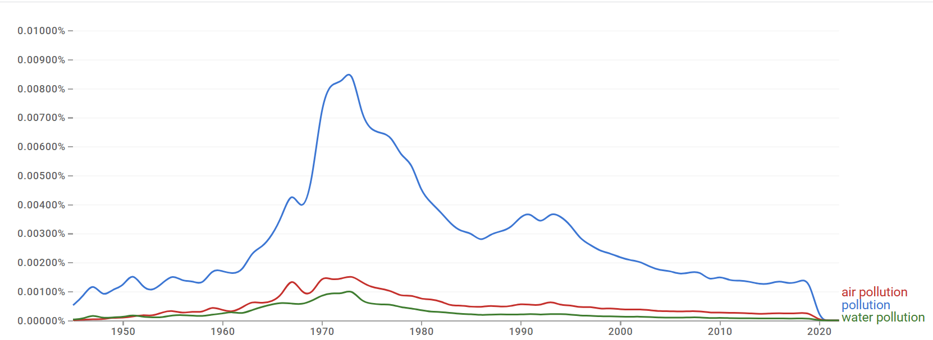
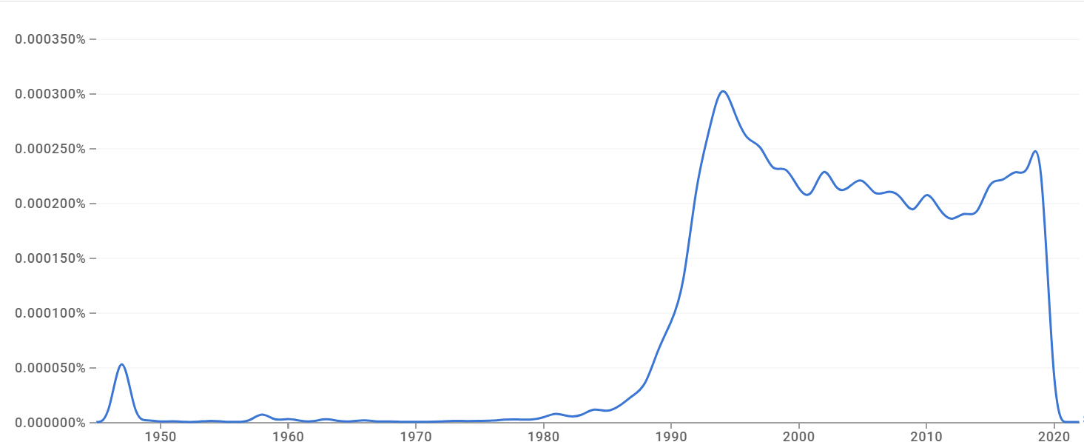
“Pollution”
The Evolution of concepts
“Sustainable Development”

Slide 33
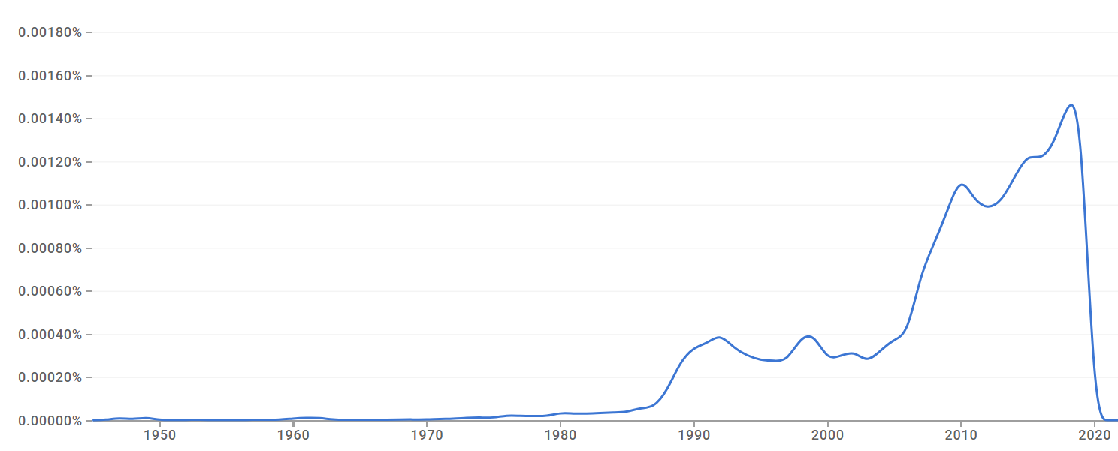
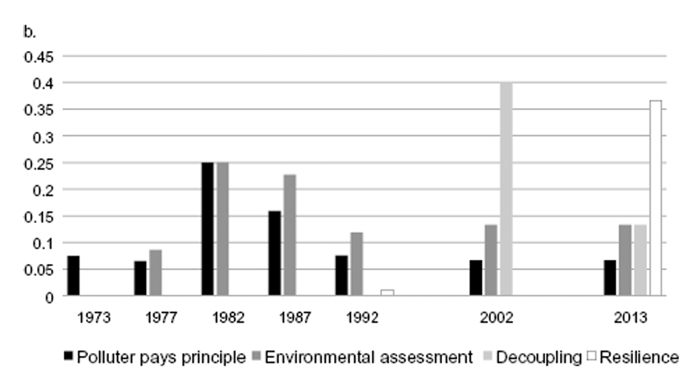
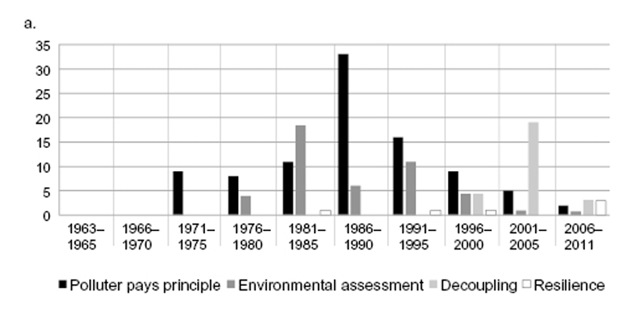
“Climate Change”

Slide 34
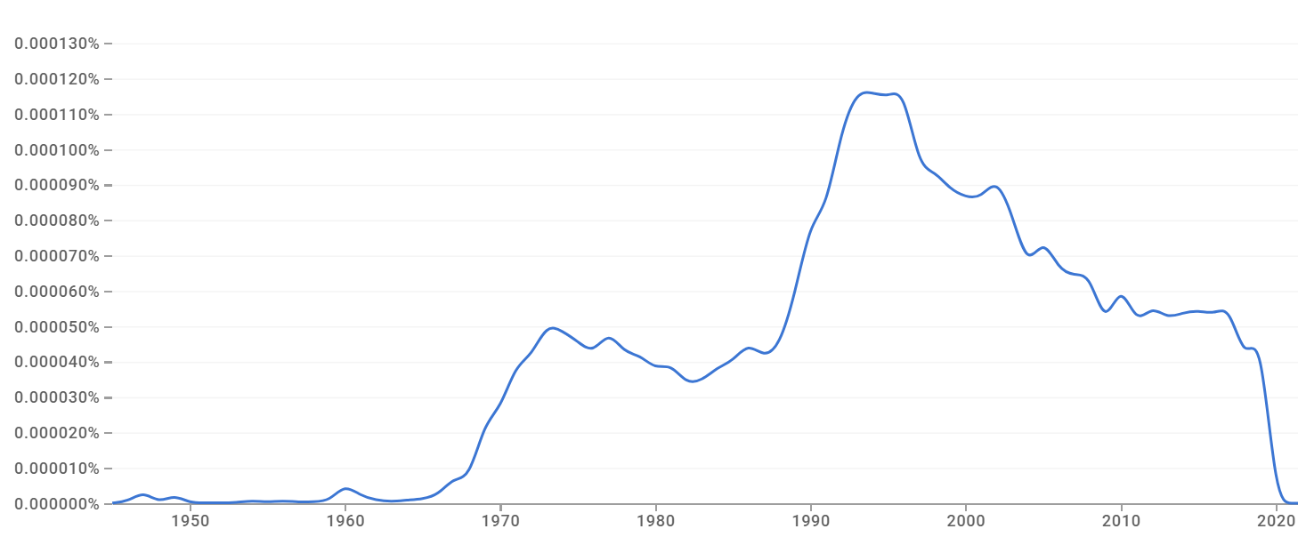

“Environmental Policy”
And now…?
Notes:
Prior to the 1960s, environmental policy did not exist as a distinct domain

Slide 35

Evolution of Environmental Policy Concepts Over Time
1970s: pollution and regulation
1990s: sustainability and integration
2010s: climate change and transformation
2020s: …
Notes:
One of the strongest contributions of the chapter is its historical analysis. In the 1970s, pollution dominated environmental thinking. By the 1990s, sustainable development became a central meta-concept, alongside market-based instruments and integration. By the 2010s, climate change emerged as the overarching problem, accompanied by ideas like resilience, carbon budgets, planetary boundaries, and the Anthropocene. The field has grown broader and more complex, not replaced itself.

Slide 36

Environmental Policy as a “Conceptual Field”
Conceptual struggle = policy struggle
Concepts shape policy possibilities
Concepts are interconnected, not isolated
Old concepts enable new ones
Innovation happens within existing repertoires
Notes:
The main takeaway from this chapter is that environmental policy is built on contested ideas. New concepts rarely eliminate old ones; instead, they accumulate and compete. Which concepts gain traction depends not only on scientific validity, but on politics, institutions, and power. Understanding environmental policy therefore requires paying close attention to language, framing, and conceptual innovation—not just outcomes.

Slide 37




Notes:
Final reflection: We can also change concepts and framings. E.g. Fear to Hope

