Slide 1
Survey Experiments
Jilke & Sniderman

Slide 2

Reminder: Extra Credit

Slide 3
REMINDER: FINAL PAPER
You should have started on at least a couple of the following sections (especially sample & data):
Sample—justify sampling strategy & critique external validity
Data sources & measures—Specify what variables will be in the analysis and how they will be measured as well as data source
  Pay attention to validity & reliability of measures
Research Design & Analysis Plan—justify your choice of design & provide all details necessary to evaluate internal validity
  How will you be analyzing the data? The details here will vary based on your method

Slide 4
REMINDER: DEADLINES
Final Project Presentation, 11/24
Draft of Proposal due to Another, 11/24
Peer Review of Another Proposal, 12/5
Proposal: Final draft, 12/8

Slide 5
Learning Objectives
Overview
What is a survey experiment? Why conduct one?
  Internal, external, and construct validity
  Between-subjects vs. Within-subjects design
Types of survey experiments
  Measurement/Split-Ballot
  Factorial/Vignette
  Conjoint
Page 5

Slide 6
What is a survey experiment?
An experiment embedded within a survey
“…studies in which the researcher controls the random assignment of participants to variations of the independent variable in order to observe their effects on a dependent variable.” (Mutz 2011, p.2; emphasis mine)
*Designing an effective survey experiment requires designing an effective experiment and an effective survey*
  If your dependent variable is about beliefs/policy preferences and you’re interested in the factors predicting those beliefs, this method is for you.
Page 6

Slide 7
Internal validity & Random assignment
Colors symbolize any differentiating attribute among the individuals (e.g.,
education, political views, extraversion)
Before Random
Assignment
Randomly Assign
After Random
Assignment
Control Condition
Treatment Condition
Page 7

Slide 8
Why Conduct a Survey Experiment?
Experiments address the fundamental problem of causal inference using randomization
Thus, they are excellent for internal validity
    Rules out alternative explanations/back doors
Caveat: Construct validity is how well a given set of measures represent the underlying concepts they are meant to quantify
  E.g. Does your “competence scale” actually measure competence? Does it
instead measure intelligence? Are these different?
BUT, low external validity
Page 8

Slide 9
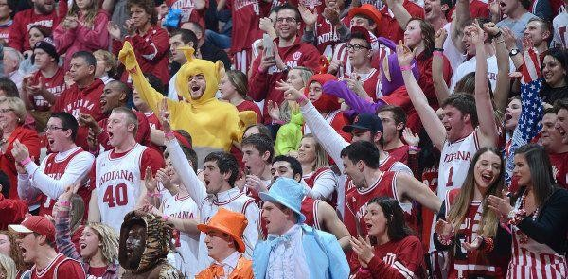
External validity
Why not just sample undergraduates?
  “College sophomores may not be people.” (Tolman quoting Hovland 1959)
  U.S. undergraduates are WEIRD (Western, Educated, Industrialized, Rich, Democratic) Henrich et al. 2010
Some research questions can probably be answered with a study on any sample (e.g. a convenience sample)
  Many research questions require more diverse/specific samples
Page 9

Slide 10
Example
Research question: does applicants’ educational attainment influence perceptions of a person’s competence and capability?
  Small group discussion:
    How would we test this in a survey experiment?
    What would be the sample?
    What would be the manipulation (treatment)?
    What would be the randomization strategy?
    What are the limitations of this experiment?
Page 10

Slide 11
Between vs. Within-Subjects Design
For our example research question: does educational attainment influence perceptions of a person’s competence and capability?
Would you want multiple “rounds” of respondents evaluating resumes? Or just one?
Characteristics of job applicant (IV)
DV/Outcome
College Degree
Perceived Competence
High School Degree
Page 11

Slide 12
Between vs Within-Subjects Designs
Between-subjects design: each participant (P) experiences only one of the experimental conditions
  E.g. only see a resume with a college degree or high school degree
Within-subjects design: each P experiences more than one of the experimental conditions
  Can be all of the experimental conditions; just a subset; etc.
    E.g. sees both a resume with a college degree and high school degree
Discussion Q: Would you want a between-subjects or within-subjects design for the example research question? What could be the pros and cons of each type of design?

Slide 13
Pros and cons of between and within subjects designs
Between-subjects designs are particularly useful when studying topics that (a) are time-intensive to study, and/or (b) are prone to social desirability
  E.g. To prevent fatigue effects, would not want to have P experience multiple conditions
  E.g. Studying race is extremely difficult due to social desirability. If you give a P two resumes (one with a stereotypical white name; one a stereotypical black name), participants may guess that you are studying race and thus not respond honestly due to social desirability

Slide 14
Within-Subjects Design
Within-subjects designs allow you to compare a participant’s responses to one experimental condition to their own responses in another condition
  Within-subjects designs are more efficient
    You greatly reduce the number of participants you need to survey because each participant responds to multiple experimental conditions
  MAY have internal validity when you’re comparing individuals to themselves

Slide 15
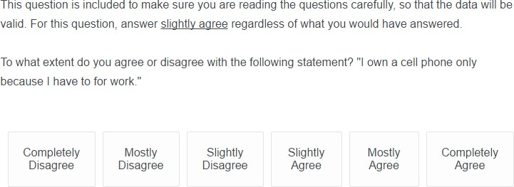
Best Practices
The experimental manipulation & DV need to be measured clearly and correctly → use prior literature as a guide!
Do an attention check
Pretest your study! With a manipulation check to make sure: 1) your instrument is effective; 2) your manipulation is effective; 3) you have variation on your dependent variables

Slide 16
Manipulation Checks
Manipulation checks are questions that verify that Ps noticed and understood your IV manipulation
  E.g. if your treatment is race/gender which you are signaling with names, a manipulation check could verify that the applicants are understood by the Ps as indicating the gender and racial group the researchers intend
PROBLEM: Manipulation checks are inherently suspicion inducing
  They ask Ps whether they noticed the thing you are studying! For this reason, manipulation checks are best for 1) pre-tests OR 2) must be asked at the end of the study after DV measures of interest have been assessed

Slide 17
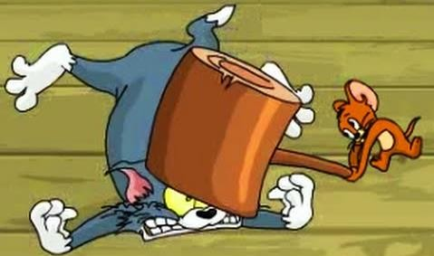
Designing Effective IV Manipulations
“Here is an important rule about creating experimental manipulations: SUBTLETY IS OUT OF PLACE IN EXPERIMENTAL DESIGN.” (Walker 2014)
When possible, it is a good idea to “hit it with the biggest hammer” possible the first time you try to study a proposed IV
a. Follow-up studies can refine your theory and scope – after you have established the causal relationship exists at all

Slide 18
SOME Types of Survey Experiments
Overview
This section is not exhaustive in its coverage of survey experiments. I cover the following commonly used types of survey experiments:
  Measurement/Split-Ballot experiments
  Vignette/Factorial experiments
  Conjoint experiments

Slide 19
Measurement/Split-Ballot Experiments
Different question wording may cause different answers; different question choices may affect answers; different instruction wording can affect answers; etc.
Belli et al. 1999* designed a clever survey experiment to test ways to improve questions about voter turnout (i.e. many Ps say they voted when they did not)

Slide 20
In talking to people about elections, we often find that a lot of people were not able to vote because they weren't registered, they were sick, or they just didn't have time. How about you—did you vote in the elections this November? Participants were randomly assigned to one of two different response options:
Condition 1 (“standard” choices)
I did not vote in the November 5th election
I voted in the November 5th election
Condition 2 (“experimental” choices)
I did not vote in the November 5th election
I thought about voting this time but didn’t
I usually vote but didn’t this time
I am sure I voted in the November 5th election

Slide 21
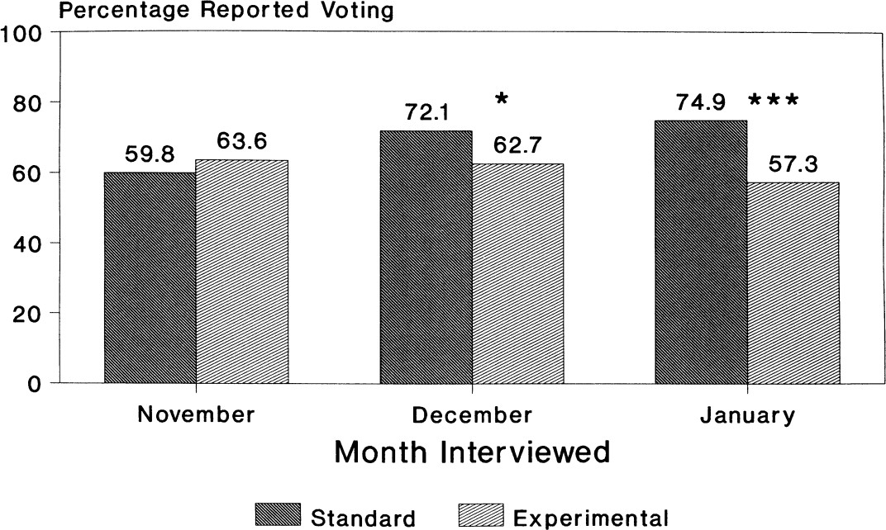
*Takeaway: reports of voting go up over time (and are less accurate) when only the standard yes/no response options are given

Slide 22
Vignettes (Most Common)
Vignettes are short descriptions or stories that vary across conditions only on key factors of interest
  These are most often a paragraph of text describing a person or situation
  Example: measuring difference in support for race-based vs. SES-based school integration

Slide 23
Factorial Design
Factorial design=more than one dimension of variation in vignette
  Example: measuring difference in support for race-based vs. SES-based affirmative action, across high & non-high achieving students
Factorial designs can be very powerful as they allow you to examine both the overall effects of an IV as well as its effects when presented in combination with other factors
  Social desirability combatted by varying many dimensions at once – making it difficult to ascertain what the manipulations are of interest

Slide 24
Example Factorial Vignette
Question: how does the target population shape policy support for affirmative action?
IV: Suppose the state flagship university in your state was changing the undergraduate admissions policy to emphasize expanding educational opportunity for [RANDOMLY ASSIGNED TARGET].
Racial and Ethnic minorities
High-achieving racial and ethnic minorities
Low-income students
High-achieving low-income students
  DV: To what extent do you support or oppose the policy described?
  Strongly Oppose
  Somewhat Oppose
  Neither Support nor Oppose
  Somewhat Support
  Strongly Support

Slide 25
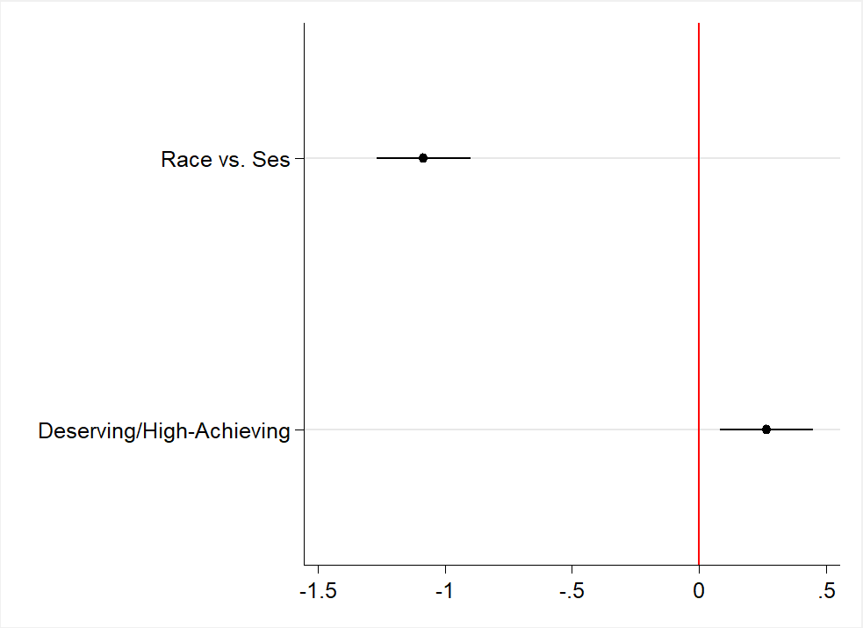
Results-Support for Affirmative Action

Slide 26
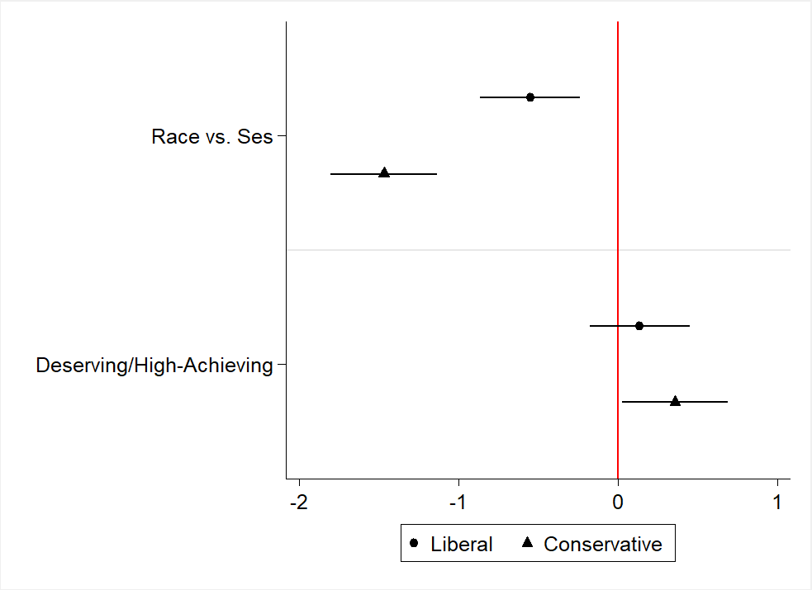
Results-Support for Affirmative Action

Slide 27
Conjoint Experiments
Independently randomize many different attributes & most of the time require multiple discrete choices between profiles.
Example: Who would you vote for in a primary?
Example Conjoint Task
Candidate 1 | Candidate 2
Far Right | Far Right
Bisexual | Straight
Christian | Atheist
No previous experience | State legislature
Bachelor’s Degree | Bachelor’s Degree
Latino | Native American
71 | 33
Transgender Man | Non-Binary
Table 1: Full conjoint experiment design with attribute order and options fully randomized (except for political affiliation)
Attribute | Levels
Gender Identity | Woman, Transgender Woman, Man, Transgender Man, Non-Binary
Sexual Orientation | Gay, Straight, Bisexual
Political Affiliation | Moderate Republican, Far-Right Republican; Moderate Democrat, Far-Left Democrat
Age | 33, 44, 56, 71
Race/Ethnicity | White, Black, Latino, Asian, Native American
Religion | Christian, Muslim, Jewish, Non-Religious, Atheist
Education | High School, Bachelor’s Degree, Master’s Degree
Political Experience | No previous experience, State legislature, US House of Representatives

Slide 28
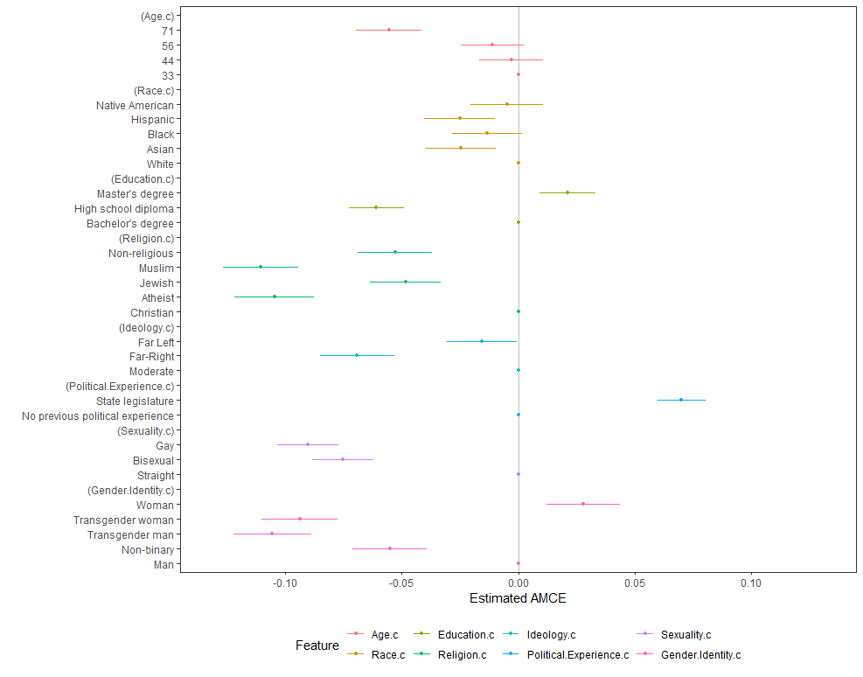
Who gets primary votes?
Less likely be selected
More likely be selected

Slide 29
Extra Slides

Slide 30
Stereotype Content Studies
Survey experiments are often used to assess attitudes, views, and stereotypes about various things
The stereotype content model (Fiske et al. 2002) is a popular model of assessing the “fundamental” stereotypes of warmth and competence for various social groups
a. Warmth and competence is considered in two-dimensional space, with the impact of stereotypes contingent on a group’s place in this space
Warmth and competence are latent variables measured using scales. Consider the competence scale:
How intelligent are members of this group? How confident are members of this group? How competent are members of this group? How independent are members of this group? How competitive are members of this group?

Slide 31
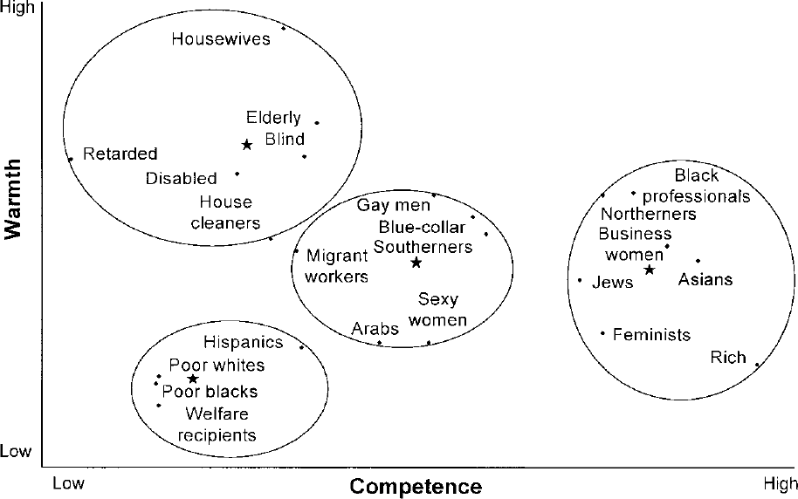
Fiske et al. 2002 JPSP

Slide 32
Designing continuous dependent variables
You should always design your instrument so you have continuous dependent variables (DVs) whenever possible
  Linear regression / ANOVA does not require a large sample
    Categorical DV models (e.g. multinomial logit) have lower statistical power than linear models and are usually estimated with maximum likelihood estimation (MLE) which requires larger samples for reliable estimates
  Experiments often have relatively small sample sizes
    Especially for between-subjects experiments, the n sizes per condition can be relatively small

Slide 33
Using scales for dependent variables
Using scales for your DVs is almost always a good idea
  Multiple categorical items can become continuous with scaling techniques
  Multiple items combined into scales can limit the impact of random error for any one item
The competence and warmth scales are good examples. In Mize and Manago 2018 SCur each item was asked as a 7-category ordinal item (anchored from 1 = “Not at All” to 7 = “Extremely”). The items in the scales are:
  Competence: intelligent, confident, competent, independent, competitive
  Warmth: tolerant, warm, good-natured, sincere

Slide 34
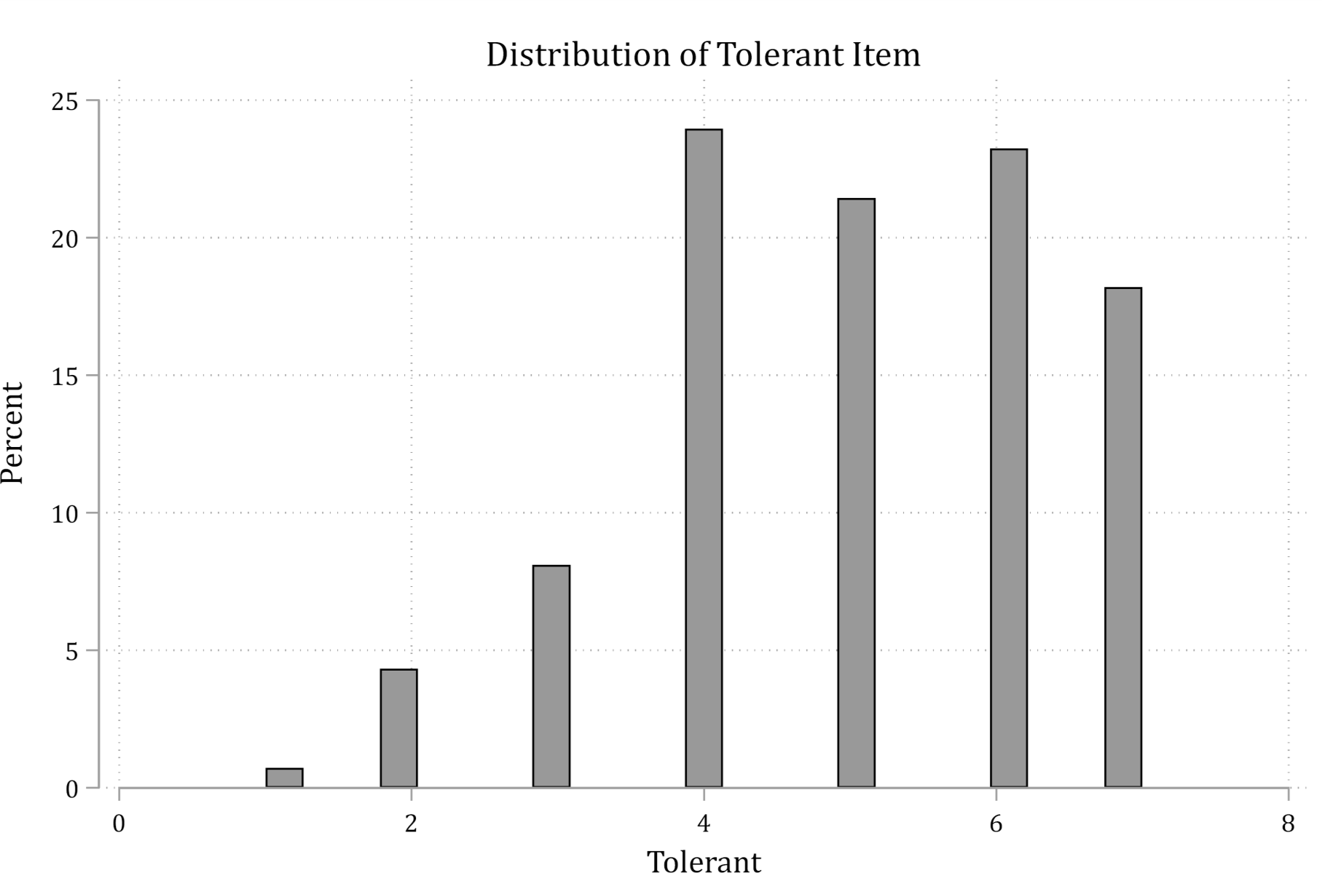

Slide 35
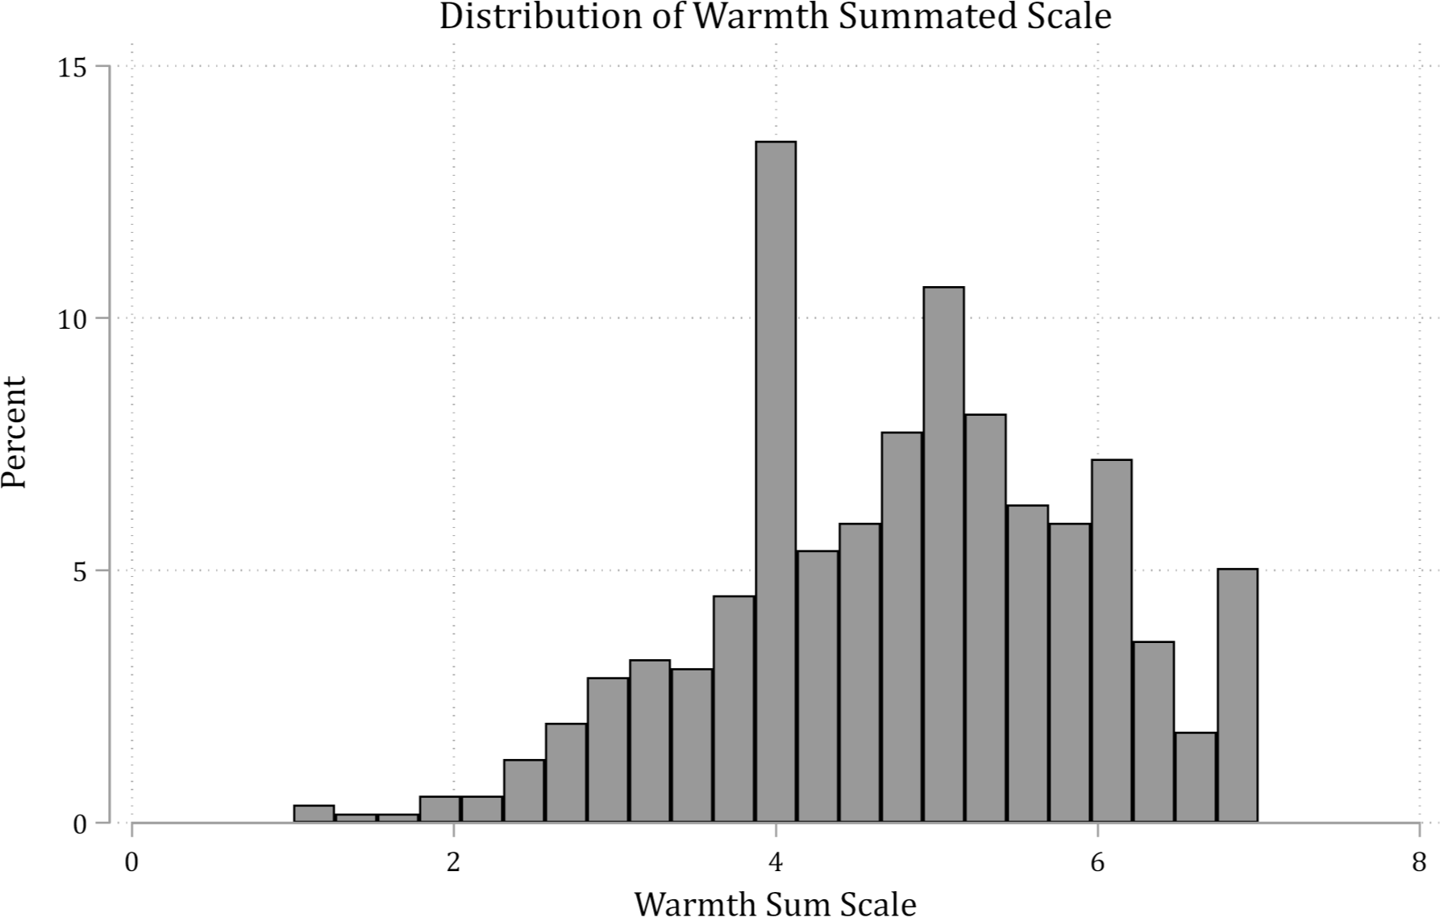

Slide 36
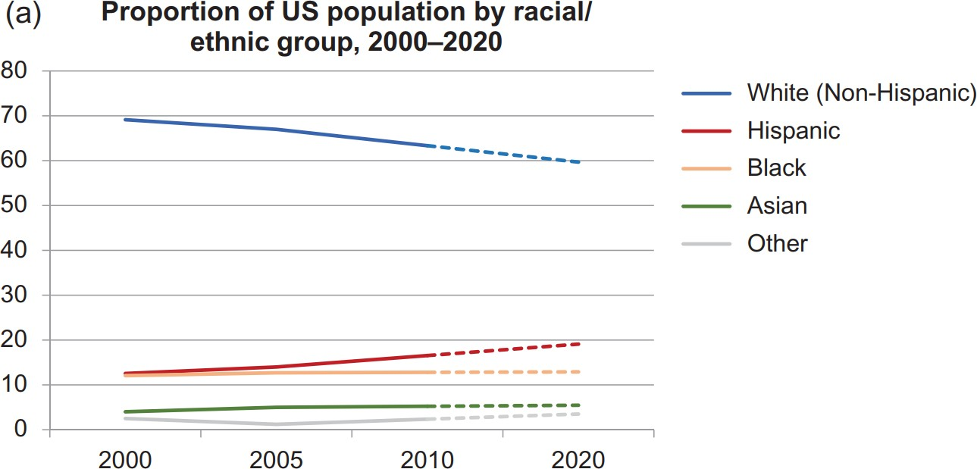
Group Position Experiments
1. How do demographic changes in the U.S. influence political attitudes? Wetts and Willer 2018 designed a very clever manipulation to study these effects

Slide 37
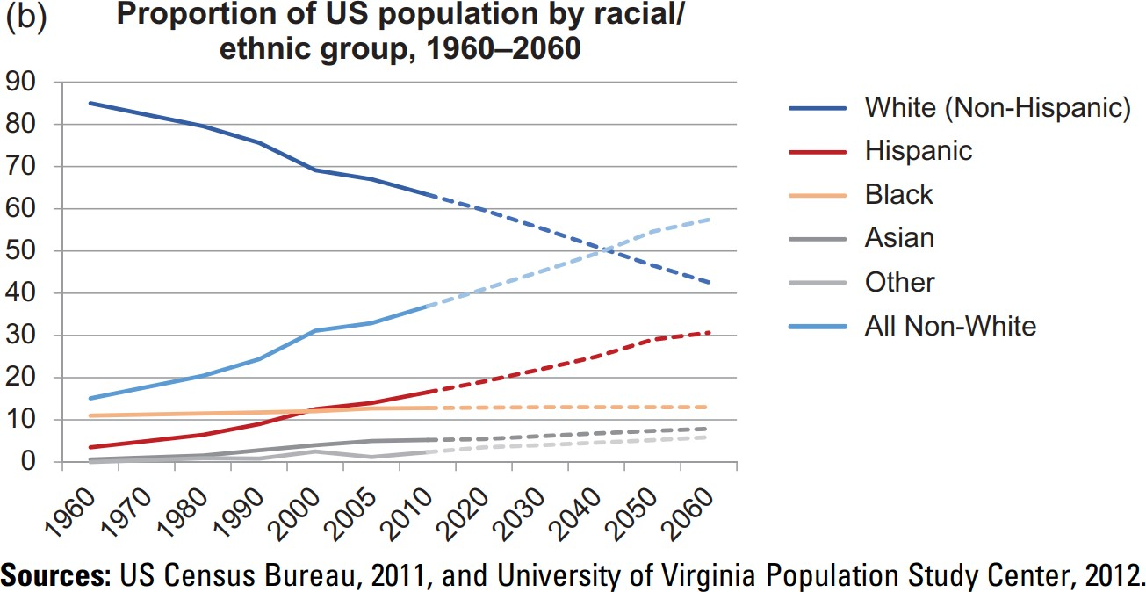
Wetts and Willer 2018
“Whites assigned to the Decline Salient condition reported significantly… higher levels of racial resentment… and opposition to welfare than those assigned to the Majority Salient condition.” (Wetts and Willer 2018 p.15-16)

Slide 38
Ethics and Deception
Is deception ethical in your experiment?
  If you’re an economist the answer is no
Sociologists, psychologists, political scientists, and other social scientists on the other hand, tend to argue that there are many questions—especially those that are due to unconscious processes and/or prone to social desirability—that are difficult to study and come to accurate conclusions about without deception
  E.g. Imagine asking a participant:
“We are interested in whether people consider race when evaluating job applicants. Please view these two identical job applicants that we artificially created: one is the resume of an equivalently qualified white man; the other is an identical resume except we intentionally made their name sound
stereotypically black. Who do you think is more qualified?”
    You don’t really expect truthful answers do you?

Slide 39
Addressing and justifying deception
“Similarly, economists who review experimental work for granting agencies, including some foundations, raise this point in an effort to impose their standards of research (or rules of the game) on experimentalists in other social-science disciplines. {Footnote 3: Both of the authors of this essay are familiar with actual examples of manuscripts being rejected on these grounds and for major revisions being required (often involving the waste of subject and investigator time) to avoid deception in the proposed research as a condition for awarding funds.}” (Cook and Yamagishi 2008)
It is difficult to know whether use of deception will be questioned or not
a. For most sociology journals, reviewers do not question the validity of the researcher based on whether deception is used (this is especially true for journals that often publish experiment work, e.g. Social Psychology Quarterly)
For more general audiences and funding agencies, best to address use of deception directly – just in case
Is there scientific evidence that using deception is bad for science by “spoiling” the subject pool? No. Quite the opposite (Barrera and Simpson 2012)

Slide 40
Hiring Studies
Race, sexual orientation, and hiring (Pedulla 2014 SPQ)
Mock hiring studies often present job applicants / workers for participants to evaluate
  These often use resumes that are identical on all aspects except for characteristics of interest (e.g. race, gender, sexuality, etc.)
  Can use other materials—be creative!
    I have used performance evaluations, job interview notes, etc.
Pedulla (2014) manipulated the race and sexual orientation of job candidates (all applicants were men)
  Race was manipulated via the names on the resume, as is commonly done
    But note my strong cautions on this in the following slides
  Sexual orientation was manipulated via “leadership experience” in a LGBT club

Slide 41
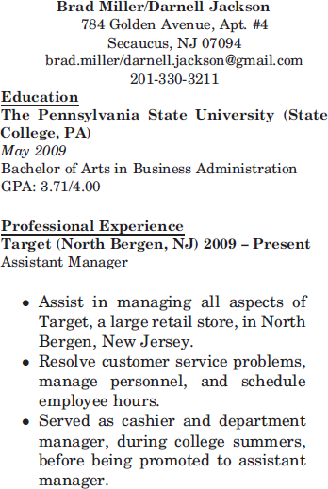
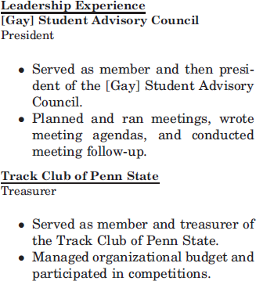

Slide 42
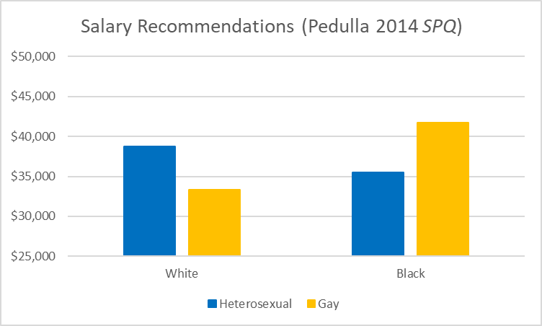

Slide 43
Measuring continuous dependent variables
It is good practice to restrict dependent variable ranges for things such as salary recommendations, bonuses, etc.
  This helps make the responses more meaningful/easier to interpret
  This also prevents problems for the statistical analysis
    E.g. What do you do with the P who recommends a $1 million bonus? A $0 starting salary?
Many hiring experiments (e.g. those conducted as survey experiments) reach a diverse set of participants (from diverse educational, SES backgrounds, etc,)
  Do not assume all participants have extensive knowledge of the type of occupation you are studying
  It is almost always helpful to provide starting points/context to help make participant responses meaningful

Slide 44
Putting dependent measures in context
E.g. “What starting salary would you recommend for this applicant?” is not a great question because most people have no idea how much most people are paid for specific jobs
  A better question: “On average, individuals in this occupation earn about
$50,000. If you were to hire this applicant, what starting salary would you recommend?”
  OR: “Company X has the discretion to pay individuals in this position a starting salary between $35,000 and $65,000. If you were to hire this applicant, what starting salary would you recommend?”
    Note: Most survey platforms (including Qualtrics) allow you to force responses to be values within a specified range

Slide 45
Using names to manipulate race
If you are considering manipulating race/ethnicity via names, consider whether there is an alternative
Names are not always unambiguous signals of things like race/ethnicity
  Also consider what other factors (SES, place of origin, etc.) are conveyed by names
    Gaddis (2017a) on selecting Hispanic names
    Gaddis (2017b) on selecting black American names
The names needed to consistently convey race/ethnicity have to be very stereotypical
  “… only 18.9 percent of black children born in New York during this period (1994 – 2012) have a name that is racially distinctive as black (more commonly given by black rather than white mothers).” Gaddis 2017b

Slide 46
Using names to manipulate race
Many past studies show that using a highly racialized name does lead to different treatment of black and white, e.g., job applicants
  These names lead to racialized stereotypes being activated
  However, at the cost of possible generalizability
    Do you want your results to be indicative of how “black Americans with very stereotypically black names” would be evaluated or how “the average black American” would be evaluated?
Alternatives to names
Pictures can be used to signal race/ethnicity for some groups (e.g. Doan 2016)
  Pictures also tend to elicit less suspicion than names
Some forms may contain information on race
  E.g. Patient-intake forms have check boxes for race/ethnicity

