Slide 1
Session 4: Intro to the Toolbox of Methods, Measurement, and Sampling
Johnson & Reynolds Ch 4 & 7
Creswell Ch. 1

Slide 2
In this Session:
Matching a question to a method
Sampling
Measurement

Slide 3
Sampling
Pure Random Sample – Probability is best
  Stratified can be useful
Convenience
  Snowball
  Quota - Representative

Slide 4
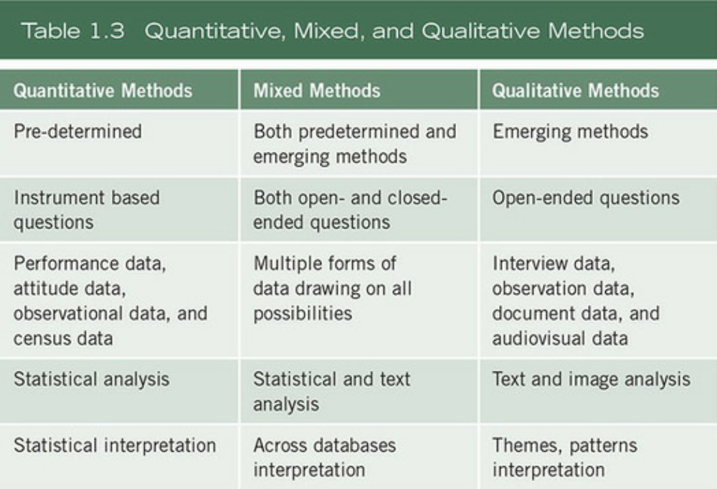
Types of Research Design
Quantitative
  Experimental or Quasi-experimental
Qualitative
Mixed-methods (both quant & qual)

Slide 5



When to use each method
Quantitative: For example, if the problem calls for (a) the identification of factors that influence an outcome, (b) the utility of an intervention, or (c) understanding the best predictors of outcomes.
Qualitative: If a concept or phenomenon needs to be explored and understood because little research has been done on it or because it involves an understudied sample
Mixed-methods: when the quantitative or qualitative approach, each by itself, is inadequate to best understand a research problem. For example, a researcher may want to both generalize the findings to a population as well as develop a detailed view of the meaning of a phenomenon or concept for individuals.

Slide 6

Measurement

Slide 7
Topics
From Concepts to Measurements
Quality of Measurements
Reliability
Validity
Measurement Design: Types of Measurements
Notes:
Relationship between two steps. How can we go from conceptualization to operationalization.
Type of measurement: provide you with some options of developing measurements

Slide 8
From Conceptualization to Operationalization
Conceptualization: Refine and specify abstract concepts you are interested in explaining
Establish hypothetical relationship between them
Operationalization: Development of specific procedures that will result in empirical observations representing those concepts in the real world.
→ Measurements(operational definition): Indicators of the presence, and the magnitude of the concepts in the real world
Voting
“Did you vote in the last…”
Political
Participation
Campaign contribution
“Did you contribute to …”
Attend political rally
“Have you attended a …”
Notes:
After we developed the conceptual framework, today we are going to discuss how we proceed to the operational stage. Ask students what is measurement?
Trust in Lundin: ‘‘To what extent do you assume that the PES ofﬁce (municipality) reveals true motives to you?’’ Existence. “To what extent” measures magnitude or degree of trust. Theses are something you can observe in the real world
‘To what extent do you assume that the PES ofﬁce (municipality) performs in line with its promises?’’

Slide 9
From Concepts to Measures
Theory
abstract
Concept
Return on Investment + Satisfaction
Definition
The level of satisfaction combined with the
return on investment, which is the cost relative to wages.
Measurements
(Operational
definition)
Indicators/measurements of satisfaction to the
following five questions:
I am satisfied with the content I learned in my degree
I am satisfied with the instruction I received
I am satisfied with the cost of my degree
I am satisfied with the value I gained from my degree
I use the skills I developed in my coursework
Data
Concrete
Data
Survey data among recent graduates of FSU
Notes:
How to decide which measurement you want to use to measure the concept in your research? They are a lot of options for measurement. You want to start from your concept. Connection with previous steps: From abstract to most concrete. I will give you an example to show how to go from concept to measurement.
Existence of cooperation, degree of cooperation: score (add up the score for each item)

Slide 10
Measurement Design: Different Types of Measurements

Slide 11
Levels of Measurement
Nominal Measures
Attributes of a variable represents exclusive categories
e.g. race/ethnicity
Ordinal Measures
- Variables with attributes we can logically rank order
e.g. Education level (high school, college, graduate), Attitudes (by
degrees of agreement)

Slide 12
Interval Measures
- Attributes of a variable are rank-ordered, and have equal distances
between adjacent attributes. The distance has meaning.
e.g. Grades in school (7th grade, 8th grade etc. )
Ratios Measures
Involves the full mathematical properties of numbers. The zero point has a true meaning (absence of the characteristic being measured)
e.g. ages, unemployment rates, weight, height

Slide 13
Levels of Measurement
Information Provided by the Four Levels of Measurement
Information Provided | Nominal | Ordinal | Interval | Ratio
Classification | X | X | X | X
Rank order |  | X | X | X
Equal intervals |  |  | X | X
Non-arbitrary zero |  |  |  | X

Slide 14


Measurement examples
What should be the level of measurement + categories for:
Gender
Race/ethnicity
Unemployment rates
Income
Trust in government

Slide 15
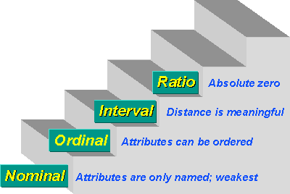
Measurements: Level of Precision
Data that could be collected numerically are often collected categorically.
Try to collect your data at the more detailed/precise level. You can always aggregate them to a less precise level.
e.g. Income→ Income Groups
Age→ Age Groups
Notes:
When data that can be measured by ratio measurements collected at ordinal or interval level, it sometimes causes problems. E.g. intervals or groups may be classified differently in different surveys. It is hard to combine them together.

Slide 16
Multi-Item Measures: Index
Index is often used to measure attitudes or very abstract concepts because they are complex or abstract and we usually do not know enough about them to devise single-item measure.
A summation index (additive index) is constructed by accumulating scores on individual items to form a composite measure of a complex phenomenon.

Slide 17
Index in Scale Format
In practice, index is often constructed by using scales.
Scaling is the assignment of objects to numbers according to a rule.
Most commonly used types of scales:
Dichotomous Questions
Likert Scales

Slide 18
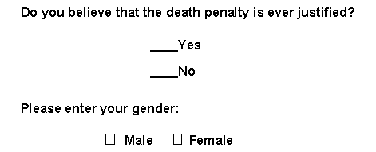

Dichotomous Questions
Response to the question has two exclusive options. Usually, you can assign 1 or 0 to the responses.

Slide 19
Index Using Dichotomous Questions: Measuring Level of Freedom
Country # | 1 | 2 | 3 | 4 | 5
Privately owned newspapers | 1 | 0 | 0 | 0 | 1
Legal right to form political parties | 1 | 1 | 0 | 0 | 0
Contested elections for public offices | 1 | 1 | 0 | 0 | 0
Voting rights for most of the adults | 1 | 1 | 0 | 1 | 0
Limitations on government’s ability to incarcerate citizens | 1 | 0 | 0 | 0 | 1
Index score | 5 | 3 | 0 | 1 | 2
1= Yes; 0=No.
Notes:
Talk about Lundin again

Slide 20
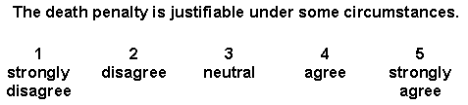
Likert Response Scale
A Likert Scale question asks a respondent to indicate a degree of agreement or disagreement with a specific statement.

Slide 21
Evaluating the Accuracy of Measurements
Reliability & Validity

Slide 22
The Accuracy of Measurements
Inaccurate measurements may lead to erroneous conclusions.
Questions to consider:
1) To what extent are you measuring what you intended to measure? → Validity
2) To what extent your measurements can produce same results over repeated applications? → Reliability

Slide 23
The Accuracy of Measurements:
Validity and Reliability
Validity is more important, but reliability is more easily tested
Low V
High R
Low V
Low R
High V
High R
Low V
Low R
Notes:
Ask student to talk about each one? Repeating shooting to the bull’s eye
Failure of reliability: Shots are randomly distributed around the target.
Failure of validity: shots are systematically off the target.

Slide 24
The Accuracy of Measurements: Reliability
Reliability: Stability and consistency of the measure
Notes:
Usually used in survey or written test . I like the analogy in the reading.

Slide 25
Methods to assess and ensure measurement reliability
  1) Test-Retest method
  e.g. Ask the same respondent to answer the same survey again; use standard test to measure a student’s academic performance multiple times.
  - Same test, Same observations
  - Two times with some time interval

Slide 26
  Potential problems:
  - Characteristics of your observation have changed
  - Administration of the first test affects the second test
  e.g. GRE or other standardized tests

Slide 27
The Accuracy of Measurements: Reliability
2) Inter-coder reliability (qualitative research)
- Design a set of measures and ask different coders to code the text
Check the degree to which different raters/observers give consistent code to the same phenomenon
‘Disgusting’ study rating attractiveness of women with endometriosis retracted by medical journal | Endometriosis | The Guardian

Slide 28
3) Using established measures
Use measures that have proved their reliability in previous research → another goal of literature review

Slide 29
The Accuracy of Measurements: Validity
Validity: the extent to which an empirical measure adequately reflects the real meaning of the concept under consideration.
Criteria to assess measurement validity:
  1) Face validity: Does it appear to measure X? → judgement based on common sense
Notes:
A high correlation would provide evidence for predictive validity -- it would show that our measure can correctly predict something that we theoretically think it should be able to predict.

Slide 30
  2) Content validity: Does it include the full domains of a concept
  e.g. Political participation: voting, campaign contribution, attending political rally OR deservingness: CARIN +

Slide 31
  3) Predictive validity, or criterion-related validity
  The degree to which a measure relates to some external criterion.
  e.g. College board exams→ It is valid if it can predict students’ success in college

