Slide 1
Session 3: Lit Reviews and Conceptual Frameworks/Theory
Ch. 3 Creswell
Notes:
Conceptual framework sets up the issues you want to observe or you want to use empirical data to prove.

Slide 2
Check in on Research Topics
Thumbs up if: you’ve got a solid question that you feel confident about
Thumb middle if: you’re sure about your topic but not sure about the specific question
Thumb down if: you’re struggling and could use some help troubleshooting the question

Slide 3

Discussion on Laenen article

Slide 4
Theoretical Frameworks & Hypotheses

Slide 5
Initial Steps to Set Up Your Research
Specify the policy problem & the research question.
Conduct a literature review.
Propose a suitable explanation/theory for phenomena under study.
Formulate testable hypotheses.
A hypothesis is an explicit statement that indicates the variables of interest are related.
  They may not turn out to be correct or true (empirically)

Slide 6
Proposing Explanations & Variables
Proposing an explanation involves identifying other phenomena that we think will help us account for the object of our research and then specifying how and why these two (or more) phenomena are related.
Notes:
Introduce related concepts: dependent variable and independent variables.

Slide 7
Dependent variable(DV): the phenomenon (e.g. characteristics or behaviors of the research object) the researcher is interested in explaining and predicting
Independent variables (explanatory variables): variables (phenomena) that influence or explain the dependent variable. → usually more than one phenomenon is needed to explain the DV

Slide 8
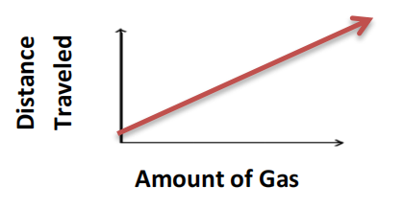
Discussion
Give me examples of potential independent and dependent variables (can be anything, doesn’t have to be related to your project)
What would a graph look like if you plotted outcome on the y axis and the independent var on the x axis?
Grade on final paper
Time spent in office hours

Slide 9
Proposing Explanations & Variables
Control Variables: A means of ruling out variables that are not of immediate interest
Language for Experiments
More accurately – covariates
Potential confounders

Slide 10
Covariates
They are variables that also affect dependent variables and may also be correlated with independent variables
However, they are not of immediate interests of your research project. You need to rule out these alternative explanations. Otherwise, they will threaten the validity of your findings.
In your research, you generate hypotheses regarding variables of interests. You don’t need to propose hypotheses for control variables.

Slide 11
Small Group Activity—Covariates
If you were to tell me how a promise of free college for all students attending LubbockISD high schools impacts college access and graduation, what would be your theory as to why?
  The independent variable is: tuition-free college
  The dependent variable is: college enrollment & graduation
1) Control Variables: What would be related to my dependent variable, that I would want to control for to rule out alternative explanations?

Slide 12
Formulating Hypotheses
Characteristics of Good Hypotheses:
1) It is an empirical statement that establishes how one variable (IV) is linked to outcome (DV).
  Normative: “Democracy is the best form of government”.
  Empirical: “Democracy is expected to lead to more economic growth in a country”
2) It is generalizable
3) It is plausible: provide justifications for the expected relationship
4) It is specific: directional (positive or negative)
5) It is testable.
Notes:
empirical: not a normative statement, relationship between two variables. How one thing affect the other. It is about whether a fact is true. It is not a judgement. E.g. “Democracy is the best form of government”. → “Democracy is expected to lead to higher economic growth in a country”
Generality: not to a specific case
Plausible: there should be some logical reason for thinking that this might be confirmed. 1) Researcher’s discretion based on instances → induction (going from specific knowledge to general knowledge) e.g. Krause paper: if I observe that NYC has large city size and abundant financial resources, they have special unit in charge of sustainability. This might be a true for other cities.
Deduction: Krause paper: If a government has strong executive branch, the chief executives want to seek control over everything because they are held accountable for general performance of the government. → If a city has mayor-council forms of government, more likely to place sustainability management in the executive.
4. Specific: directional, positive or negative relationship
5. Consistent with your data, show how you are going to test it → operationalize
6. Testable: possible and feasible to obtain data

Slide 13

Defining Concepts
Concepts in social sciences are often abstract and lack of completely precise and shared meaning.
Clear definitions of the concepts in hypotheses are important:
Developing measurement
Communication
2 ways to define concepts:
Making the meaning explicitly.
Reviewing and borrowing definitions developed by others in the field.

Slide 14
Formulating Hypotheses: Causal Relationships
It is useful to think in terms of cause-and-effect relationships
More formally, social scientists require at least three kinds of evidence to establish causality
1) Association
Variables must be associated in a statistical sense

Slide 15
Causality and Good Hypotheses
2) Direction of influence
A cause must precede its effect/direction of influence should be from cause to effect

Slide 16
Causality and Good Hypotheses
3) Non-spuriousness (elimination of rival hypotheses)
- Spurious relationship occurs when a correlation has been produced by a third factor and neither of the variables involved in the correlation has influenced the other.

Slide 17
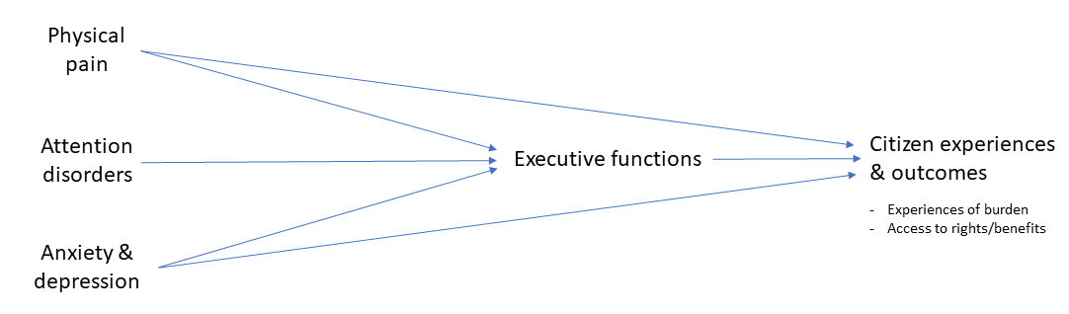
Formulating Hypotheses
Arrow Diagram/Path Diagram: A handy device for presenting and keeping track of complicated explanations or relationships among variables.
Logic Models: Visual representation of program inputs, activities, outputs, and outcomes.

Slide 18

Exercise: Identify variables
For your paper:
What are your dependent variables?
What are your independent variables?
What are the possible covariates? (i.e. what are other variables that may be related to your dependent variable that could confound your estimates?)
Write out a draft of one of your hypotheses.
Draw an arrow diagram explaining how your IV impacts your DV

Slide 19
Evaluate hypotheses with peers
With partners, evaluate:
1) Is the hypothesis normative or empirical? Is it testable?
2) What are other variables they may want to include as controls?
3) Causal mechanism: What are the explanations underlying the relationship they predict? How will the IV impact the DV?
4) What assumptions are they making about the causal mechanism? What external factors may be at play?

Slide 20
Logic Models
For many of you, it may also be helpful to create a logic model.
You probably have a solid idea of the goal, but what about:
  Assumptions
  External factors
  Inputs/activities
Take the remaining time to fill out as many boxes as you can, which should also reveal to you which elements you need to work on.

