Slide 1

Session 2
Research Question and Lit Reviews
PUAD 5319
wwehde@ttu.edu
Office: 14 Holden Hall, hours – 2:30 – 5:30 Mondays

Slide 2
In this Session:
Review good research questions…
Discuss Christensen
Literature reviews
Start?
Conceptual Frameworks

Slide 3
Phase 2: Specifying Research Questions
A general research question can be further broken down into several sub-problems. It makes your research question more specific.
Three main concerns that help the researcher narrow down the problem to researchable questions:
What entities (individual, people, groups, formal organizations, nations) are to be studied → Unit of analysis
What aspects or characteristics of these entities/phenomena are of interest → Variables
What kinds of relationships among the characteristics are anticipated → Relationships between variables
Notes:
Thinking about theses questions will link you to later steps, formulating hypotheses, measurement, sampling
Unit of analysis directly determines your observation.

Slide 4
What makes for a good research question?
It passes the “so what” test
It is stated in researchable terms.
It is answerable with empirical evidence
It helps us understand the way the world works
It is feasible (i.e. data is available & you can measure the outcome)
It has an appropriate unit of analysis
It is narrow enough for a class paper
  Does the question tackle a problem that is too large for one research paper? (e.g. What are the determinants of social mobility?)

Slide 5
Developing a Literature Review
Creswell Ch. 2

Slide 6

Goals of Literature Reviews
To evaluate the state of knowledge or practice on a particular subject—this involves critical analysis and synthesis
Lit reviews aren't about you: how much you've read, how harshly you can critique. They're about your reader: what does s/he need to know to position your research question and proposed answer in the field?

Slide 7

Goals of Literature Review Process
Highlight the areas of agreement and disagreement in past research—this can help refine your research question!
  Organize based on themes, not individual studies
Identify the “gaps” that exist in past research:
  Theoretical
  Methodological
  Sample/Data
  Empirical Findings

Slide 8
Steps in Developing Literature Review
Step 1: Search & find key studies
Step 2: Summarize
Step 3: Synthesize, cite & write
Step 1: Define the scope of the literature review:
  What key words?
  What disciplines?
  What timeframe?
  What research methods?
Literature Review Tutorial
Notes:
Non-linear process: the second point: you can swap that, you do literature review first and you find the gap→ which help you narrow down and find your research question.

Slide 9
Steps in Developing Literature Review—Step 1 Search for key studies
Use search engine or library database to search those articles.
Google Scholar
Web of Science
2. Consult with the subject librarian
3. Use this new resource, that provides a map of key studies and how they are connected https://www.connectedpapers.com/
Notes:
Show an example, google scholar, gun control policy, citations/date

Slide 10

Go Down the Rabbit Hole—Step 1 Search for key studies
Identify the relevant literature to review:
Start with relatively recent literature reviews.
  Like today’s article – coherent, theory based.
  Or, more systematic.

Slide 11
Back tracking
Look at key studies identified in these works—Look at the references of those studies.
  Foundations

Slide 12
Forward tracking
Look at the “cited by” on Google scholar to get the most recent articles.
  The “Future”

Slide 13
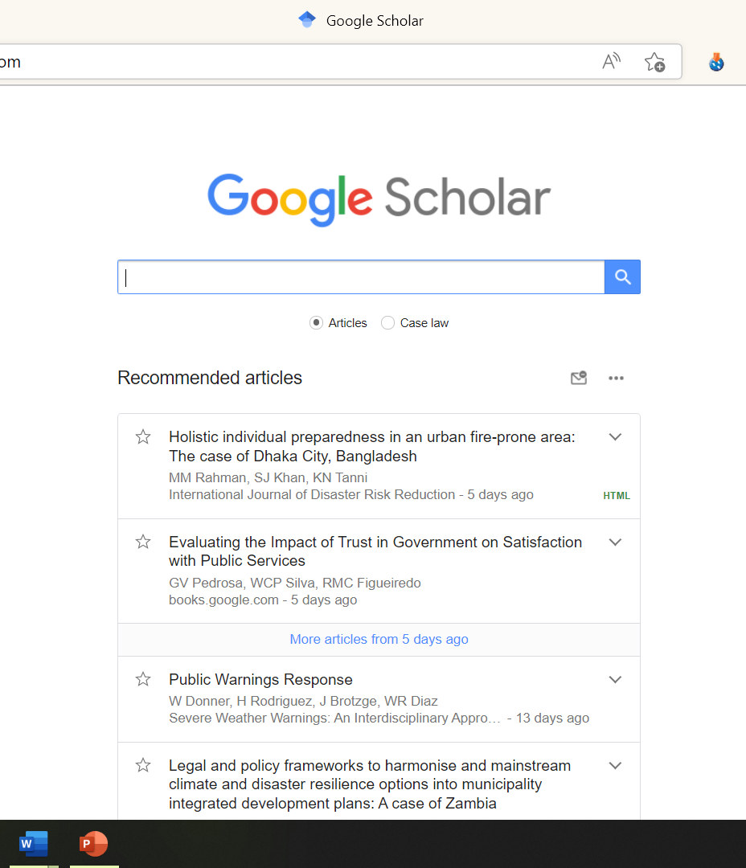
Step 1 Search for key studies (20-25 minutes)
LET’S DO IT!

Slide 14
Identify 2 key studies that you can use in your paper.
  For these studies, go to the “cited by” and identify a third study that is perhaps the most recent
  Go to https://www.connectedpapers.com/ and identify key authors/papers
Save in a folder on your computer so you can read later. Organize into subtopics if you have the time!

Slide 15
Steps in Developing Literature Review: Step 2—summarize
Read and take organized notes on each paper based on key categories you want to focus on:

Slide 16
NOTES
Research questions examined
Theoretical framework
Research design
  Data sources, sample, and measures
Key results
Strengths & Limitations
  Future research/gaps

Slide 17
Extra Resources – Wesley Wehde, Ph.D. (wwwehde.com)
Use Academic Article reading worksheet?
Organize the results of your literature review into themes using the spreadsheet?

Slide 18
Step 2—summarize (10-20 minutes)
Open the Literature Review spreadsheet & save on your computer
Enter key information for the 2 studies you identified earlier
If you have time, enter links for other studies to look at later
Alternative way to take notes & save studies: Citation software
  Zotero demonstration

Slide 19
Steps in Developing Literature Review—Step 3 synthesize
*Organize your literature review around themes and not discrete studies*

Slide 20
Pull the results of the literature review together
  What are the areas of agreement or disagreement?
  What are the reasons for the disagreements? (different theoretical lens, different methods, different samples, etc.)
  What do the disagreements indicate about gaps in research and possible contributions you can make.
  What hasn’t been said about your topic? → gaps

Slide 21
Example wording: e.g. “Empirical studies on X generally support a positive relationship between A and B (Author A, 1999; Author B, 2003; Authors C & D, 2010). However, empirical support for significant positive effects is not universal (Author E, 2012).”

Slide 22
Example of organizing literature review results in a table
Table 1. Policy Designs and Findings from Published Promise Research on Postsecondary Outcomes
Program | Structure | Eligibility Requirements | Findings
Kalamazoo Promise | First-dollar aid covers tuition & fees at any public institution in Michigan | Attend Kalamazoo Public School; 2.0 GPA and 12 credits per semester in college | Increase in college application, enrollment, credits attempted, persistence and attainment (Bartik et al. 2019; Andrews et al. 2010)
El Dorado Scholarship | First-dollar scholarship covers tuition at any college in the country (capped at the highest tuition and fees at an Arkansas public university) | Attend high school in El Dorado School District from kindergarten-12th for 100% or 9th-12th for 60% of scholarship | Increase in college enrollment and bachelor’s degree completion. Null impact on associate’s degree completion (Swanson & Ritter 2018)
New Haven Promise | First-dollar aid up to $10,000 per year covers tuition at all public college in Connecticut. Includes student support system. | 40 hours community service in high school, 3.0 GPA or higher in high school, 90% attendance rate in high school, Attend school and reside in New Haven, no expulsions in high school. In college, student must maintain a 2.0 GPA in first year and 2.5 GPA afterwards. | Unclear impacts on college enrollment and persistence (Daugherty & Gonzalez, 2016). None consistently statistically significant and positive.
Pittsburgh Promise | Last-dollar aid covers cost of attendance up to $5,000/$10,000 max award per year to attend any institution in Pennsylvania | Attend Pittsburgh Public Schools, 90% attendance rate and high school GPA requirement (varies over time) | Increase in college enrollment & persistence (Page et al. 2018)
Knox Achieves | Last-dollar aid covers tuition and fees in any Tennessee community college | Attend Knox County high school | Increase in two-year college enrollment and credit accumulation. Reduction in four-year enrollment (Carruthers & Fox 2016)
Oregon Promise | Last-dollar aid covers tuition and fees in any Oregon community college | Oregon residents with 2.5 GPA | Increase in college enrollment, shift from four-year to two-year colleges in first cohort (Gurantz 2018)
Buffalo Say Yes to Education | Last-dollar aid covers tuition at in-state two or four-year colleges | Graduate from public high school in Buffalo & fill out FAFSA | Increase in enrollment in public and private four-year and two-year colleges. Increase in enrollment in selective colleges (Bifulco et al. 2019)
The Degree Project | Last-dollar aid providing up to cost of attendance or $12,000 per year to one cohort of students to attend any two or four-year public college in Wisconsin. | Attend and graduate from eligible high school in Milwaukee Public Schools, make 2.5 high school GPA, attend class 90% of the time & FAFSA, need at least $1 of unmet need & enroll within four years of high school | Increase in two-year college enrollment and attainment (Harris et al. 2018)
Source: Bell 2021. Does Free Community College Improve Student Outcomes?

Slide 23
As you gather more studies, key themes/variables will become more obvious
These themes will be how you organize your literature review.
Some find it helpful to create a “Mind Map” of the literature:
  http://www.raulpacheco.org/2019/08/from-review-of-the-literature-to-mind-map-of-the-field/
  https://app.mindmup.com/map/new/1643471874825

Slide 24
Steps in Developing Literature Review—Step 3 synthesize
Justifying your research and show your scholarly contribution→ One of the major goals of your literature review
Exposing the inadequacy in the current research & summarizing the gap (theoretical inadequacy, or empirical inconsistence)
Positioning your research in the current debate or gap & be persuasive
Notes:
Thus, the goal of my research is to….
e.g. Current research focus on… There should be a shift from what the sustainability practices are and why we do that to implementation and management. Lack of …. See Krause (2014) → they study the administration of local initiatives.

Slide 25
Citation
References: using APA Style
- Harvard APA Tutorial
http://gseacademic.harvard.edu/~instruct/articulate/apa_mod/APA_Intro/player.html
Two general ways to integrate source material into your review
  Scholar A (2016) finds, acknowledges, suggests that...
  Paraphrase what the citing material says (Scholar A, 2016).

Slide 26
Citation management tools allow you to store and organize citations and files, as well as to create bibliographies formatted in major citation styles (MLA, APA, Chicago, etc.).
RefWorks | Zotero | EndNote
I just use Google Scholar – because I’m an old dog

Slide 27
Conclusions on Literature Review
Key elements of final product:
Concisely summarize from a set of relevant sources the collective conclusions most pertinent to your own research interests
Comment on the agreement and disagreement on a particular issue
Identify the research gaps (theoretical or empirical)
Highlight your contribution to the literature
Cite at least 15 sources! (APA format)

