Slide 1
Session 1
Introduction to Research Methods (Design) in Public Administration
PUAD 5319
Dr. Wehde (Call me Dr. or Professor Wehde)
wwehde@ttu.edu
Office: 14 Holden Hall, hours – 2:30 – 5:30 pm Mondays
Notes:
One key thing about research in public administration is storytelling. Why? Because you are not doing research for yourself, you want to study public policy or management problem that may affect a group of people. And you want give prescription to those problems and make real impact to the world. First, you want to tell an appealing story. This depends on your topic, it should be of interests of a large group of people. Secondly, your story should be convincing. You want to convince your audience, public, policy makers, managers in the orgs etc, to take your suggestions. That is what this course is about: we are going to learn how to design and implement a research about a public problem and tell an appealing and convincing story for the public interest.

Slide 2
In this Session:
Basics of scientific research process
What makes good research and storytelling
What makes for a good research question?
Ethical issues in research

Slide 3
My work/research
Goal: Understand how members of the public think about and respond to crisis and hazards with a focus on attitudes toward government response and federalism in the US.
  Potentially help the public respond more effectively
Substantive Areas of Expertise:
  Emergency Management
  Survey Methods
  Administrative Burdens
  Narrative Policy Framework

Slide 4
Why should we care about research design in public administration?
It’s relevant to your work:
- Solving a policy or public management problem—speaking truth to power
Evidence-based decision-making. Is the evidence really valid? How to generate better evidence?
It’s relevant to your MPA program:
- Relationship with 5320
Start to prepare for your Portfolio
Notes:
Problem-solving and prescription: before solving the problem, you will need to find out the cause of this problem→ explanatory research.
Research in public administration and public policy comes in two distinct but related forms. One flows from the 19th century scientific tradition with the expressed objective of providing a general explanation for observable phenomena. The second derives from the action oriented environment of public administration, which focuses on prescription of best practices and prediction of effects. Even in prescriptive research, some underlying explanatory theory underlies the predictions of the effect of the practices and why practice A is likely to be better than practice B in a certain environment. Thus, traditional scientific explanatory research is a necessary prerequisite for any prescriptive research. Therefore, the primary orientation of this course is to focus on development of social science explanations for public administrative phenomena and the development of research designs which permit testing of hypotheses derived from these explanations.
This course is the first of the PAD 5700-5701 sequence of research methods courses. This course introduces students to the basic logic, design, and conduct of applied social science research in public management and policy. Later on, PAD 5701 will cover the utilization and interpretation of basic statistical techniques in public management research and policy analysis. PAD 5700, planning and first half of implementation of a research; PAD 5701, implementation and interpretation
This will help you to process information you gather in your daily life. Do we really believe what the experts and politician say?

Slide 5
Learning Objectives
By the end of class, you should be able to:
Critically assess research designs and articulate limitations to measurement, validity, and threats to causal inference.
  Be a smart consumer of policy analysis reports or other types of research you may use for public decision-making
Design effective data collection instruments and articulate why they chose the sample and measurement they did
  SURVEYS!!!!
Address the fundamental problem of causal inference with experimental, quasi-experimental and mixed-methods designs
Developing the ability to communicate complex research designs to multiple audiences

Slide 6
How do we accomplish learning objectives?
Showing up prepared & lead discussion
Critically analyzing research published on issues of importance to policy/PA
Writing the front half of the research design (problem statement, lit review & conceptual framework)
Carefully crafting research design to uncover causal estimates on question of interest
Reviewing peer’s research design & critiquing validity
Presenting research design to class

Slide 7
Textbook/readings
I have gone out of my way to make sure you don’t have to buy a textbook (college is expensive and I don’t want to burden you with yet another fee).
  However, if you’re interested in learning more I have a ton of recommendations
We will be drawing from:
  Creswell—Intro to Quant, Qual & Mixed-Methods designs
  The Effect—Quasi-experimental research design & quantitative designs
    Sidenote: this dude is funny—read the footnotes

Slide 8
Assignments
Participation/Discussion Leader (30%):
  Discussion Leader (15%)
  Quizzes & Class Activities (15%)
Final Project: Research Design Proposal (50%):
  Problem statement (0%; You submit it to get feedback and approval.)
  Literature review and conceptual framework (20%)
  Final Proposal (30%)
Final Project Presentation & Peer Review (20%)
  Final Project Presentation (10%)
  Final Project Peer Review (10%)

Slide 9
Discussion Leader
For the week you are leading discussion, you will:
Prepare a 30-45 minute discussion on one of the example articles listed with “*” in the reading list. You will need to use all the key concepts and criteria you learn in the week’s readings to assess the published research article.
  In this discussion, you are expected to discuss how the authors designed their research and evaluate how well they did based on the criteria we have learned in the class. In addition, you also want to provide constructive suggestions to the paper if possible.
I use these published research articles as examples to learn how to design each step in a research project.

Slide 10
Problem Statement—not graded, just give you feedback
1-page problem statement:
Clearly state what the research question(s) is.
  Your research question should be an explanatory research question
Why it is important and what your contribution is going to be:
  Implications for public management or policymaking
  Contribution to existing knowledge/literature
Clearly state your unit of analysis.
  If you have citations, please use the APA style.
Due: September 14th

Slide 11
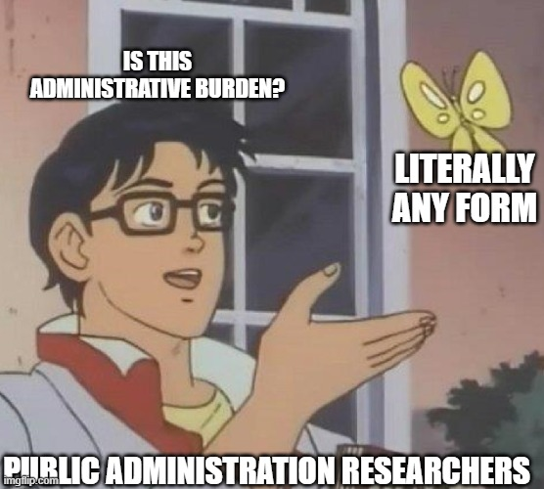
Extra Credit: Meme activity
Can earn 1 point on Research Design Project by creating a meme related to themes of course, or other public admin/policy topics!
Omicron

Slide 12
Notes on My Approach to Teaching
Be engaged… I care about participation.
You should monitor your emai!
We will follow common sense guidelines. If you have a close contact with COVID+, get tested. If you’re sick/positive with COVID or anything else, stay home and it is an excused absence.
Don’t cheat.
Every one of you can get an A if you put in the effort. My course is set up for your success, not failure
I will always be fair and generous whenever I can be.

Slide 13
Intro to Scientific Research, Research Questions & Ethics
PUAD 5319
Notes:
One key thing about research in public administration is storytelling. Why? Because you are not doing research for yourself, you want to study public policy or management problem that may affect a group of people. And you want give prescription to those problems and make real impact to the world. First, you want to tell an appealing story. This depends on your topic, it should be of interests of a large group of people. Secondly, your story should be convincing. You want to convince your audience, public, policy makers, managers in the orgs etc, to take your suggestions. That is what this course is about: we are going to learn how to design and implement a research about a public problem and tell an appealing and convincing story for the public interest.

Slide 14
What is scientific research?
Scientific research is the process of producing generalized understanding (theory) through systematic observation.
Three types/purposes of research:
1) Exploratory research
Explore a phenomenon in order to formulate a more precise research problem for further study
2) Descriptive research
Describe a particular community, group, or situation as completely, precisely, and accurately as possible
3) Explanatory research
Explain a social phenomenon, and find out causal or correlational relationships. Answers questions of WHY or HOW.
Notes:
In real life, your research may involve all these three types. This course focus on explanatory research.
Example: Impacts of clean energy package in Recovery act
1) What is included in the clean energy package? What programs they support? What does each program do?
2) Impact of the clean energy package. Establish a set of outcome indicator and describe them
3) e.g. more solar adoption in FL residence. Is it driven by the incentives from clean energy package? Other reasons? Higher income, interest groups, or utility bill saving?
Example: smart city
What is smart city? How a city can be called smart city? Key features? What makes a city smart city (Drivers?)
Descriptive: adoption of various smart technologies across US cities → we can find there is variation across cities. Why some cities adopt a wide range of smart techs while some cities don’t have any?→ explanatory researc
What affects the adoption of a certain type of technology?

Slide 15
Writing activity
Your boss asks you to provide the best possible evidence on the following question (this is a real priority for FEMA):
  Does changing the number of forms to fill out to receive post-disaster individual assistance affect the program and program outcomes? If so, how?
Take 5-10 minutes to write down how you would design a study to address the question and provide as much detail as possible. How would you gather data? How would you measure the key concepts?

Slide 16
“So what”?:
Management/Policy implications
Contribution to existing knowledge
Research Questions:
X → Y?
Literature
Review
Conceptualization
Conceptual Framework:
Hypotheses:
X1→Y, X2→ Y, …
2) Theories/plausible causal mechanisms underlying the hypotheses
Measurement for each variable:
X1 -- X1’
X2 – X2’
Validity? Reliability?
Internal
Validity
External
Validity
Design and Data Collection
Designs
Quantitative
-experiment
-quasi-experiment
2. Qualitative
3. Mixed-Methods
Sampling/Case Selection:
-Probability sampling v. nonprobability
- Single case v. Multiple cases?
Data Collection
First-hand:
Survey, interview, focus group, field observation
2. Secondary data
Data Analysis
Conclusions

Slide 17
Key Elements of Social Scientific Research
Major steps in social scientific research:
1) Formation of the explanatory research problem
Research begins with a well-defined question or problem which has theoretical or/and practical implications
Most students should plan to ask a question along the lines of “How X policy impacts Y outcome”
  Problems initially chosen almost always require more precise formation. It’s okay to change throughout semester!
2) Conceptualization
Propose possible explanations for the phenomenon you are studying based on existing research (literature review) and your initial observation (e.g. explorative research)
Formulate hypotheses to test, clearly define each variable/concept
Notes:
One of the most important purposes of social scientific research is to answer questions about social phenomena.
After you have research question, the way you conduct a empirical study is to propose some expected answers to your research questions. Then, you go to the real world to observe it systematically and then to see if your guess is confirmed.
A good first step in designing your project is to outline such a report. Although your final report may not look much like your initial image of it, this exercise will help you figure out which research designs are most appropriate.

Slide 18
Key Elements of Social Scientific Research
3) Measurement
- Devise operations that will link specific concepts to empirically observable events.
4) Sampling
- Select observations that will allow them to generalize to people and events not observed.
5) Choosing appropriate designs and data collection
Choose appropriate methods to establish causal relationships using your sample (experiment, quasi-experiment, case study).
Make observation (collect first-hand data or use secondary data)
Notes:
Choosing designs and collecting data will be conducted at the same time. If you use secondary data, you may have your data first and then choose appropriate designs to exclude alternative explanation
18

Slide 19
Key Elements of Social Scientific Research
6) Data analysis and interpretation (NOT IN THIS CLASS—you’ll do this in 5320)
The data collected on your observations are processed and analyzed using qualitative data analytic methods or statistical methods to confirm or reject your hypotheses.
Draw conclusion about hypotheses and theory that guided the research and, if appropriate, assesses the practical implications of the findings.

Slide 20
Specifying Research Questions
The Effect Ch. 2; Leedy and Ormrod, Ch.2
Notes:
From now on, we are going to talk about the initial steps in an empirical research project.
The heart of every research. The statement of problem should first be expressed with the utmost precision and then further divided into sub-problems.

Slide 21
Finding A Research Topic
Starting point for research: selection of a topic (the “so what?” test)
Address an important question – answers to that problem will “make a difference”, useful to practitioners and policymakers—Applied research
Advance the frontier of knowledge
Finding a “legitimate problem”
1) Choose a topic that intrigues and motivates you
2) Choose a topic that others find interesting and worthy of attention
3) Previous literature:
Address the suggestions for future research
Replicate a research project in a different setting/Apply existing explanation to a new situation
Explore unexpected or contradictory findings in previous research
4) Practical consideration: cost (time, money, personnel), data availability
Notes:
Emphasize the starting point again:

Slide 22
What makes for a good research question?
Once a general topic has been chosen, it must be stated in researchable terms.
Two conditions:
You have to be able to answer it with empirical (quant/qual) evidence.
  What is the best James Bond movie? Vs. Who is the most popular Bond among movie-watchers? Vs. How did/does watching Casino Royale affect movie-watchers’ opinions of Daniel Craig?
It should help us understand the way the world works
A good question gives an indication of what your theory may be as to how the world works.
Good research design practice helps us avoid the problem of data mining. We don’t start with the data and then create theory

Slide 23
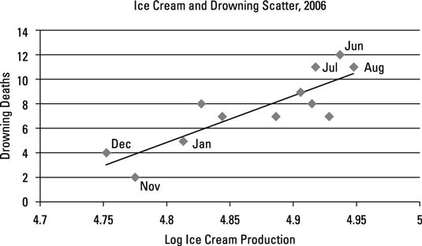
What to consider in developing your RQ?
Consider potential results—what possible answers could you get? What would be the implications for policy?
Causality & Spuriousness: If we find that ice cream production is correlated with drowning, what do we do with that? If we find children who play video games are more aggressive, what would that tell us?
Spurious relationship occurs when a correlation has been produced by an unmeasured third factor.

Slide 24
What to consider in developing your RQ?
Consider potential results—what possible answers could you get? How would you make sense of that result? What would be the implications for policy?
Consider feasibility—is the data available? Can you measure the outcome?
Consider design—is there a way to design my research such that I can uncover unbiased causal estimates?
Keep it simple—Questions that could have more than one answer are tough (e.g. What are the determinants of social mobility?)

Slide 25
Specifying the Research Questions
A general research question can be further broken down into several sub-problems. It makes your research question more specific.
Three main concerns that help the researcher narrow down the problem to researchable questions:
What entities (individual, people, groups, formal organizations, nations) are to be studied → Unit of analysis
What aspects or characteristics of these entities/phenomena are of interests → Variables
What kinds of relationships among the characteristics are anticipated → Relationships between variables
While these questions are related to later steps in research design, you should start to think about it from the very beginning. They help you fully comprehend the meaning of your research questions.
Notes:
Thinking about theses questions will link you to later steps, formulating hypotheses, measurement, sampling
Unit of analysis directly determines your observation.

Slide 26
Units of Analysis
Units of analysis:
the entities (objects or events) you study
could be individuals, social groupings(e.g. organizations, interest groups), social artifacts (e.g. programs, policies, administrative jurisdictions) etc.
Unit of analysis directly determines your observations. You need to collect data at the level of your analysis.
e.g. General research question: how does application assistance impact equity in access to COVID small business relief funds?
Option 1: small businesses in US
Option 2: small businesses in a specific state
Option 3: small businesses in a specific city

Slide 27
Thinking about Variables
IV -> DV
IV -> Mediating -> DV
IV (with or without Moderating) -> DV

Slide 28
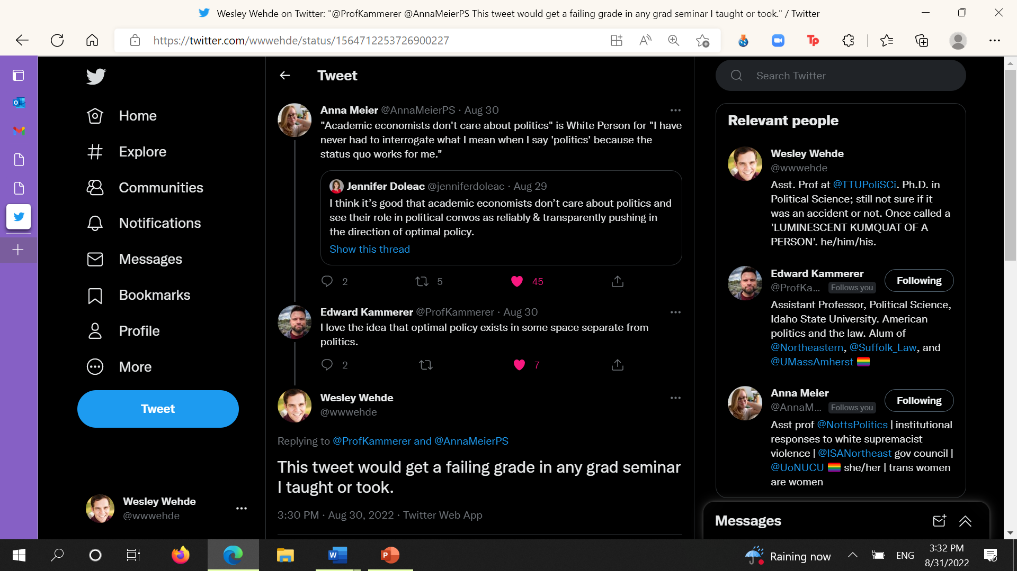
Defining Terms

Slide 29
How to think about your project
Take some time to brainstorm a problem you care about & potential research questions
For one of your research questions answer the following:
  What is the unit of analysis? (or potential units of analysis)
  What are the variables you’d be analyzing?
  What relationship do you predict between the variables?
  What would stakeholders do with your results?
  Is it feasible to answer the question? Can we measure the outcome?

Slide 30
Ethical Issues in Social Science Research

Slide 31
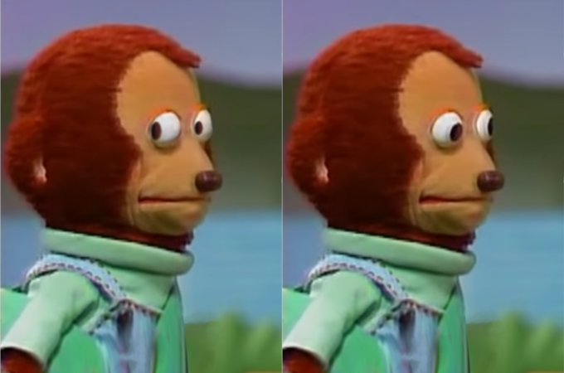
What to NOT DO
San Antonio contraceptive study: In 1971, an oral contraceptive study was conducted on 70 poor Mexican-American women to evaluate the efficacy of different kinds of female contraceptive pills.
They agreed to participate in a study to determine the side-effects of contraceptives.
The randomized half received oral contraceptives and the others a placebo.
They were not informed that they were subjects of this kind of research or that they might receive inactive medication. As expected, there were high numbers of unplanned pregnancies in the placebo group; ten of the 76 participants became pregnant during the study.

Slide 32
What to NOT DO
RETRACTED: "I am not alone – we are all alone: Using masturbation as an ethnographic method in research on shota subculture in Japan“
  This year
“The author has now explained that the work described in this note was carried out as a piece of independent research in Germany, without institutional ethical oversight. The author stated that they followed professional ethical guidelines for their discipline, including the primary injunction to ‘do no harm’…
The Editors are mindful of arguments that moral offense generated by the publication of the note provides problematic grounds for the censoring of scholarship. However, the Editorial Team recognises the argument that the note legitimizes sexual activity involving sexually graphic illustrated images of children and young people, both as an activity in itself and as a research method.”

Slide 33
Ethical Issues in Research
Obligations to the scientific research community: Honesty and accuracy
Obligations to participants in your research (IRB process)
Voluntary participation and informed consent
Anonymity and confidentiality
No harm to the participants
Value-free research?
Notes:
Anyone involved in social science research, then, needs to be aware of the general agreements shared by researchers about what is proper and improper in the conduct of scientific inquiry.
The third one the research community has not reached to an agreement yet.

Slide 34
Ethical Obligations to the Scientific Research Community: Honesty and Accuracy
Scientific progress is based on mutual trust among investigators who build their ideas and research on the work of one another.
Therefore, dishonesty and inaccuracy in reporting and conducting research undermine science itself.
- Use “Turnitin” (or whatever it is called here) for assignments in this class
Research should be replicable.
- Many journals require the researchers to provide their data and the codes/programs they use to analyze the data.

Slide 35
Ethical obligations to participants: Informed consent and voluntary participation
It is conceivable that research participants may be harmed physically, personally (e.g., by being humiliated or embarrassed), psychologically (e.g., by losing their self-esteem), and socially (e.g., by losing their trust in others).
Subjects’ informed consent is obtained by making it clear to them that their participation is voluntary, and by providing them with enough information about the research so that they can make an informed decision about whether to participate.

Slide 36
Ethical obligations to participants: Anonymity and confidentiality
The right to privacy typically is secured in surveys by promising anonymity, which is provided by having respondents fill out unmarked questionnaires, or confidentiality, which is provided by removing identifiers from the data, not disclosing individual identities in research reports, and not divulging individual information without the respondent’s permission.
This right is protected in field research by altering reports of field studies so as to prevent recognition, and by asking the research participants themselves if the material is objectionable.

Slide 37
Ethical obligations to participants: Protection from harm
Informing subjects about reasonable or foreseeable risks;
Assessing the impact of potentially harmful procedures after an investigation, in order to counteract possible negative effects.
The basic safeguard against the potentially harmful effects of deception is debriefing—explaining the true purpose of the study and nature of the deception at the conclusion of the study.
Notes:
More relevant in health or social research. Researchers use deception because they believe that without it subjects would not behave naturally and research results would be meaningless.
Opponents of deception believe that it (1) violates informed consent, (2) damages the credibility of science and trust in authority, and (3) does not accomplish the scientific objectives that it is purported to accomplish.

Slide 38
IRB Approval for Human Subjects Research
Institutional Review Boards (IRBs) are committees at research institutions that are responsible for reviewing research proposals involving the use of human and animal subjects.
Such boards determine if the investigator has thoroughly considered the potential for harm and has provided adequate safeguards for the protection of subjects’ rights.
Don’t forget to get IRB Approval when you develop your proposal if the subjects are individual human beings.
TTU IRB website:
  Human Research Protection Program | Research Home | TTU
Notes:
The National Research Act also established a requirement for Institutional Review Boards (IRBs) through which universities would monitor compliance with ethical standards in research involving human subjects.
(Babbie 64)
Research in public administration is very likely to study human subjects, such as government official’s behavior, performance; impacts of a policy on their target group etc. survey, interview, as long as your data is identifiable.

Slide 39
Concluding Remarks
Doing scientific research in public administration is not only about science, but also art of storytelling.
Appealing: research questions that address important policy or management problems, have implications for policy making and management practice
Convincing: rigorous research design and implementation
Ethical: The research process should be ethical.

