Slide 1
Trapped in America’s Safety Net
Ch. 3 & 4

Slide 2
The Place of the Poor
Or the 3-tiered social welfare system in more detail

Slide 3
A half-century ago, Dr. Martin Luther King, Jr. addressed the stilted rhetoric used use to talk about public spending to promote the social good:
Whenever the government provides opportunities in privileges for white people and rich people they call it “subsidized” when they do it for Negro and poor people they call it “welfare.” The fact that is the everybody in this country lives on welfare. Suburbia was built with federally subsidized credit. And highways that take our white brothers out to the suburbs were built with federally subsidized money to the tune of 90 percent. Everybody is on welfare in this country. The problem is that we all to often have socialism for the rich and rugged free enterprise capitalism for the poor. That’s the problem.
“The Minister to the Valley,” February 23, 1968, From the archives of the SCLC.*
https://cityobservatory.org/dr-king-socialism-for-the-rich-and-rugged-free-enterprise-capitalism-for-the-poor/

Slide 4
Means-Tested
Why is this word so important? Have you ever used a means-tested program?
As Campbell notes, most of us will use one at some point.
She uses the word “mainstream”
Why does this matter?

Slide 5
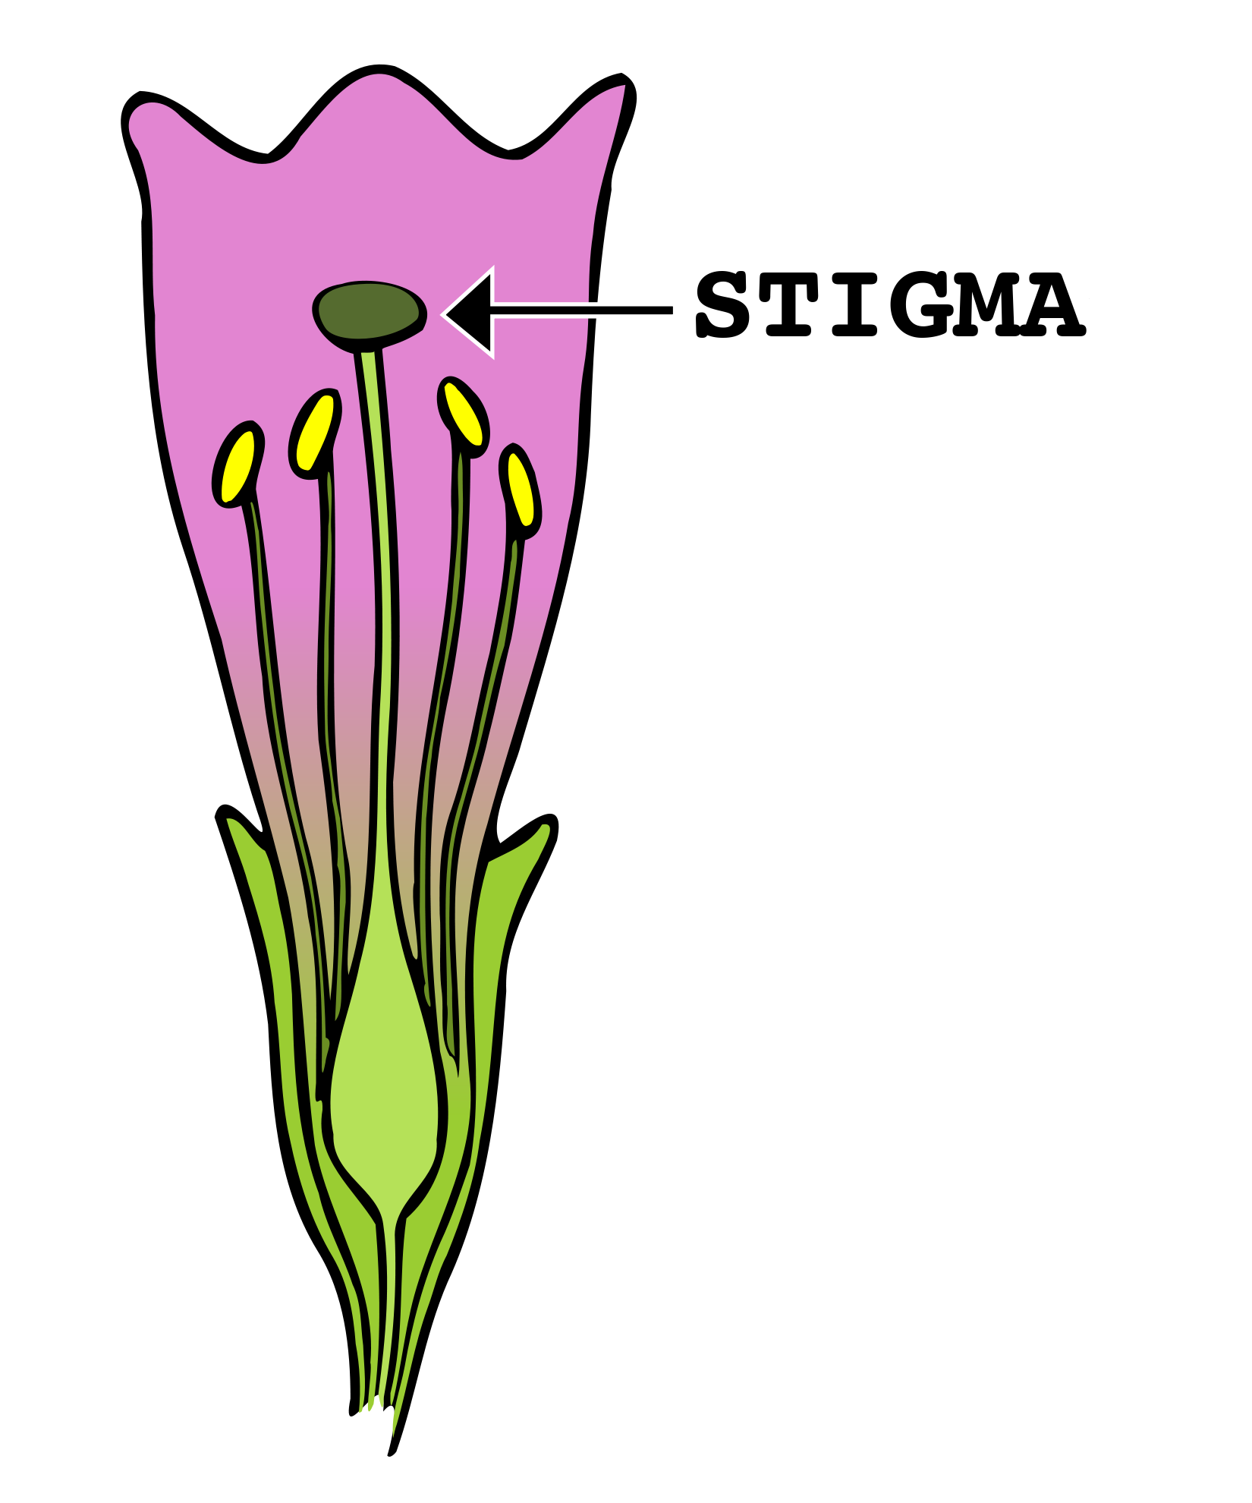
Stigma
Even Dave draws a line
Why?
Policy Design -> psychological effects
NOT DESERVING (Social Construction)

Slide 6
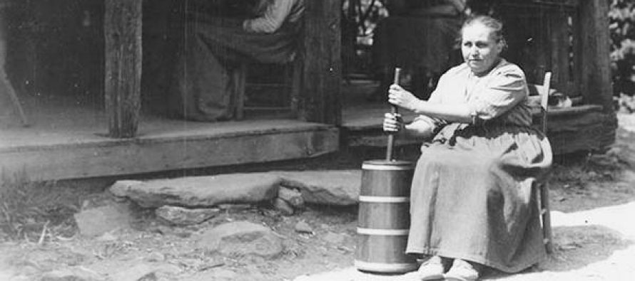
Churning – going without coverage for a period
Hello – I might go uninsured this year as I transition from ETSU to TTU.
Between jobs -> no insurance.

Slide 7
Political Framing of Welfare as Expensive
Just is NOT true for means tested programs
Only Medicaid even approaches “expensive”
Defense spending 2013 was ~$640 billion
That’s literally off the chart that Campbell presents for social insurance, assistance, and tax expenditures

Slide 8
Private Welfare
Is expensive – Campbell’s insurance for her family is 30% more than a minimum wage worker makes in a year
Creates limited economic mobility – once you get a benefitted job you are unlikely to leave
Job lock – too scared to leave because lose benefits

Slide 9
Long Term Care – still a problem
Even for Andrea – in the most privileged tier
Why?
Lack of political will
Humans are bad at planning for/expecting the future
Optimism bias

Slide 10
Wage Stagnation
Huge relatively underdeveloped component
US shift to “knowledge based” economy
Accompanied by labor market concentration for most other jobs
Limited regulation of wages (i.e. minimum wage did not change with the economy – last raise was 11 years ago)
Weak unions

Slide 11
Phaseouts, Cliffs and Marginal Tax Rates
Campbell compellingly shows those on social assistance pay the highest marginal tax rates – in some cases 100%
The US tax system overall is flat or regressive
Even though income taxes are technically progressive
Tax credits, loopholes, etc.
Cliffs occur when ALL benefits are lost by passing an arbitrary threshold
Phaseouts are reductions in benefits over various thresholds

Slide 12
Perverse Incentives
Instead of helping lift out of poverty – these policies preserve poverty
Income inequality is a necessary component for some – need someone to look down on
BUT research shows countries with lower income inequality have
Higher standards of living
Are happier
Less depressed
Than countries with high income inequality

Slide 13
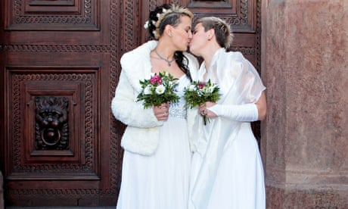
Marriage?
Policy which disincentivizes marriage
Why?
Why might this be a problem?
Culture? Contract?

Slide 14
Solutions
Universal policies – no more means testing
Everyone pays, everyone gets it – like Social Security but without the work requirements
Equality vs. Equity?
Tie social welfare and tax policy together
Improve conditions for low wage jobs (benefits, wage increases)
Others?

