Slide 1

Trapped in America’s Safety Net
Ch. 5 & 6

Slide 2
FEDERALISM!? GOOD? BAD?!
Bad – well for social policy
This is the thesis of Ch. 5

Slide 3
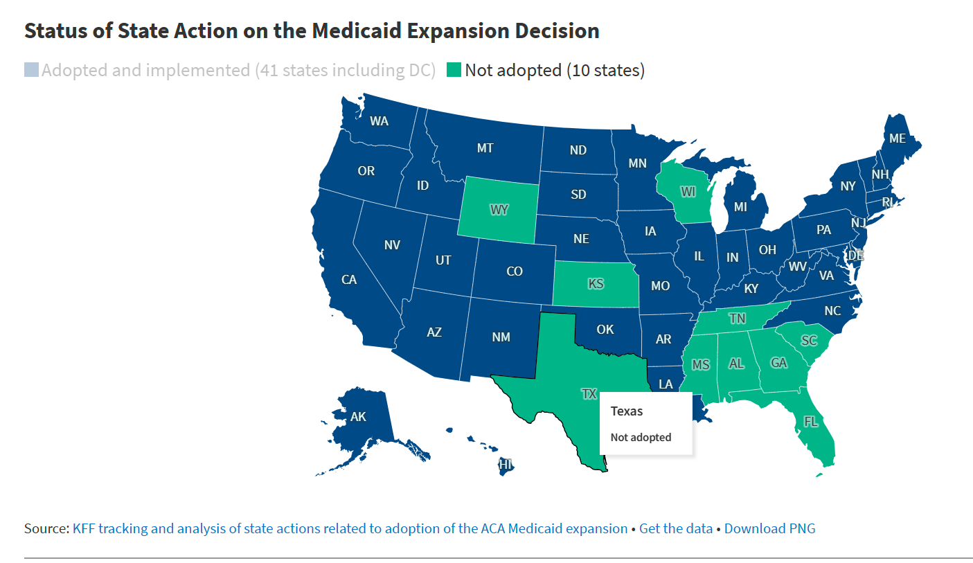
Why is Federalism bad for social policy?
How does social policy differ from say economic development or higher education policy?

Slide 4
Texas?
I highlighted it on the previous slide – since writing of her book many more states have expanded or will expand Medicaid – 24 had not as of writing now only 10 have not
  TX is still one of those that has not expanded
  What other states have not? Why?
  Why have so many of the initial hold outs expanded?
As you read, pay attention to where TX or your home state is on the charts.

Slide 5
Tennessee gets a callout
For supporting the LEAST amount of Home based Long term Social Services or Long Term Care as of 2010
  Did increase as she notes but was literally 0 hours per day before.
  From my reading (and you can never be certain as you know from th book) it is just over 7 hours a day now
“What happens in the stingiest states?”
  People FLEE – literally flee

Slide 6
How does the example of Tennessee’s Long Term Care Policy demonstrate elements of the ACF?
What are the coalitions?
Is there evidence of policy learning?
How did policy change come about?

Slide 7
Inequity in Roots of Racism
There is no way to understand modern US policy without understanding racism
These policies are limited and were designed to keep out Black Americans because they were viewed as undeserving when the policies were created
  These policies have not changed much because these views have not changed much

Slide 8
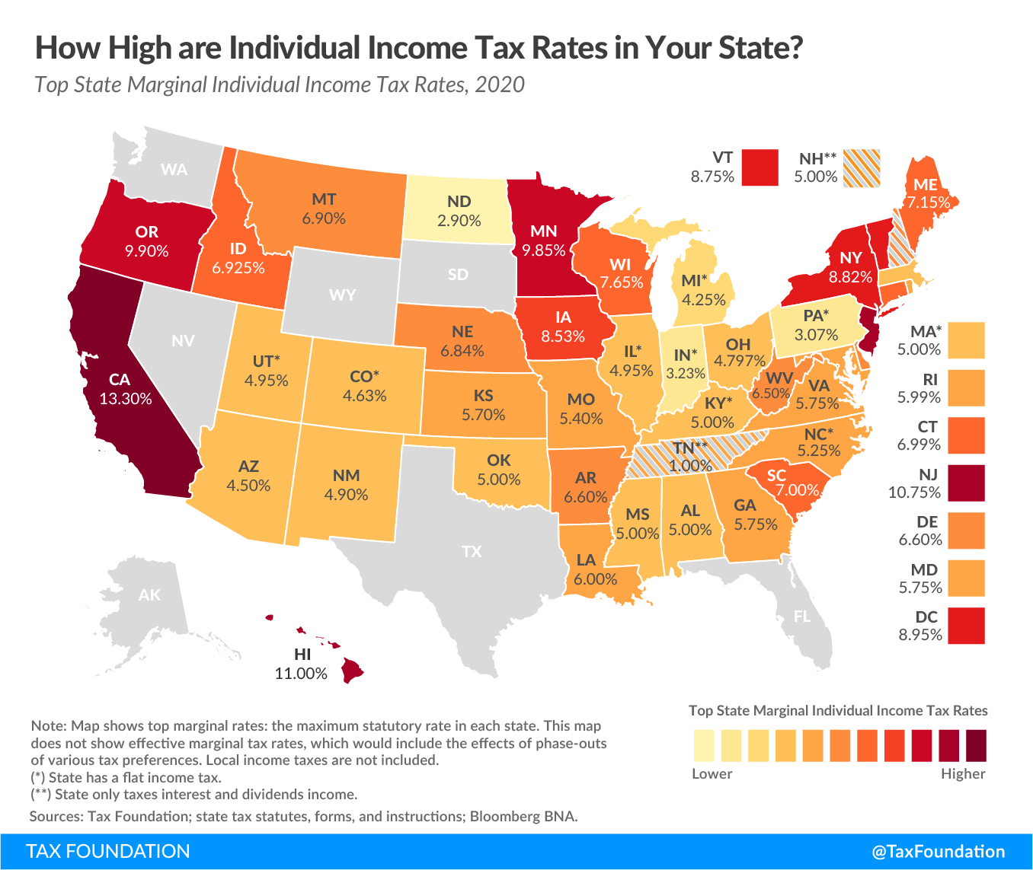
What about taxes?
Campbell discusses differing tax credits – fails to mention differing taxes
  I.e. Tennessee, Texas, and a few other states have 0 income tax – how might this play into these conversations?
  Are income taxes regressive or progressive in general?

Slide 9
Policy Analysis
Campbell even uses the explicit language of policy analysis – in reference to the federalism of social policy
  Evaluates Responsiveness, Innovation, Efficiency, Choice
    Fails on all 4 fronts
      State controlled social policy is NOT more responsive – i.e. states that need more social assistance do not provide it
      It CAN BE innovative – but not always in a good way
      Not efficient – really just causes “race to the bottom”
      CHOICE IS AN ILLUSION

Slide 10
Campbell’s Final Argument in Ch. 5
Is that better social insurance and assistance would
  Improve health outcomes which would improve education and job outcomes, productivity, reduce indigent care spending at hospitals and just in general actually COST less than what we currently spend

Slide 11
Final Argument
There is PROBABLY no escape for them
  Medicare is not enough
  Private insurance if Dave got a job with benefits wouldn’t be enough and the ACA exchange policies won’t either
  Litigation? Pipe dream
  Divorce? THAT SHOULDN’T EVEN BE AN OPTION ARE YOU KIDDING ME
  Working Disabled Program in Cal – Nope not eligible

Slide 12
Universal policy is Best policy (mostly/often/caveated when necessary but not here)
Universal health insurance would help them the most
  Unfortunately, very few political candidates (and no major party) supports this policy option

Slide 13
What feedback effects exist from universal policy design?
How are these different from targeted policy design feedbacks?

Slide 14
Germany
Less than 2% tax split between employee and employer – guarantees LTC through either institution based or cash assistance for home healthcare for disabled individuals
  I would LOVE to pay 1% more in taxes to guarantee that if I am disabled tomorrow I could have access to healthcare and support services I would need
    But also if I’m never disabled – totally fine!

Slide 15
Our system isn’t cheaper
And if anyone tells you it is they are either 1) lying or 2) using data poorly/maliciously
  People who say it is cheaper often focus on what our GOVERNMENT SPENDS
    But that negates just how much individuals and their employers spend
    So yeah our government might spend less but the services/insurance cost A LOT
      And if the government provided it all – we’d spend less
        Think about how much buying power the US government would have for its almost 330 million residents?

Slide 16
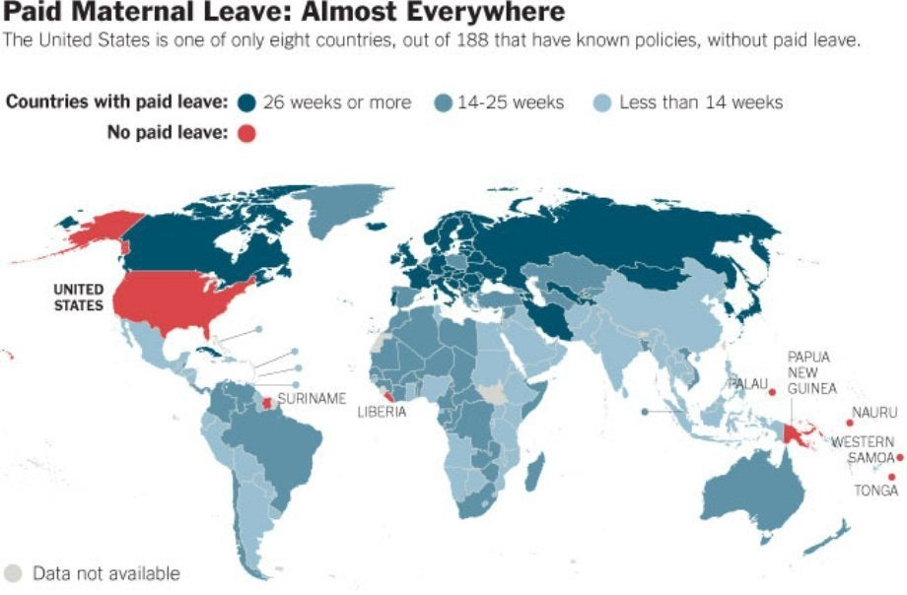
No Paid Maternity or Parental Leave

Slide 17
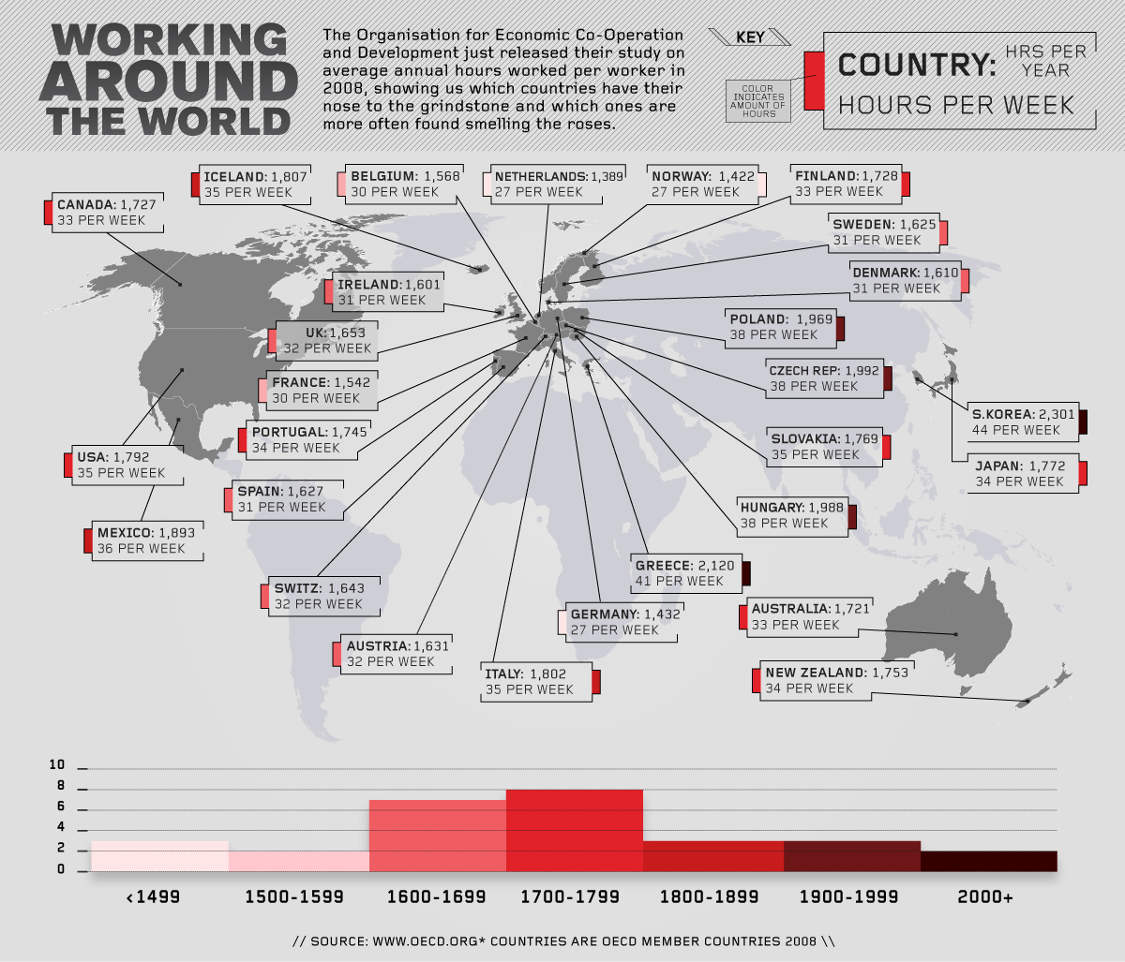
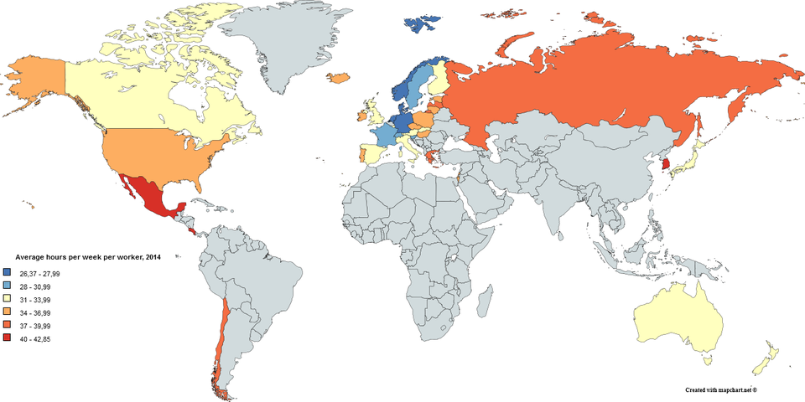
We work too much

Slide 18
Need to save $240,000 for healthcare costs in retirement alone
Let alone – your house or travelling or whatever else you need/want in retirement

Slide 19
Trade-offs
US has more access to high tech healthcare technology
But lower access to same or next day simple doctor’s appointments

Slide 20
The Federal Budget
Discretionary Spending in Fiscal Year 2024: An Infographic | Congressional Budget Office

Slide 21
Taxes?
Lowest among rich nations – could raise a small amount and do a lot to address these inequities

Slide 22
Final Point
This could happen to you (almost 2 million car crashes with injury or death in 2018 – now think about that multiple over a lifespan – average individual is in 4 car crashes in their life)
You are way more likely to have THIS happen
Than you are to end up in the top tax bracket (1,053,529 Americans in 2020 and 801,750 in 2019)

