Slide 1
Policy Innovation and Diffusion

Slide 2
What is Policy Innovation?
NEW policies
What does NEW mean?

Slide 3
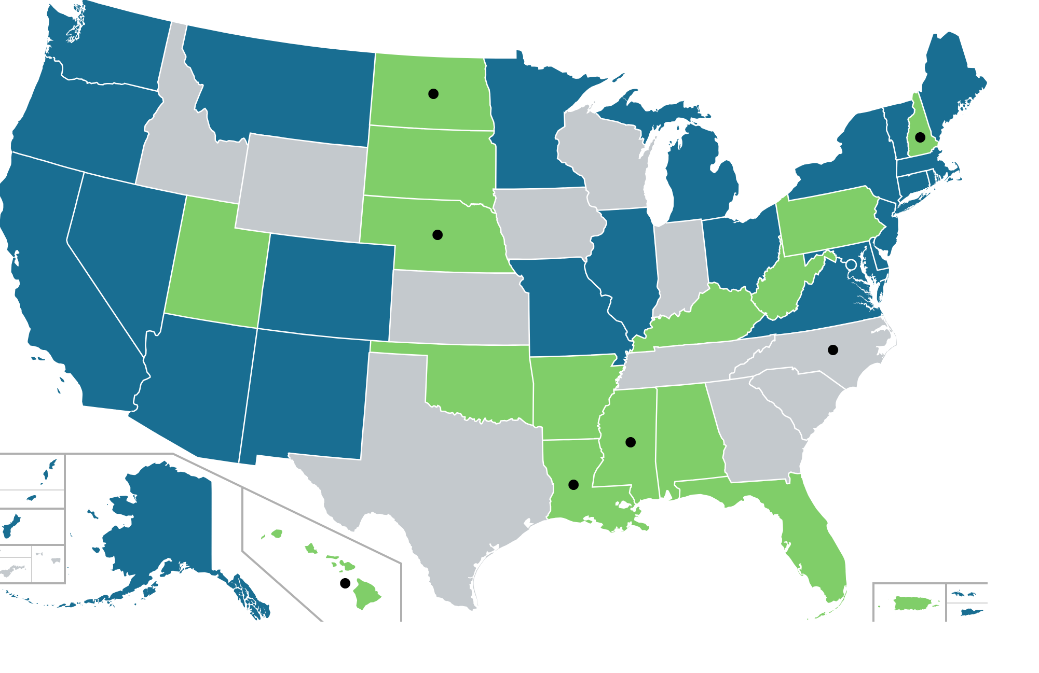
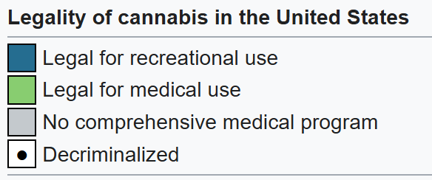
patterns of policy diffusion
2023
Regional diffusion model
Notes:
Last year is 2016. Approx 25 states legalized MJ for medical use
Geographic clustering
Proximity makes diffusion more likely, but does not tell the whole story
Policy diffusion theory seeks to understand what factors shape whether states adopt or fail to adopt policies in this manner

Slide 4
patterns of policy diffusion
The National interaction model
# adopting jurisdictions
time

Slide 5
causes of policy diffusion
Explanations for policy Diffusion
Reasons for emulating prior policy adoptions of other government jurisdictions
Learning
Imitation
Normative pressure
Competition
Coercion
Internal determinants
Characteristics of the government jurisdiction that drive policy change

Slide 6
Learning
Requires contact
Most difficult to measure

Slide 7
Imitation
Easy to measure
But not terribly interesting

Slide 8
Normative Pressure
Professional societies
Norms
Least studied

Slide 9
Competition
Race to the top?
Race to the bottom?

Slide 10
Coercion aka Top Down
Via federal legislation and regulation

Slide 11
Bottom up
From local up to federal
Maybe my menu labelling example?

Slide 12
Internal Components
Openness of the system and number of veto points
More generally ‘predictors’ of policy change

Slide 13
Policy change via innovation and diffusion
Incrementalism or muddling through
With
Punctuations!

Slide 14
Limits?
Focuses on adoption (and can only be observed post adoption)
Does agenda setting happen via these mechanism?
In US – mostly state-to-state research
Then local to local
Global research typically uses different language for nation-to-nation research

Slide 15
Punctuated Equilibrium

Slide 16
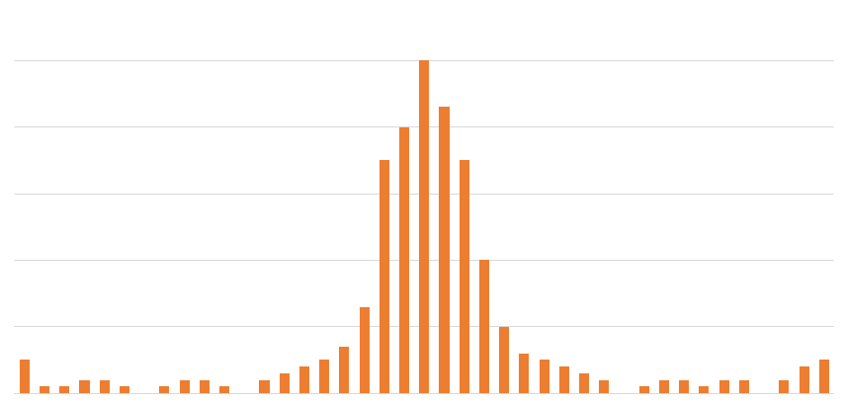
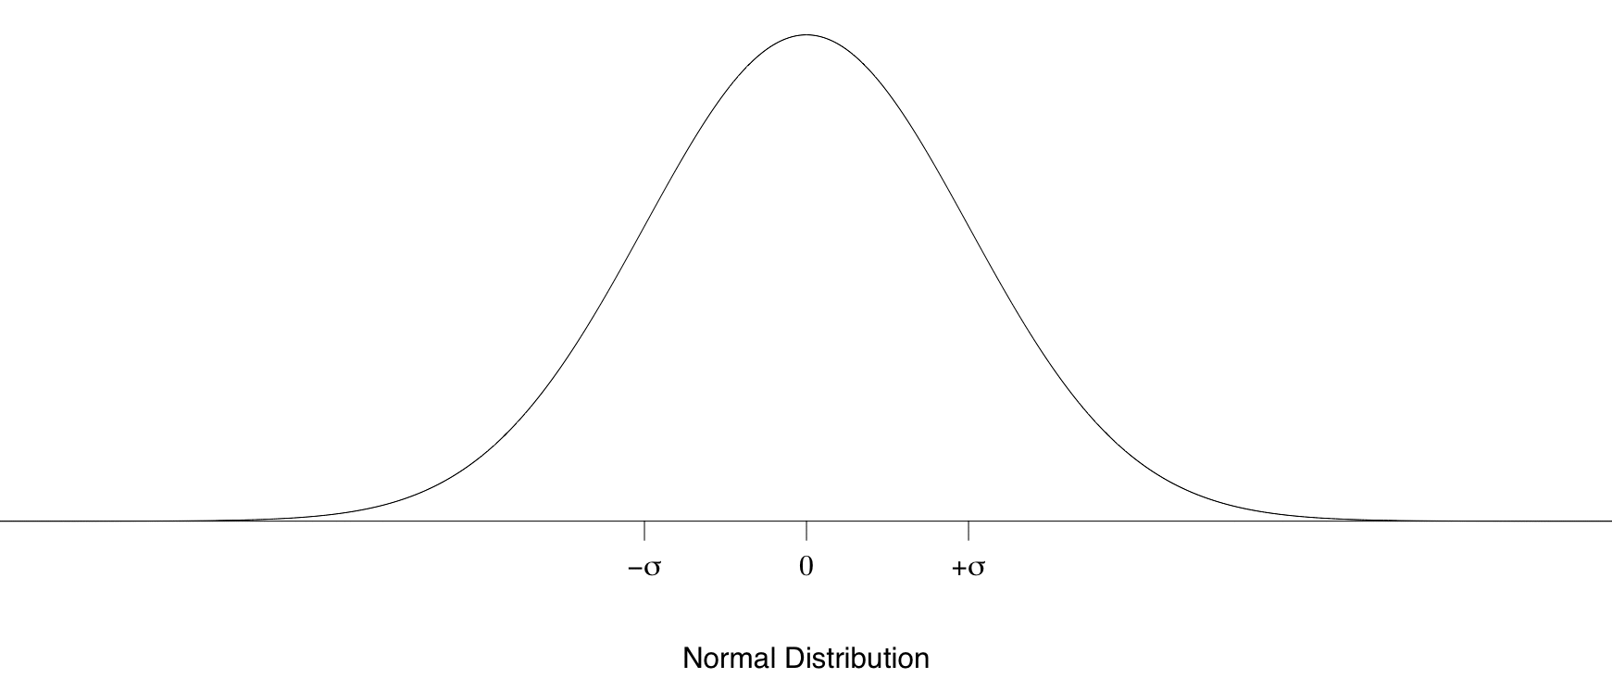
Lots of instances of small, or no, change
Few instances of moderate change
Some dramatic changes
big changes
no change
big changes
Policy Changes

Slide 17
Some dramatic changes
$$$
Agency budget
Lots of incremental change
$
Time

Slide 18
Measurement Issues
Much easier with budget data

Slide 19
Go to Regulations.gov and leave a comment on a regulation of interest to you. Your comment must be at least 250 words long and be related to the regulation at hand. Cite and include at least one source in your comment. Screenshot your page on regulations.gov and submit the text of your comment to me over email for 1 point of Extra Credit.

