Slide 1
Cost Benefit Analysis

Slide 2
You do CBA everyday
Go to dinner vs. cooking dinner?
  What are the costs and benefits? How do you compare these options?
Study vs. sleep vs. YouTube vs. video games
  Same idea – allocation of time and resources

Slide 3
Cost Benefit Analysis
A subset of policy analysis focusing explicitly on, well, costs and benefits
  Can be to help make decision before hand (ex ante)
  Or ex post to measure effectiveness
    We focus on ex ante in this class/unit

Slide 4
Basic Steps – Notice Overlap with Policy Analysis More Broadly

Slide 5
Standing
Who has standing? Whose benefits and costs count?
  Usually determined by the client

Slide 6
Select Alternatives
Overlap with policy analysis
How many in an infinite world?

Slide 7
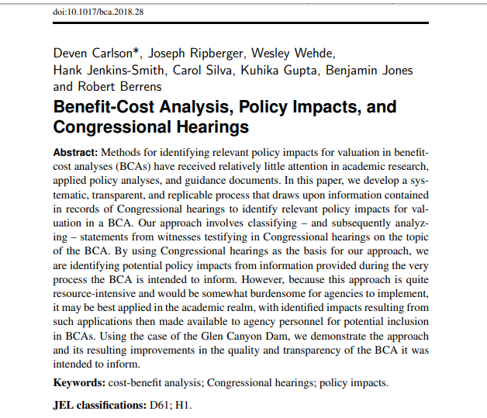
Catalogue impacts and indicators
How to comprehensively identify impacts?
  Text takes narrower physical approach
One way

Slide 8
Project or predict impacts
Across all alternatives
Difficulties – time scale

Slide 9
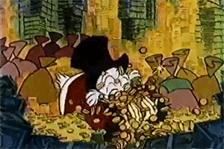
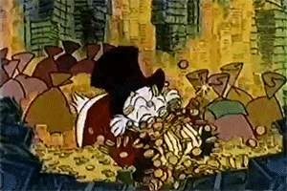

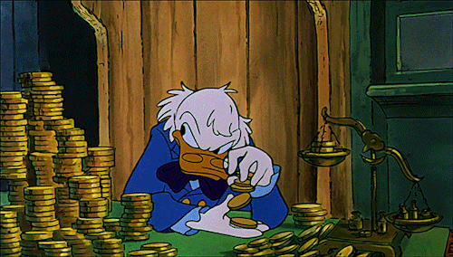


Monetize
This means everything must be quantified as $$

Slide 10
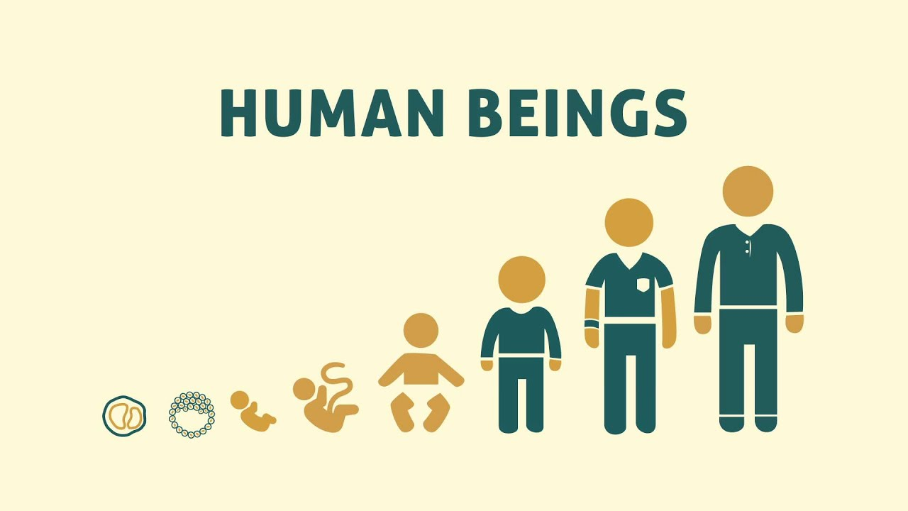




Consequences of Monetizing
Human Life
This is the first Google Image search result for “diversity”
The environment

Slide 11
Monetizing
Various methods
  Comparing to market prices
    I.e. what’s the closest good in the market use that price

Slide 12
Monetizing
Hedonic Analysis
  Measuring things like travel time as proxies for value
    Say for the Grand Canyon

Slide 13
Monetizing
Contingent valuation
  Using carefully designed survey experiments to measure willingness to pay
    Can be negative – i.e. changing will reduce your utility
  I am doing this!

Slide 14
Discount to present values
Do some math to calculate future costs and gains as value loss or gain today
  Which rate to use?

Slide 15
Add
Costs + Benefits = NET
Benefits > Costs
  Weighting?

Slide 16
Perform Sensitivity Analysis
Check your assumptions
  What happens when you project a few less or a few more users?
Incorporate uncertainty

Slide 17
Monetizing
Various methods
  Comparing to market prices
    I.e. what’s the closest good in the market use that price

Slide 18
Monetizing
Hedonic Analysis
  Measuring things like travel time as proxies for value
    Say for the Grand Canyon

Slide 19
Monetizing
Contingent valuation
  Using carefully designed survey experiments to measure willingness to pay
    Can be negative – i.e. changing will reduce your utility
  I am doing this!

Slide 20
Discount to present values
Do some math to calculate future costs and gains as value loss or gain today
  Which rate to use?

Slide 21
Add
Costs + Benefits = NET
Benefits > Costs
  Weighting?

Slide 22
Perform Sensitivity Analysis
Check your assumptions
  What happens when you project a few less or a few more users?
Incorporate uncertainty

