Slide 1
Survey Samples and Recruitment

Slide 2

Learning Objectives
Primer on Finding Quant Data
Best Practices for Survey Recruitment

Slide 3

Finding existing data
https://sebastiantellotrillo.com/acb94b9f169941fbac268737482378f7
Go to the link for ICPSR & use your search terms to find a data source you could hypothetically use for your project.

Slide 4
Other Existing Sources
Pew: Pew Research Center | Nonpartisan, nonadvocacy, public opinion polling and data-driven social science research | Pew Research Center
Roper iPoll if TTU had it…

Slide 5
Types & Purposes of Surveys
Research types
  Experimental
  Quasi-experimental
  Non-experimental
Purposes
  Information gathering
    Exploratory/Descriptive
  Theory testing
    Explanatory/Predictive
Should only use descriptive survey if no ability to estimate causal effects in quantitative design

Slide 6
What do you need for your paper?
Sampling strategy
Survey mode
Informed consent—pay attention to ethics (add to appendix)
Specify survey question wording
Be wary of common mistakes that we’ll go over next week!
Measurement/Scales
Ordering
Plan for comparing the sample to population
Evaluate biases in the sample

Slide 7
What are we trying to avoid?
Sources of Survey Errors: Difference between survey data (sample parameter) and the population parameter.
Coverage error: this is related to whether the sampling frame (those actually sampled) are representative of the target population → different types of survey may have potential problems for its sampling frame.
Selection bias & Non-response bias: that those not responding to a survey are systematically different than those that do respond.
Measurement error: the survey does not elicit accurate responses due either lack of clarity, lack of knowledge, or strategic behavior.
GOAL: Eliminate/reduce measurement error & sampling bias. Enhance internal & external validity & reliability!!!

Slide 8

Why Choose a Survey? Pros and Cons
Pros:
  Can address a wider range of topics and more economical in that they can address several research questions at one time.
  Collect substantially larger and more representative samples than other methods
Cons:
  They are limited to self-reports of behavior
  They are subject to biases in the sampling and responding process.

Slide 9

Survey Design
Considerations:
Ethics/informed consent
Mode
Question style & wording
Measurement/Response formats
Layout & Ordering
Notes:
Survey is one of the methods you can use to collect data for the sample you want to observe in your study. There are other ways of collecting data. Talk about relations between session 6 and session 7. Ask people about their survey experience.
9

Slide 10
Ethical considerations: How to treat respondents
Informed consent
Minimise risk / harm to respondents
Confidentiality / anonymity
No coercion
Minimal deceit
Fully debrief/Honor promises to provide respondents with results
26

Slide 11
Informed consent form
A page which allows participants to indicate whether they consent or do not consent to participation in the study:
How is consent given / not given? (Can be active consent or passive consent)
Statement should include that participants are free to not participate in any part of the study and to withdraw at any time
Link to form: Consent Process | HRPP | Research Home | TTU

Slide 12
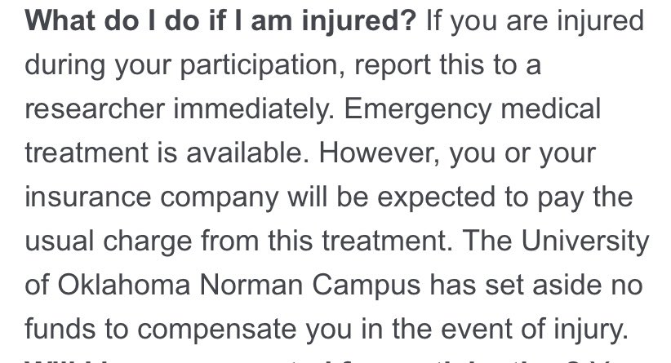
What are key points?
Purpose/goal
Establish credibility
Benefits & costs of participating
Confidentiality
Contact information in case things go wrong
Implicit consent by clicking next

Slide 13
Survey Mode

Slide 14
Best Practices for Choosing Survey Mode
High
Goal: Match the mode of your survey to your question
Face-to-Face Interview survey
Telephone survey
Mail questionnaire survey
Internet survey
Interview Survey
Costs
Response
Rates
Self-Administered
Low
#1: What are the costs and benefits of different survey modes?
#2: What might be the best mode for a particular question?
Notes:
Ask students why they are listed in this order?

Slide 15
Comparisons among Different Modes of Survey
Face-to-face interviews allow one to ask the most complex and sensitive questions➔ exit polls
Telephone interviews must ask questions simple enough for respondents to understand and retain while formulating an answer
Mailed questionnaires, tend to yield shorter answers (and more non-responses to open-ended questions).
A mail/online survey is recommended:
  When a large sample is desired
  When costs must be kept low
  When moderate response rates are tolerable.
Tools for programming online surveys:
  www.surveymonkey.com
  Qualtrics
  Google Forms
Notes:
Discuss other strength and weaknesses

Slide 16

Mixed-Mode Survey
When using a single mode alone cannot achieve desired results:
Combined effects (tradeoffs between budget, time, and data quality)
Lower costs: from less-expensive modes to more costly modes for those who do not respond initially
Improve response rates (reduce non-response errors)

Slide 17

Survey Sample Types
List based random sample
  Population?
Quota based, panel sample
  ‘representative’
Convenience sample
  Undergraduate
  Snowball

Slide 18
Evaluating Your Sample
Even with a fairly high response rate, it is possible that your sample is not representative of the population.
As a last step, you want to evaluate your sample representativeness. It is important to compare observations in and out of your sample on as many relevant variables as possible.
Relevant variables: explanatory variables, control variables
If there are systematic differences between observations in your sample and out of your sample:
1) Add observations from less represented group by continuing your survey
2) Sometimes, it can be fixed by using sample selection correction methods (statistical methods)
3) Admit the limitation and discuss how this may bias your results in a certain way.

Slide 19
Evaluating Your Sample
Example: The School Procurement Practices Survey.
Sample size: 431 districts (63.5% response rate)

Slide 21
Sample Sources
Lists
How to get?
Panels
Companies such as Qualtrics, Prolific, Amazon Mturk, CloudResearch Connect, YouGov, etc. etc.

Slide 22
1. Pretesting
The purpose of pretesting is to try out the survey instrument on persons similar to those in the target group in order to check for ambiguous questions, inappropriate responses options, and so on.
This is absolutely crucial stage if the survey is going to be successful. So it should not be skimped on.

Slide 23
1. Pretesting: Questionnaire
  Provide survey to knowledgeable colleagues to review and comment on:
    1) Have I included all necessary questions?
    2) Can I eliminate some of the questions?
    3) Are the questions clear and appear neutral?

Slide 24
1. Pretesting: Pilot Survey
Provide survey to potential respondents (5-10 people) to complete and comment on:
  Are all the words understood?
  Are the questions interpreted the same?
  Are there any questions, which respondents might skip or have difficulty understanding?
  Are there any specific problems with the survey mode(s) (face-to-face, phone survey, mail survey, and online survey)?
  e.g. visualization, inconsistency between surveys using different modes in a mix-mode survey

Slide 25

2. Distributing the Survey
Interview Survey: select respondents from sampling frame and conduct interviews
General Timeline for Mail Survey:
1 week before: First contact: pre-notice letter
First mailing: sending out the survey
1 week after: follow-up post-card
3-4 weeks after: Second follow-up mailing
6-8 weeks after: Final mailing
Steps 2) to 5) also apply to online survey (via email).

Slide 26
2. Distributing the Survey
Mail Survey: Pre-Notice Letter
Timing: It should be sent approximately a week before the first mailing of the questionnaire is sent out.
Its goal is to create interest in the survey and create anticipation of the mailing. The sections of the letter should be:
explanations of what will happen
It’s useful to let your respondents know how you get their mailing addresses
what the survey is about
why it is useful
what steps are taken to protect the respondents identity

Slide 27
2. Distributing the Survey
Mail Survey/Web Survey: First Survey Mailing/Email
The first mailing/email is very crucial because it will generate the largest share of responses.
It should be sent personally by first class mail/individual email (also useful to let the respondents know how you get their emails).
Besides the questionnaire, the most important part of this mailing/email is the cover letter.

Slide 28
2. Distributing the Survey
Mail Survey/Web Survey: First Survey Mailing/Email
Questionnaire: If the survey is going to be anonymous you can tell them that once they return the questionnaire the identification information will be removed so that the survey will be anonymous.
Incentive: Dillman is a big believer that a small financial incentive, such as $5-$10 (or gift cards), can make a big difference to response rates.
Return envelop: The return envelop should ideally include real stamps to create another social obligation for respondents.
Web survey: cover letter in the email text + survey link

Slide 29
2. Distributing the Survey
Mail Survey/Web Survey: First Survey Mailing/Email
Cover letter is crucially important in communicating the purpose and importance of survey. The letter should be personalized with date at top, name and address of person being sent to, and actual signature.
The content of the letter should include:
The request: what are you asking the person to do (Estimated time to complete the survey)
Why they were selected
Why the survey is important
How will confidentiality be handled
If an incentive is provided, inform them of this
Contact information if they have questions
Final thank you

Slide 31
3. Follow-up: Final Mailing/Email Reminder
It can be sent out in 6-8 weeks after the first survey mailing/email. The mailing/email should include all the same elements except the incentive. You want to show the survey ending date.
You can also try to have their peers email them about the survey
Notes:
If you

Slide 33
Example: Email Reminder for Online Survey

