Slide 1
Summary Stats,
Regression & (maybe) Propensity Score Matching
17

Slide 2

Meme Activity Reminder

Slide 3
Reminder: Research Design Paper
You should have started on at least a couple of the following sections (especially sample & data):
Sample—justify sampling strategy & critique external validity
Data sources & measures—Specify what variables will be in the analysis and how they will be measured as well as data source
  Pay attention to validity & reliability of measures
Research Design & Analysis Plan—justify your choice of design & provide all details necessary to evaluate internal validity
  How will you be analyzing the data? The details here will vary based on your method

Slide 4
Descriptive Statistics
Descriptive statistics aim to summarize a sample; there are two types of descriptive statistics:
1
Measures of central tendency provide information about the most typical or average value of a variable
Measures of variability (dispersion) provide information about the distribution of a variable
2

Slide 5
Central Tendency (Mean)
Arithmetic Mean (𝑥̄ or 𝜇): the sum of a series of observations divided by the number of observations
𝑛
1 𝑥 + 𝑥 + ⋯ + 𝑥
𝑥̄ = (∑ 𝑥 ) =
1 2
𝑛
𝑛
𝑖
𝑛
𝑖=1
Use when describing continuous variables
Sensitive to extreme values (e.g., income)

Slide 6
Central Tendency (Median)
Median: the middle value in a series of observations
Arrange a series of observations from smallest to greatest then take the middle value
Note: if there is an even number of observations, then there is no
single middle value; the median is then usually defined to be the mean of the two middle values
In a distribution, the median is the 2^{𝑛𝑑} quartile and the 50^{𝑡ℎ}
percentile
Use when describing continuous variables
Robust to extreme values (e.g., income)

Slide 7
Central Tendency Compared
0.20
Median Mean
0.15
Density
0.10
0.05
0.00
62
66 70
Height (Inches)

Slide 8
Central Tendency Compared
Median Mean
0.20
0.15
Density
0.10
0.05
0.00
65 70
Height (Inches)

Slide 9
Central Tendency (Mode)
Mode: the most common value in a series of observations
Some variables include multiple modes (multimodal)
Use when describing discrete variables

Slide 10
Dispersion (Variance)
2 2
Variance (𝑠 , 𝜎 ): the extent to which a variable’s values deviate
from or vary around it’s mean; the average distance of each observation from the mean
Measures how far observations are from their average value (spread of the data)
Low variance → observations are relatively close to the mean value
High variance → observations are relatively far from the mean value
2

Slide 11
Dispersion (Standard Deviation)
Standard Deviation (𝑠, 𝜎): standardized measure of variance
Expressed in the same units as the mean (i.e., inches)
Mean distance from the mean

Slide 12
Dispersion
80
70
Density
s = 2
s = 4
60
Sample 1
Sample 2
Height (Inches)

Slide 13
Visualizing Data
In The Visual Display of Quantitative Information (1983), Edward Tufte says that graphical displays should:
Show the data
Induce the viewer to think about the substance rather than about methodology, graphic design, the technology of graphic production or something else
Avoid distorting what the data have to say
Present many numbers in a small space Make large data sets coherent
Encourage the eye to compare different pieces of data
Reveal the data at several levels of detail, from a broad overview to the fine structure
Serve a reasonably clear purpose: description, exploration, tabulation or
decoration
Be closely integrated with the statistical and verbal descriptions of a data set

Slide 14
Visualizing Data - Rules
1
2
3
4
Always include a title Always include axis labels
Include a legend when necessary
Avoid chartjunk (elements that are not necessary to comprehend the information in the plot)
5
In bivariate plots, the dependent variable (𝑦) goes on the y-axis and the independent variable (𝑥) goes on the x-axis
Don’t use pie charts
6

Slide 15
Visualizing Single Continuous Variables
Density Plot
Histogram
0.20
0.15
150
Frequency
Density
100
0.10
0.05
50
0.00
0
62
66
70
60
65 70
Height (Inches)
Height (Inches)

Slide 16
Visualizing Single Discrete Variables
Bar Plot
400
300
200
100
0
Frequency
(57.5,60] (60,62.5] (62.5,65] (65,67.5] (67.5,70]
(70,72.5]
(72.5,75]
Height (Inches)

Slide 17
Note: Histograms are not the same as Bar Plots!
If you have a continuous variable with more than 10 categories, use a histogram!
If you have a discrete variable or a continuous variable with more than 10 categories, use a bar plot!

Slide 18
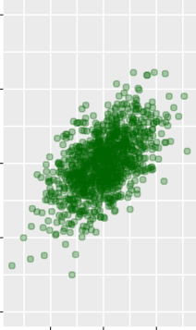
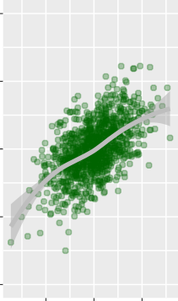
Visualizing Continuous 𝑥 and Continuous 𝑦 Variables
Scatter Plot
Smooth Line
Both!
155.0
155.0
155.0
Weight (Pounds)
152.5
Weight (Pounds)
152.5
Weight (Pounds)
152.5
150.0
150.0
150.0
147.5
147.5
147.5
145.0
145.0
145.0
63 65 67
Height (Inches)
63 65 67
Height (Inches)
63 65 67
Height (Inches)

Slide 19
Visualizing Discrete 𝑥 and Continuous 𝑦 Variables
Box Plot
Violin Plot
Height (Inches)
70
Height (Inches)
70
60
60
50
50
Men
Women
Men
Women

Slide 20
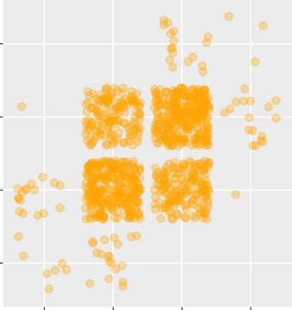
Visualizing Discrete 𝑥 and Discrete 𝑦 Variables
Jitter Plot
Bar Plot
300
(152,154]
Weight (Pounds)
200
Weight
(146,148]
(148,150]
(150,152]
(152,154]
(150,152]
Count
(148,150]
100
(146,148]
0
(61,63] (63,65] (65,67] (67,69]
Height (Inches)
(61,63] (63,65] (65,67] (67,69]
Height (Inches)

Slide 21
Regression Learning Objectives
Regression (Ordinary Least Squares Regression or OLS)
  This is not a research design for causal inference. This is a stats tool that is used across all quasi-experimental designs (and most quant methods in general)

Slide 22
Regression
AKA OLS or ordinary least squares regression

Slide 23
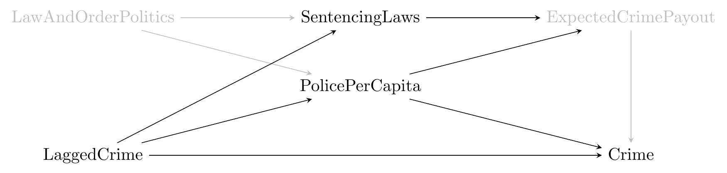
Regression in a nutshell
Pro: Regression can allow you to statistically control for the influence of backdoor paths explicitly.
  Each quantitative method covered in this course generally uses regression

Slide 24
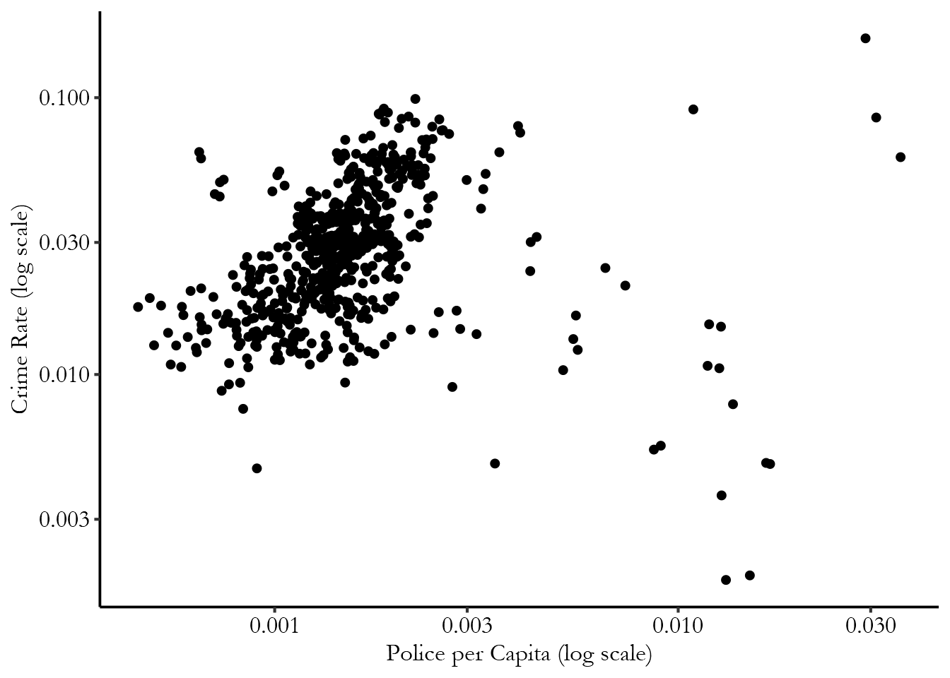
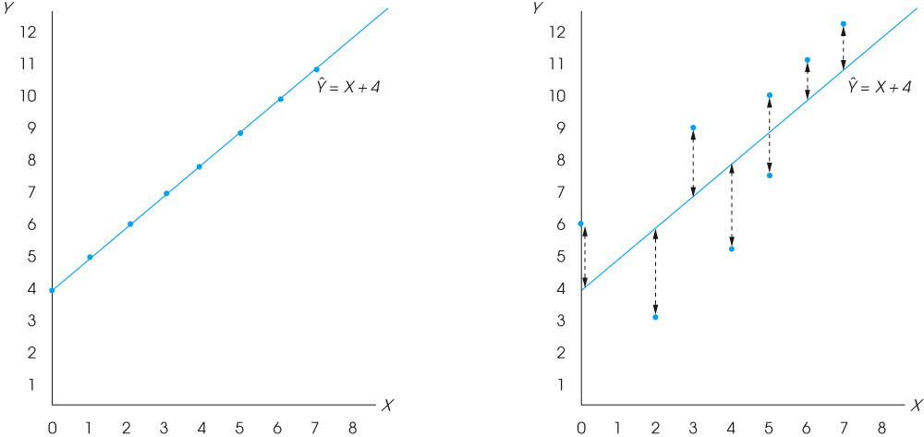
Raw Data Scatter Plot
Regression Output
Interpretation: A one unit increase in X (treatment) leads to a [effect size] unit increase in Y (outcome)
Notes:
Figure 17.5
(a) A scatter plot showing data points that perfectly fit the regression line defined by the equation Y ˆ = X + 4. Note that the correlation is r = +1.00. (b) A scatter plot for the data from Example 17.1. Notice that there is error between the actual data points and the predicted Y values of the regression line.

Slide 25
Regression Approach
We are only going to talk about LINEAR regression, but there are a lot of different functional forms (curvy lines)!
Regression explains the outcome (Y) as a function of the Treatment (T) and other controls (X). The coefficient of T is the average treatment effect.
  Our estimate of the treatment effect is the remaining variation in Y that is not explained by controls. Illustration: https://www.nickchk.com/causalgraphs.html
Y_{i} = δT_{i} + βX_{i} + ε_{i}
Outcome = Treatment + Controls + Error Term
Crime Rate = Police per Capita + Controls(Lagged Crime, Sentencing Laws) + Error

Slide 26
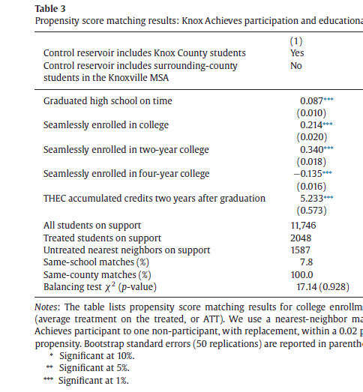
How to read a regression table
The numbers with stars next to them= effect of policy on outcome
  0.087= 8.7 percentage points
The numbers in parentheses are standard errors
  We are confident that the range of the effect is from 7.7-9.7 percentage points
The stars mean that the effect is significant → more stars=more confident we are that not due to random chance

Slide 27
Assumptions
  Con: Assumes bias is due to observable factors only—no way to test/validate
  Problem remains that some things are unobservable. This is the key downfall of Regression & many other methods

Slide 28
What do I expect from you?
If you’re going to do a survey experiment or any quasi-experimental design, you will likely use a standard OLS regression.
This should be specified in your analysis plan/research design section, along with your set of control variables.
  I do not expect you to understand the nitty gritty details (standard error adjustment, functional form, etc.) or implementation

Slide 29
Propensity Score Matching Methods

Slide 30
Introduction to Propensity Score Matching (PSM)
PSM is used to find a comparison group of non-participants with similar pre-intervention characteristics as the treatment group
3 Steps:
  Estimates similarity of the non-participants with the treatment group→this is the propensity score
    Outcome=participation, predicted by observable characteristics
  Then, creates “matched” treatment and control groups
    After matching or weighting, no observable differences between groups
  Estimate program impacts by looking at differences between matched/weighted treatment and control groups

Slide 31
What are the advantages of PSM over Regression?
Regression uses the whole dataset to compare treatment and controls, even if treatment and control observations are very different in terms of the observables
PSM only compares treatment and control observations that are similar (along observable characteristics)
  We only keep control observations that are "close" to the treatment observations we want to match

Slide 32
Activity Intro
Imagine I am trying to estimate the impacts of a tuition-free college program—like Knox Achieves—on the likelihood that you attend college
  Problem is that participants are likely systematically different from non-participants
I’ve run a regression where I predict whether someone participates in the program as a function of my observable characteristics and found that these characteristics are most important:
  high school GPA;
  gender;
  first-gen;
  Race/ethnicity

Slide 33
Activity-Find your Match!
Read the characteristics on your notecard—green are observable in our data, red are unobservable
The goal is to find your match based on ONLY these characteristics: 1) high school GPA; 2) gender; 3) first-gen; 4) race/ethnicity.
Some may not have a match
Watch other students to see who seems to be similar to you (based on who stands/sits)
  Treatment=tuition-free college program participation (half of students are participants, half non-participants)
  Your match should have the opposite treatment status

Slide 34
Discussion
What are the differences in observable characteristics across you and your partner?
What are the differences in unobservable characteristics across you and your partner?
How could those bias the findings? Why are those problematic?

Slide 35
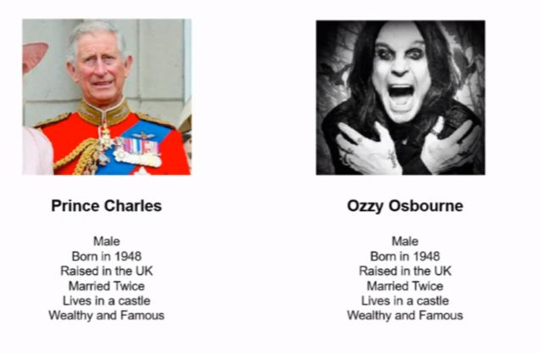
Assumptions & problems with PSM
Assumption: Eliminating selection based on observables will reduce bias
  Possible in theory, but not likely in practice
Problem: the variables you choose to match on can be incomplete & if your data isn’t rich, it won’t do a good job of accounting for bias
We may also kick out folks who don’t match which limits external validity

Slide 36
What you need to include in your paper for PSM
1) What characteristics are you going to match on? Justify based on prior literature.
2) Explain how matching on these characteristics makes for a better control group & why you’re choosing matching over another method.

Slide 37
Bonus Slides

Slide 38
Testing sensitivity/robustness
1) Test the extent to which observable characteristics are balanced in the matched sample. Do this by presenting the means of the matched treatment and control groups.
2) Test whether the results change when you use multiple different sets of matching characteristics.
3) Test to make sure you have sufficient sample size. Common support must produce an adequately large sample size or else you won’t have power

Slide 39
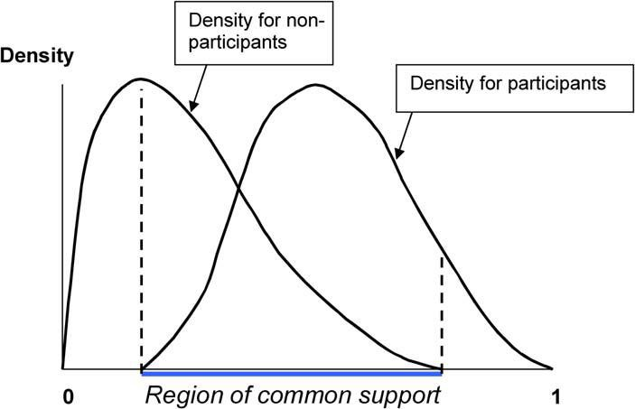
Region of Common Support
Region of common support for propensity score between participants and non- participants must be large enough to find an adequate comparison group

Slide 40
Standard Errors
Because propensity scores are predicted, analytical standard errors obtained from a t-test of the outcome for matched treatment and comparison observations are not correct
We typically use bootstrapping to estimate the correct standard errors.

Slide 41
Sensitivity Analysis
There are many modeling decisions that can affect the results, including
  Specification of propensity score equation
    What variables to include
    How many interactions to include and at what level
  Matching method and caliper or bandwidth to use
Must test sensitivity of results to these decisions.
  If results are not robust to these changes, this should raise a question mark about their reliability

Slide 42
Matching Methods
There are many ways to undertake the matching
  Simplest method:
    One-to-one matching
      Match each treatment observation with “nearest” comparison observation
      Can impose a maximum distance, through a “caliper”
      Subject to potential outliers
      Addressing ties in propensity scores
    Nearest n-neighbors
      Uses the average of the nearest n-neighbors among comparison observations
      Can also impose a caliper

Slide 43
Matching Method
More complicated but probably sounder methods
  Kernel matching
    Kernel functions are symmetric functions around a particular point that can be used to provide a weight that is inversely proportional to the horizontal distance from that point
    The weight is the vertical height at each distance from the central point
    The weight typically goes to zero after a certain distance has been reached (usually referred to as bandwidth)

