Slide 1
Resources for Data Analysis

Slide 2
"Quantitative Research Methods for Political Science, Public Policy and" by Wesley Wehde, Tracey Bark et al. (etsu.edu)

Slide 3
General Principles

Slide 4
Spurious Correlations (tylervigen.com)

Slide 5
Examples of Good and Bad Graphics

Slide 6
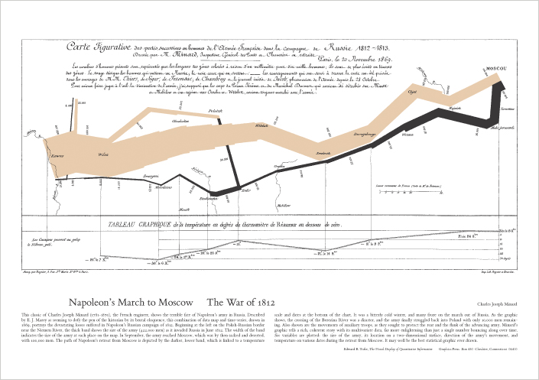
Edward Tufte: Posters and Graph Paper

Slide 7
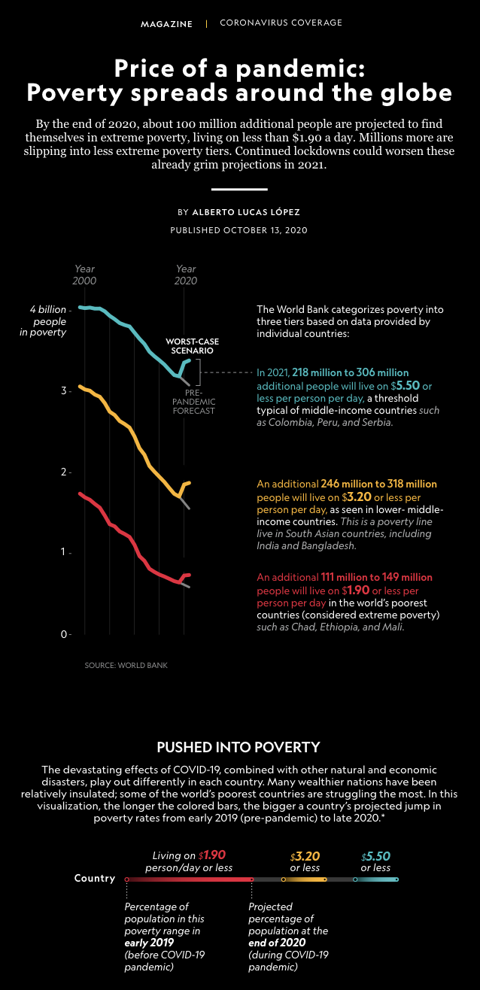
COVID-19 could push 100 million more people into poverty (nationalgeographic.com)

Slide 8
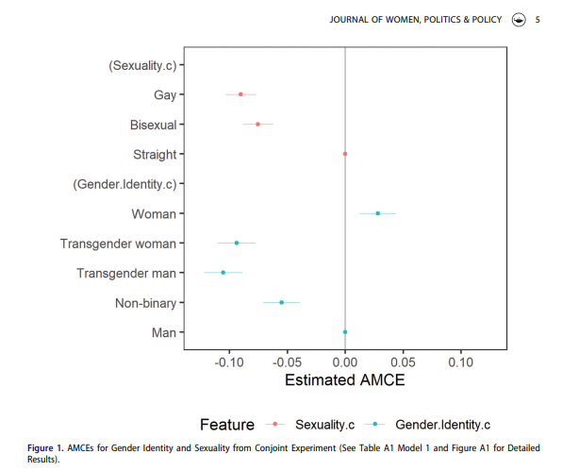
Bringing the Ts and (N)Bs to the Table: Estimating Intersectional Candidate Gender Identity and Sexu (tandfonline.com)

Slide 9
https://youtu.be/jbkSRLYSojo?si=rO43ldq7BEusAd-B

Slide 10
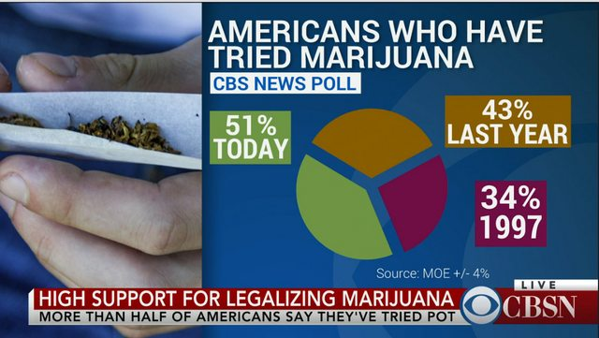
12 Bad Data Visualization Examples Explained - Code Conquest

Slide 12
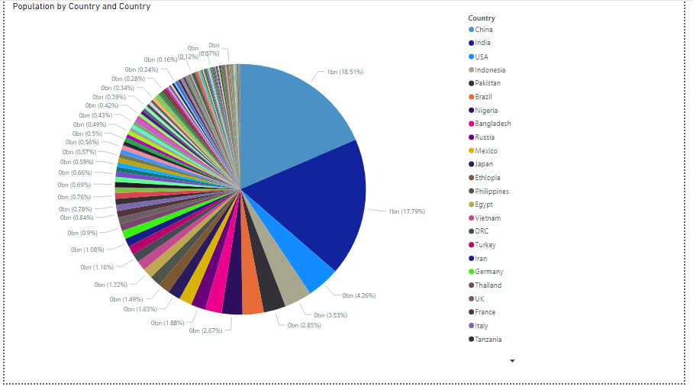
Bad Data Visualization Examples - Avoid these 5 mistakes! (sranalytics.io)

Slide 13
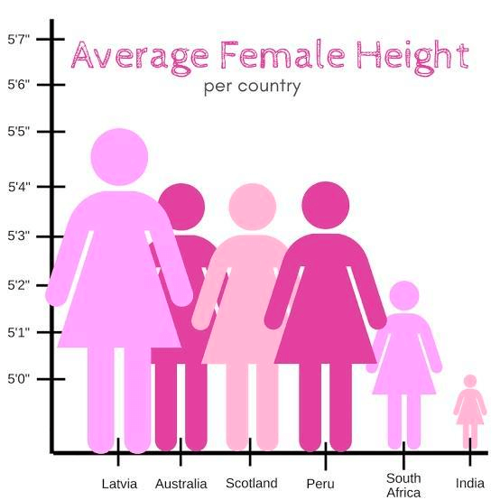
Top 8 Data Visualization Examples: Good, Bad, and Prohibited (ninjatables.com)

Slide 14
How to Make a Good Table

Slide 15
Principles of Tables
Rows are variables
Columns are models or statistics
Such as means, minimums, etc.
Digits? How many?

Slide 16
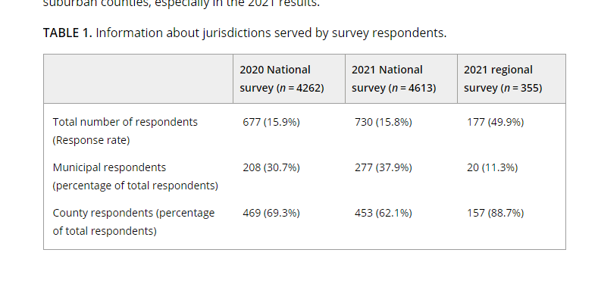
Examining factors associated with emergency managers' collaborative planning with health departments prior to and during the COVID‐19 pandemic - Hildebrand - 2023 - Public Administration Review - Wiley Online Library

Slide 17
Now Let’s Try It

