Slide 1
Event-Studies & Difference-in-Differences

Slide 2
Learning Objectives
Logic of Event-Studies (AKA interrupted time series)
Assumptions & Best practices for event-studies
Logic of Difference-in-differences
Assumptions & Best practices for difference-in-differences

Slide 3
Design | When to use | Advantages | Disadvantages
Randomization | Whenever feasible When there are no ethical issues | Gold standard—high internal validity Can block randomize to observe for whom the program works | Not always feasible Not always ethical Low external validity
Matching | When other methods are not possible (weakest design) | Overcomes observed differences between treatment and comparison (increasing internal validity over regression) | Limited internal validity due to unobservable differences
Difference-in- Differences/Event-Study | You have panel data! If two groups are growing at similar rates Baseline and follow-up data are available | Eliminates fixed differences not related to treatment Good external validity | Can be biased if trends change Ideally have 2 pre-intervention periods of data
Regression Discontinuity | If an intervention has a clear, sharp assignment rule | Project beneficiaries often must qualify through established criteria | Only look at sub-group of sample Assignment rule in practice often not implemented strictly

Slide 4
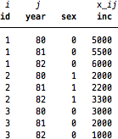
Data required for event study/DiD
Panel data, meaning you have units over time
You have to have data before and after the treatment
An observation is a person (id=i) in a year(=j)
Characteristics can be time varying & not
  inc (income) is time varying (x_ij)
  Sex is time invariant

Slide 5
Event-Study AKA: Interrupted Time Series

Slide 6
Logic for Event Study
Leverage change over time to estimate effects of a policy/program
In order to do this well, we have to think about how time could be confounded by other things happening in the world.

Slide 7
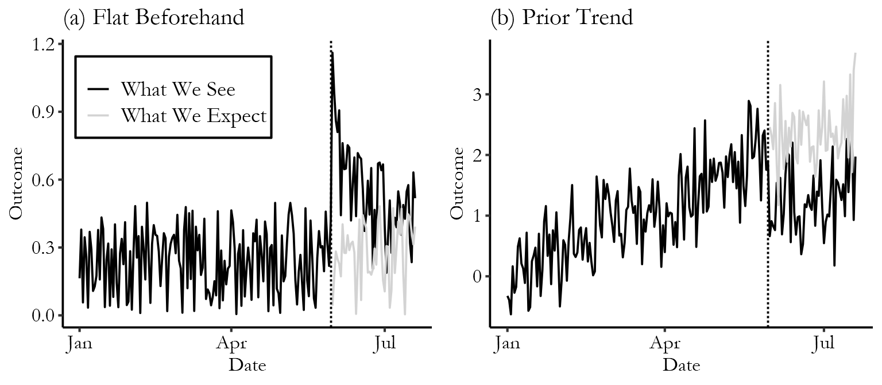
Logic for Event Study
Leverage change over time to estimate effects of a policy/program
Trends prior to policy change can help us determine what the counterfactual would have been
Post=Treatment
Pre-period=Control

Slide 8
Example Event Study/ITS
Dulat’s example: Establishment of military base in Jacksonville. Dulat could do an event-study to examine the changes in economic indicators after the military base was established, compared to prior years.
Discuss: What issues may he run into?
He could also do difference-in-differences if he gets the economic data for another city that doesn’t have a military base (control group)

Slide 9
Assumptions for Event-Studies
No other simultaneous reform/phenomena that could be influencing the outcome
The pre-period data is a good approximation for what would have happened in absence of the treatment. In other words, there are little to no observable differences in the pre- and post-period sample characteristics
  If there are, your results may be driven by differences in the type of people included in the pre- and post-period

Slide 10
Best practices for Event-studies
Research whether there were other policies at the same time & report on the results of your searches
Compare the characteristics of the sample in the pre- and post-period to determine if there are substantial differences
Control for time varying factors that may confound your design—COVID-19 is a great example.

Slide 11
Difference-in-Differences

Slide 12
Intro with Causal Graphs
https://nickchk.com/causalgraphs.html
Resource for students doing event-study/DiD: https://www.youtube.com/playlist?list=PLg-LvQ_7SfMD9d8kbSd_Ig_HB-5h6HCTx

Slide 13
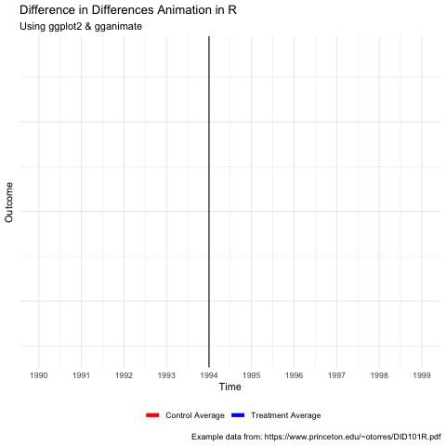
Logic of DiD design
When we have a control group, we run a difference-in-differences
  Why is difference in differences preferable to an event-study?
We account for the fixed differences across the treatment and control, which helps isolate the change from the policy
Estimates show how much more the treated group changed than the untreated group when going from before to after.
Y= (treated group after - treated group before) - (untreated group after - untreated group before)

Slide 14
Best Practices
Compare the characteristics of units in pre- and post-period
  For treatment & control groups
  If there are large differences, consider propensity score matching to get a more similar sample and then conduct DiD design
Include other important control variables
Make sure there is no other simultaneous policy/event to validate the assumption that the policy change of interest is the most important thing happening at that point in time
Test parallel trends assumption

Slide 15
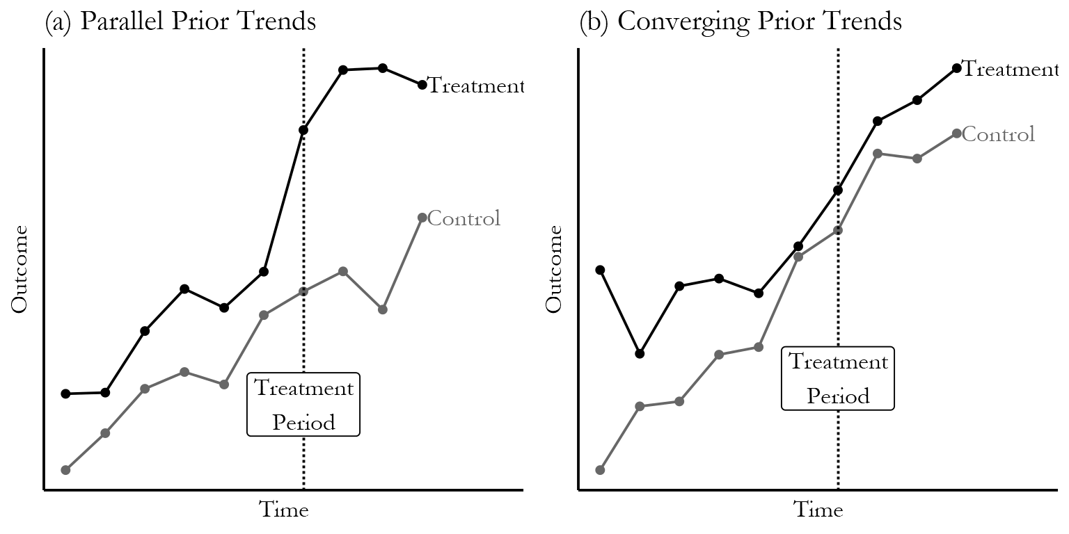
Assumption: Parallel Trends

Slide 16
Methods Workshop
Discuss the method you’re planning to use and the design issues you’re facing currently.
Each person talk about their design & get feedback for 15 minutes.

